Slide 1
Peripheral Artery Disease
N202 – Patho/Pharm I
Paige Harris, Stacey Johansen, Andrea Provost, Kaley Smith, and Whitney Stiegman

Slide 2
Definition
What is peripheral artery disease (PAD)? (CardioInstitute, 2011)
  PAD – Atherosclerotic disease of arteries (McCance & Huether, 2010)
    Usually affects lower limbs, especially lower extremities
More than 10 million people in the US have PAD (Barnes Jewish Hospital, 2011)
More likely in older people with diabetes, high blood pressure, high cholesterol, or who smoke

Slide 3
Signs & Symptoms
Intermittent Claudication (WebMD, 2009)
  Muscle pain or cramping in legs that is triggered by walking
  Disappears quickly after a few minutes of rest
Leg numbness or weakness
Coldness in lower leg or foot
Sores on toes, feet, or legs that won’t heal
Change in the color of legs
Hair loss or slower hair growth on feet or legs
Slower growth of toenails
Shiny skin on legs
No pulse or weak pulse at the dorsalis pedis and/or posterior tibial
Erectile dysfunction in men

Slide 4
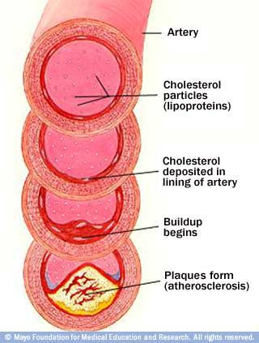
Causes
Atherosclerosis (main cause): Fatty deposits (plaque )builds up in artery walls and reduces blood flow (Bhimji, 2011; Stoppler, 2011)
Less common causes include:
  Blood Clot
  Inflammation of the arteries
  Infection
  Injury
(Mayo Clinic, 2011)

Slide 5
Risk Factors
Major risk factors (American Heart Association, 2011; Mayo Clinic, 2011):
  Smoking*
  Diabetes*
  Obesity – BMI >30
  Physical inactivity
  High blood pressure – >140/90
  High cholesterol
  Increasing age – >50 years old
  A family history of PAD, heart disease, or stroke
*Highest risk due to reduced blood flow

Slide 6
Diagnosis & Treatment
Diagnostic testing (Mayo Clinic, 2011)
  Physical exam (peripheral pulses, blood flow, sores)
  Ankle brachial index (ABI)
  Doppler, angiography, CT using contract dye
Treatment (Mayo Clinic, 2011)
  Lifestyle changes (diet, exercise, stop smoking)
  Balloon angioplasty, stenting, bypass
  Medications (lower cholesterol, manage high blood pressure, control glucose, relieve symptoms)

Slide 7
Prevention
Maintain a healthy lifestyle (American Heart Association, 2011; Mayo Clinic, 2011)
  Regular physical activity
    30 minutes, 3 times a week
  Lower cholesterol levels
    Diet low in saturated fat, trans fat, and cholesterol
  Quit smoking
    Smokers have 4 times the risk

Slide 8
References
American Heart Association. (2011). Prevention and treatment of PAD. Retrieved from http://www.heart.org/HEARTORG/Conditions/More/PeripheralArteryDisease/Prevention- and-Treatment-of-PAD_UCM_301308_Article.jsp
Barnes Jewish Hospital. (2011). Peripheral artery disease. Retrieved October 21, 2011, from http://www.barnesjewish.org/heart-vascular/peripheral-artery-disease
Bhimji, S. (2011). Peripheral artery disease. Retrieved from http://www.emedicinehealth.com/peripheral_vascular_disease/article_em.htm
CardioInstitute (Creators). (2011, September 20). Cardio corner: What is peripheral artery disease? [Video] Retrieved from http://www.youtube.com/watch?v=2S5Hmhpv_9w
Mayo Clinic. (2011). Peripheral artery disease (PAD). Retrieved from http://www.mayoclinic.com/health/peripheral-arterial-disease/DS00537
McCance, K. L., & Huether, S. E. (2010). Pathophysiology: the biologic basis for disease in adults and children (6th ed.). St. Louis: Mosby Elsevier.
Stoppler, M. (2011). Peripheral artery disease. Retrieved from http://www.medicinenet.com/peripheral_vascular_disease/article.htm
WebMD. (2009). Peripheral arterial disease symptoms. Retrieved October 23, 2011, from http://www.webmd.com/heart-disease/tc/peripheral-arterial-disease-of-the-legs-symptoms

