Slide 1
Post Myocardial Infarctions Discharge and Home Care Shelby Cottrell, Abby Palmer, Tori Knierim, Megan Buzzard, Hannah Wilkins Patho-Pharm 11 October 2011

Slide 2
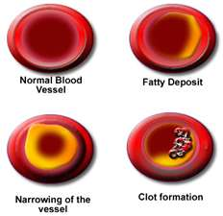
Self-care Concerns
What do we as nurses tell our patient to prevent reoccurrence of MI?
Reduction of risk factors for MI can increase the long-term chance of survival
Patients who smoke and consume excess alcohol are encouraged to stop
Patients with high serum cholesterol should be given appropriate diet tools and guidelines for nutrition.
Patients with high triglycerides should be given niacin.
Overweight patients should try to achieve a body mass index of 18.5-29.4kg/m2.
Diabetes and Hypertension should be controlled.
Blood pressure should be reduced to under 140/90 mm Hg

Slide 3
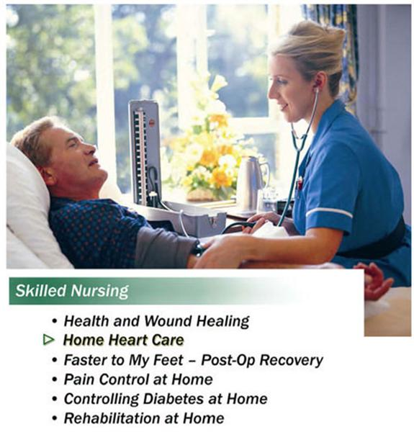
Additional Safety Concerns
Exercise
Reduces complications from prolonged bed rest
Accelerated return to optimal level of functioning
If the patient feels faint have them discontinue what they are doing and relax.
Make sure that the patient knows the signs and symptoms of MI and knows when to call 911.

Slide 4
Safety Tips
Cardiac Rehabilitation
May be advised to attend a cardiac rehab program
Immunization
Influenza immunization
Work issues
Usually can go back to work in 2-3 months
Driving and flying
No driving for at least 4 weeks; no flying for 2-3 weeks
Sex Issues
Best avoided for a few weeks
Stress, anxiety, and relaxation
Relaxation exercises and stress management

Slide 5
Additional Safety Tips
Tell your doctor if you…
have chest pain when exercising or walking briskly
become more tired than usual
get breathless
feel you are depressed
notice swelling in your feet

Slide 6
3 Main Post MI Drugs
1. Aspirin (Antiplatelet Drug)
- Helps to reduce clots
- Reduces “stickiness” of platelets
2. Beta Blocker
- Ease workload of heart
- Block Beta Receptors
-Reduces HR & BP
3. ACE Inhibitor (MEGAN JUST ADD YOUR INFO TO THIS SLIDE SO WE DON’T GO OVER THE 8 MAXIMUM)

Slide 7
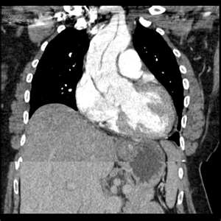
References
Bax, J., Betriu, A., Crea, F., Falk, V., Filippatos, G., Fox, K., Huber, K., Kastrati, A., Rosengren, A., Steg, P., Tubaro, M., Verheugt, F., Weidinger, F., & Weis, M. (2008). Management of acute Myocardial Infarction in patients presenting with persistent ST-segment elevation. European Heart Journal, 29, 2909-2945.
Lehne, R.A. (2010). Pharmacology for nursing care. St. Louis, MO: Saunders Elsevier.
Medication after a myocardial infarction. (2010, May). EMIS Inc. Retrieved from http://www.patient.co.uk/health/Myocardial-Infarction-Medication.html

