Slide 1
Myocardial Infarctions Discharge and Home Care Shelby Cottrell, Abby Palmer, Tori Knierim, Megan Buzzard, Hannah Wilkins Patho-Pharm 11 October 2011

Slide 2
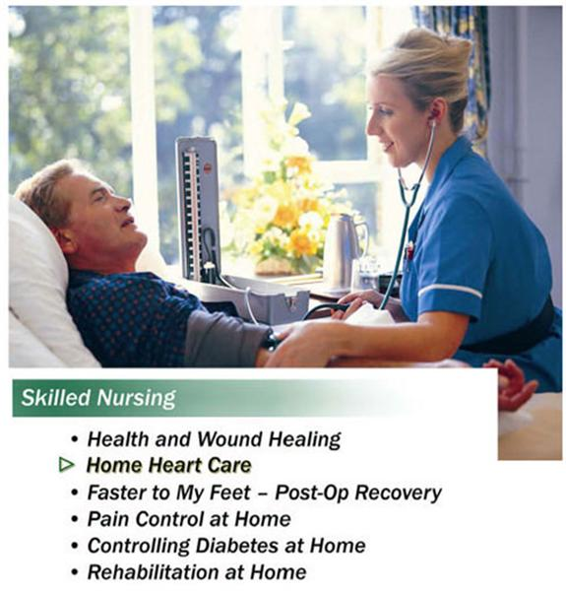
Patient Safety Instructions
What do we as nurses tell our patient to prevent reoccurrence of MI?
Exercise
Reduces complications from prolonged bed rest
Accelerated return to optimal level of functioning
Reduction of risk factors for MI can increase the long-term chance of survival
Patients who smoke and consume excess alcohol are encouraged to stop
Patients with high serum cholesterol should be given appropriate diet tools and guidelines for nutrition.
Patients with high triglycerides should be given niacin.
Overweight patients should try to achieve a body mass index of 18.5-29.4kg/m2.
Diabetes and Hypertension should be controlled.
Blood pressure should be reduced to under 140/90 mm Hg
If the patient feels faint have them discontinue what they are doing and relax.
Make sure that the patient knows the signs and symptoms of MI and knows when to call 911.

Slide 3

Self-Care Concerns
Smoking termination
Diet and weight control
Maintain serum cholesterol level
Dietary plan
Cholesterol-lowering drug if necessary
Below 100 mg/dL
Physical Activity
Diabetic Maintenance
Blood Pressure Control
Achieve a blood pressure of <130/80

Slide 4
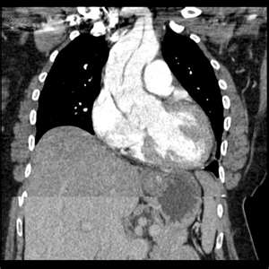
References
Lehne, R.A. (2010). Pharmacology for nursing care. St. Louis, MO: Saunders Elsevier.

