Slide 1
Impact of Hispanics on providing nursing care
By the year 2000, Hispanics will outnumber African Americans and become the majority minority. Statistics reveal that health problems of Hispanics in the United States (Caudle ,1993)
.
Diabetes,
Injuries and violence
Substance abuse
HIV/AIDS
Limited access to health care, and many other problems shared by the poor and disenfranchised.
Notes:
Interventions with Hispanic population require nurses to be knowledgeable about customs, beliefs, and language of the Hispanics. The journal article Providing culturally sensitive health care to Hispanic clients talked about how nurses also need to be alert to and active in health care policy making that will improve access to health care for the growing Hispanic population (Purath ,1994)

Slide 2
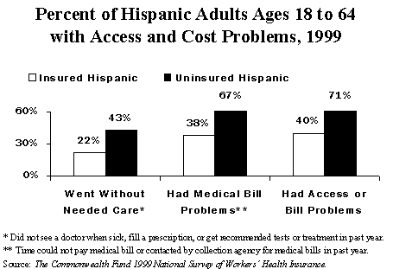
Impact of Hispanics on providing nursing care
The report, “Health Care Disconnect: Gaps in Coverage and Care for Minority Adults,” by Commonwealth Fund(2006) researchers Michelle M. Doty and Alyssa Holmgren, analyzes data from the Commonwealth Fund 2005 Biennial Health Insurance Survey.
Results reveal that a high proportion of Hispanics are disconnected from the health
Uninsured Hispanic adults are at high risk for not getting needed care
More than one-fourth (27 percent) of uninsured Hispanic adults with health problems had no doctor's visit in the past year
Notes:
The Common Wealth Fund Study shows that Hispanics are confident about being able to self-manage chronic diseases or health problems. Americans and Hispanics, alone, will not ensure equal access and equal care. We as nurses need to seek to improve the availability of on-going care relationships with health care providers and promote continuity in Hispanic culture.

Slide 3
Impact of Hispanics on providing nursing care
Mexican women promote healthy behaviors by diagnosing sick family members, and prescribe home remedies(Waldstein ,2010)
Familism is a strong sense of family care and obligation, it is considered an important Mexican American cultural value.
Research shows that older Latina women view health not as the absence of illness; rather, they see the decline of health as natural and anticipated. Hispanic elderly expect care from family as they become more frail (Padilla&Villalobos ,2007)
Notes:
Interventions for a Hispanic patient require a more complex understanding of Mexican American culture. For nurse to treat Hispanic clients they need integrate cultural factors into health promotion activities. According to Padilla&Villalobos, 2007 journal article Cultural Responses to Health Among Mexican American Women and Their Families family support for the elderly is important and family is often turn to for every day health needs .

Slide 4
References
Waldstein, A (2010) Popular medicine and self-care in a Mexican migrant community: toward an explanation of an epidemiological paradox. Medical Anthropology 2010 Jan; Vol. 29 (1), pp. 71-107. Retrieved from http://web.ebscohost.com.ezproxy.lakeviewcol.edu:2048
Yolanda C. Padilla, Griselda Villalobos (2007). Cultural Responses to Health among Mexican American Women and Their Families. Family & Community Health January/March 2007 Volume 30 Number 1 - Supplement: January/March 2007 Pages S24 - S33. Retrieved from http://www.nursingcenter.com/library/JournalArticle.asp?Article_ID=691987
Caudle P.(1993). Providing culturally sensitive health care to Hispanic clients. Nurse Pract. 1993 Dec;18(12):40, 43-6, 50-1. Retrieved from http://www.ncbi.nlm.nih.gov/pubmed
Commonwealth Fund (2006). Hispanic and black adult’s uninsured at much higher rates than white adults. The Nation's Health the Official Newspaper of the American Public Health Association October 2006. Retrieved from http://www.nhchc.org/Hispanic_black_uninsured.pdf

