Slide 1
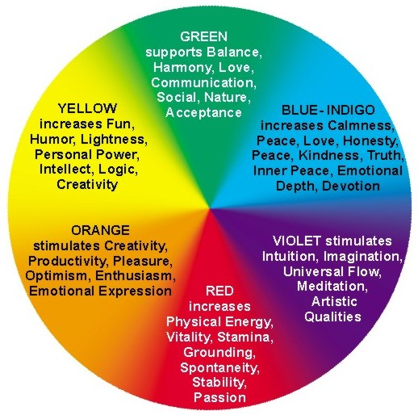
COLOR THERAPY
By: Kirsten W., Ashlee M., and AJ I.

Slide 2

What can Color Therapy do for you?
Can enlighten and bring happiness to your life
Creates a balance and health in our lives
Holistic medicine because it works on all aspects of life:
Physical
Emotional
mental,
spiritual

Slide 3

RED
Increases physical energy, vitality, stamina, grounding, spontaneity, stability & passion
Helps get rid of negative
thoughts (stimulated
by adrenal glands)
Has potential to make a
person feel irritable

Slide 4
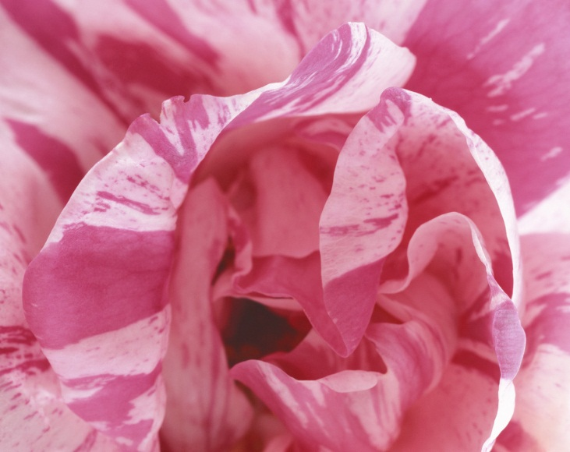

pink
Brings a calming feeling
Represents sensitivity
Can make people feel safe

Slide 5

yellow
Increases fun, humor, lightness, personal power, intellect, logic & creativity
Should be used in
small doses because it
represents energy
Large doses make people feel tired because all of the energy make your eyes feel tired.

Slide 6
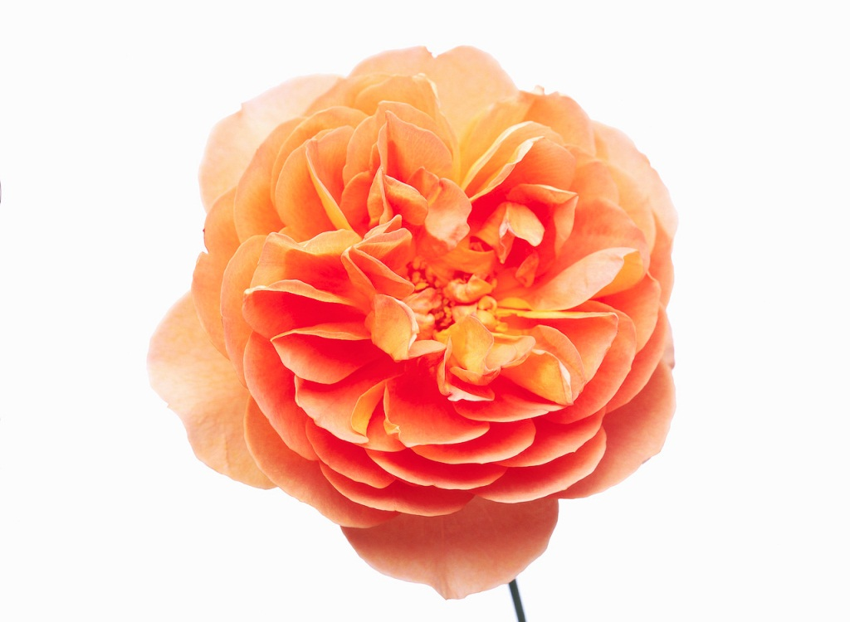
orange
Stimulates creativity, productivity, pleasure, optimism, enthusiasm, & emotional expression
Also stimulates hunger
& digestion.
Can give off feelings of
youth & help boost
self-esteem

Slide 7
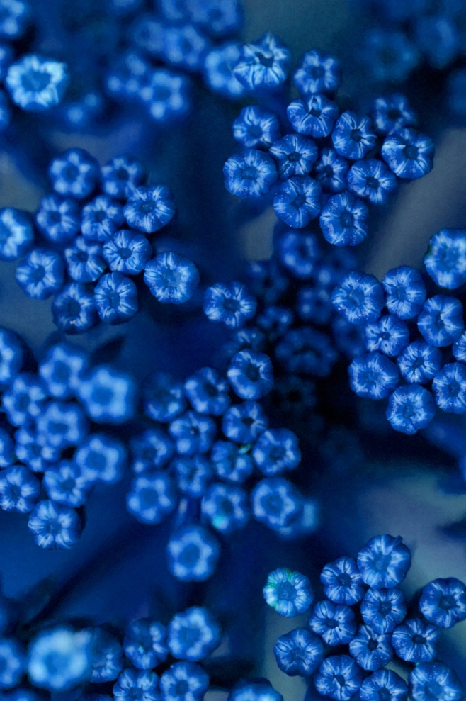
blue
Increases peace, love, honesty, kindness, truth & devotion
Causes body to produce
chemicals that calm the
body
Decreases hunger/appetite

Slide 8

purple
Stimulates intuition, imagination, meditation, & artistic qualities
Reduces fear and nervousness
Associated with spirituality

Slide 9

green
Supports balance, love, communication, socialization, and acceptance
Causes relaxation because it is the
easiest color on the eyes
Common in nature and gives the feeling of harmony

Slide 10

Brown
Promotes comfort and gives a “homey” feeling
Evokes a sense of strength and reliability
Can promote conversation

Slide 11
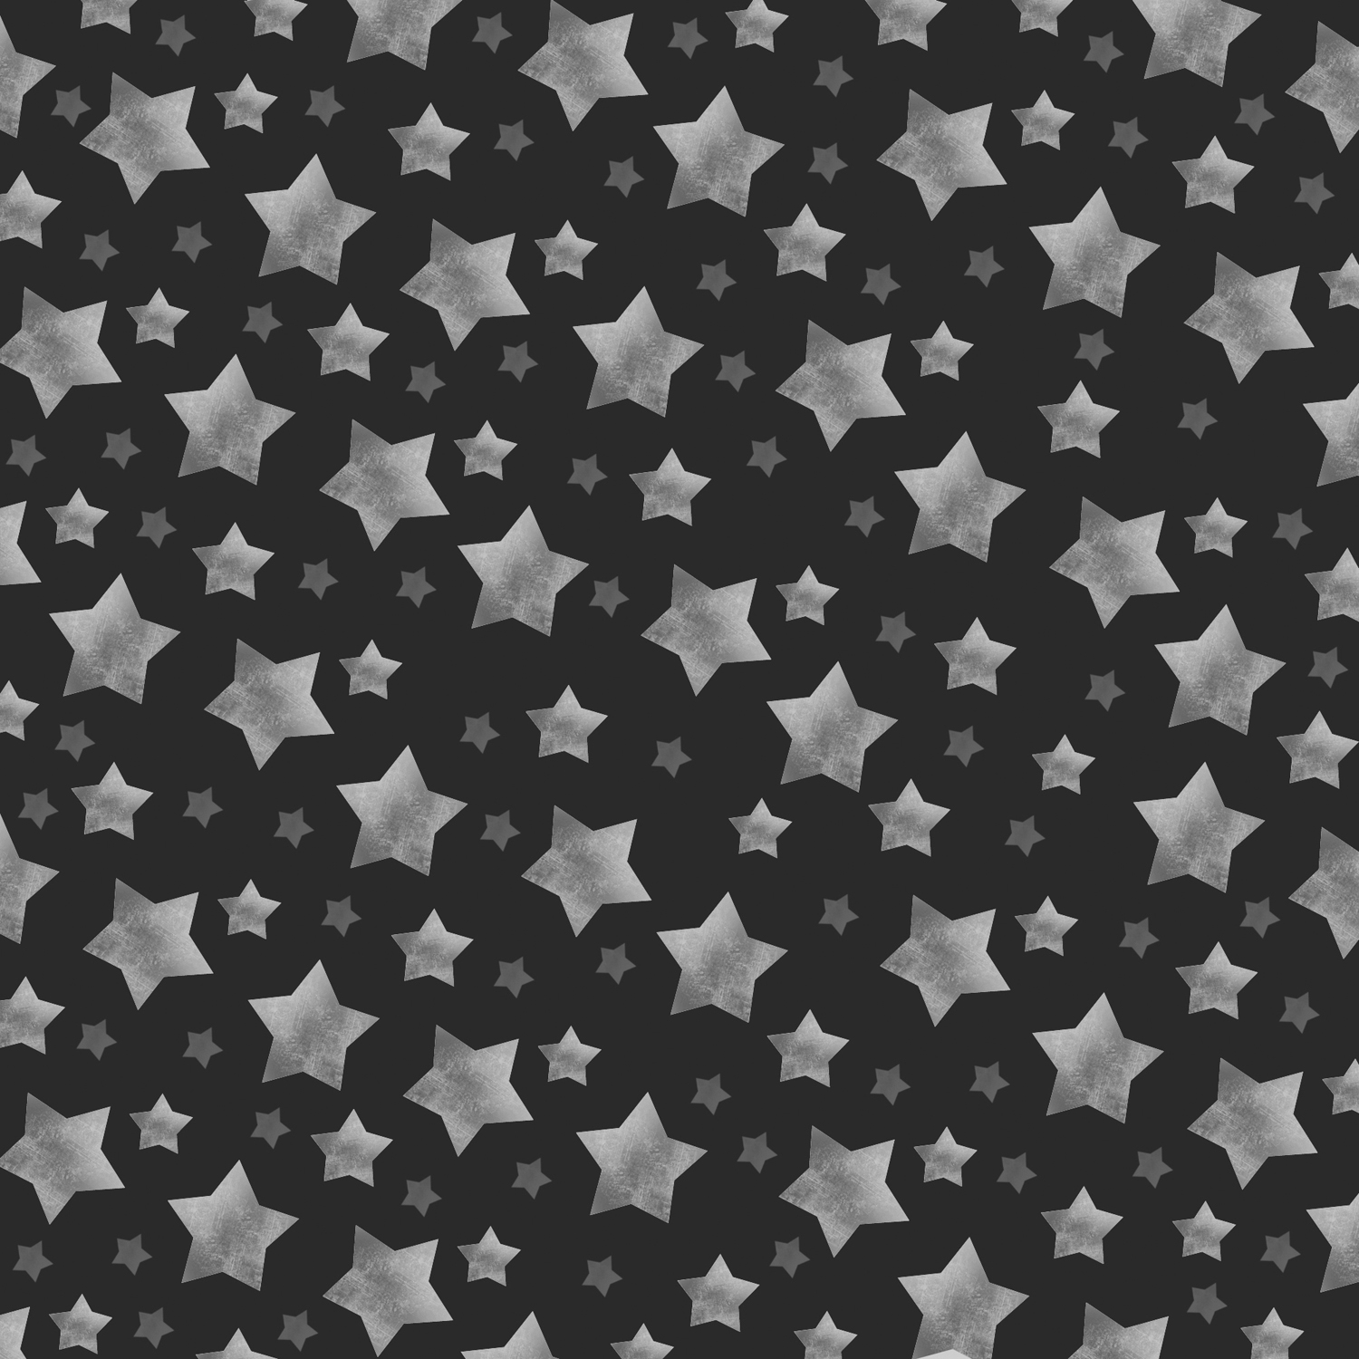
Black
Has no color so it does not stimulate or have calming features
Too much black can prevent growth change
Can cause feeling of
depression

Slide 12

white
White is universal because it contains all of the colors
Seen as pure & clean.
Some cultures associate
this with death and mourning so be careful
using too much white

Slide 13

CONCLUSION
Every color has a different meaning and emotion it can bring
Not enough or too much
color can cause many
different effects
Highly encouraged that all
homes/facilities use color therapy

Slide 14
REFERENCES
(2005). Color Therapy. Retrieved from http://www.therapycolor.com/

