Slide 1
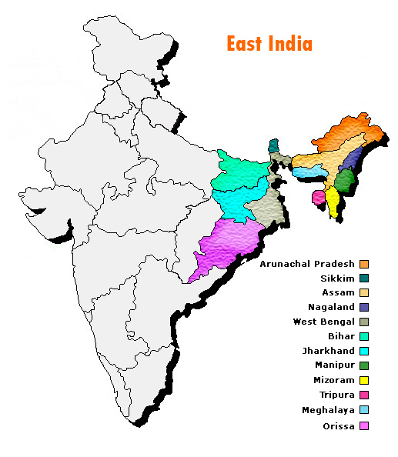
EAST
INDIA
Ihechi Alilionwu
Megan Buzzard
Tearra McDade
Dominique Davis

Slide 2
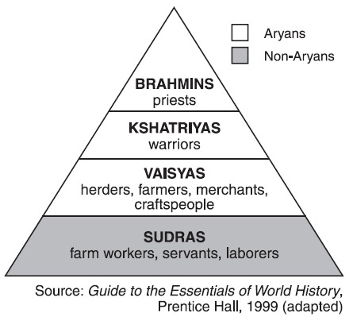
Who we are (Culture)
Hierarchy
Caste system created a culture that emphasize established hierarchical relationship
Conscious of social order and their status relative to others
All relationships involve hierarchy
Meeting Etiquette
Religion, education and social class influence greeting
Greet elders first
When leaving a group each person must be bid farewell individually
Men shake hands with other men, women shake hands with other women

Slide 3
WhO WE ARE (Culture)
Gift Giving Etiquette
Business Etiquette
Reduced time value and deadline
Work overload
Do business with familiar people
Long standing relationship prior to business
Third party introduction equals credibility
Gifts eases the transition into next life
Gifts of cash exchanged between family during ceremonies
Do not give frangipani or white flowers
Yellow, green and red are lucky colors
Hindus don't receive gifts made of leather, No pigskin or ETOH products for Muslims

Slide 4
Culture Continued
Dinning Etiquette
Dinning Etiquette
Take off your shoes before entering the house
Dress modestly and conservatively
Politely turn down the first offer of tea, coffee or snacks
Indian food eaten with fingers
Wait to be sat
Guest of honor served first followed by men
Wash hand before and after meal
Always use your right hand
Leave a small amount of food on plate if full if not finish

Slide 5
THIS IS US (CULTURE)
Communication
Communication
Do not use “no” verbally or non-verbally
Respect elders
Right hand Vs. Left hand
Ones sided communication between parents and children
Relationships built on mutual trust an d respect
Non-confrontational
Authority makes decision
Slow decision process
Successful negotiations celebrated with a meal.

Slide 6
THIS IS US (CULTURE)
Spirituality
Death and Dying
Cremation
Mourning rituals (Men wear white and boys may shave heads)
Abstinence from celebrations and festive after death
Multiple gods and superstitions
Marriage varies by religion
Karma

Slide 7
THIS IS US (CULTURE)
Role of the Family
Pregnancy and child rearing Practices
People categorize themselves into a group
Close ties to family members
Mutual obligations
Deep Rooted trust among relatives
Papaya not eaten during pregnancy due to abortion suspicions
Bangle ceremony in 7th month to honor mother and child for healthy delivery
Community child rearing mindset
Children responsible for chores
High value for respect
High value for education and excellence

Slide 8
Culture continued
Naming Convention
Titles
Name based on religion, social class and region
Ex: Hindus have a given name and a surname
Muslims do not have surnames. Instead men add the father’s name to their own name ex Abdullah bin Ahmed is Abdullah the son of Ahmad
Women use the connector Binti
Revered titles professor, doctor, engineer
Status based on age, degree, caste, profession
Sir and Madam if not title
First name usage with permission

Slide 9
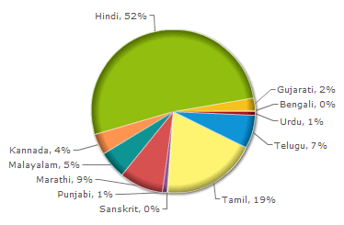
Languages of East India
The different states of India have different official languages.
For example; Bihar in east India has three official languages – Hindi, Urdu and Bengali.
Sikkim, also in east India, has four official languages of which only Nepali is recognized by the central government.
Central government decided that Hindi was to be the official language of India and therefore it also has the status of official language in the states.

Slide 10
Languages of East India Continued
East Indian languages comprise the likes of Bihari languages.
Bengali is the most overriding language of this part of the Indo-Gangetic Plain.
Hindi occupies the largest number of speakers at over 90 million, but owns trivial ethnic influence beyond Bihar.
East Indian languages owe their lineage to the Indo-Aryan language family.

Slide 11
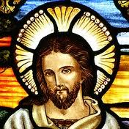
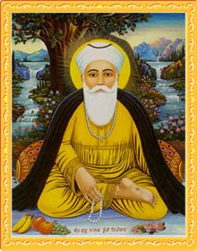
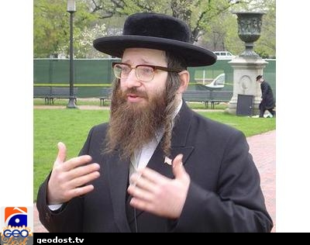
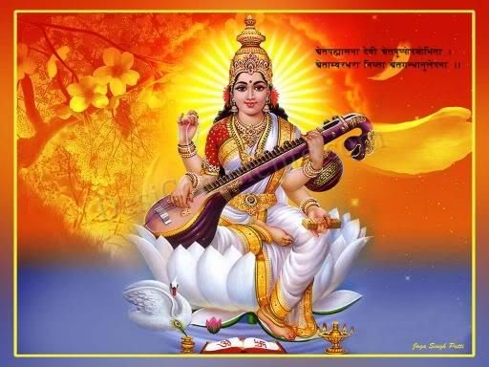
Religion
Hinduism
-About 80% of the population of India practices Hinduism
- Hinduism, Buddhism, and Jainism are seen as the molders of the India philosophy
Sikhism
-2% of the population
Largest non-Indian religion is Islam
Other religion include Christianity, the Jewish religion, and Bahaism

Slide 12
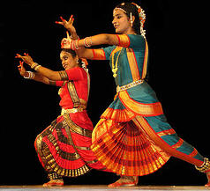
Health Practices
Yoga
Ayurvedic principles
‘Ayus’=long life ‘veda’=knowledge
In Ayurvedic theory it is believed that good health requires that there is a balance of three humors
-bile (fire)
-phlegm (water)
-wind
Some of the medications that are used are by syrups or oils made from the herbs, shrubs and roots of plants or by using different minerals available naturally.
involves deep breathing exercises and postured exercises, which focus on meditation and concentration.
helps practice with health and wellness, which include:
mental and physical cleansing
soul enlightenment
curing diseases
allergies and respiratory problems
depression

Slide 13
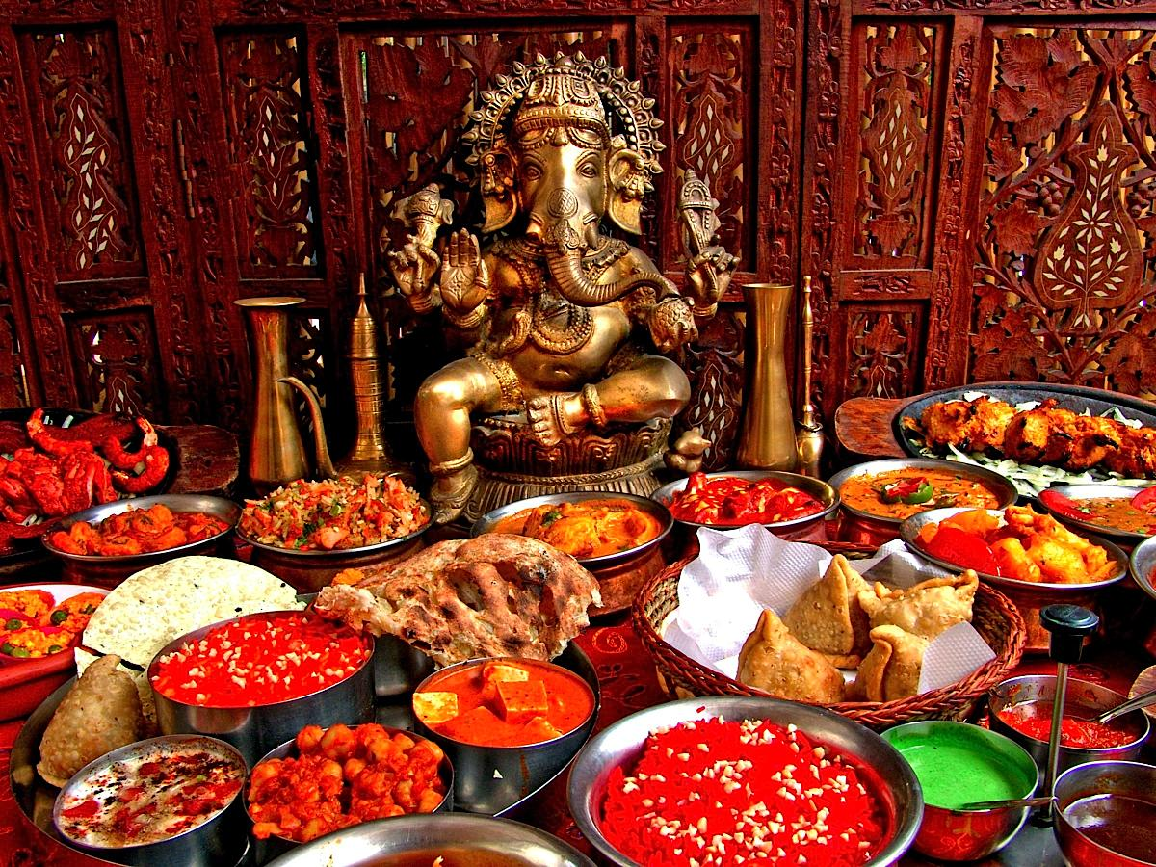
FOOD RITUALS
According to Hinduism , food is an aspect of “Brahman”
meaning a gift from God that should be treated with great respect
Purpose of food offerings
Fasting Rituals
Charity Rituals

Slide 14
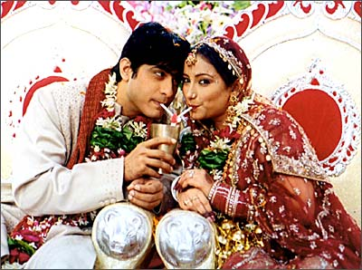
MARRIAGE
pROCESS
Borjatri “ Grooms Procession”
Shubho Dristi “ Marriage Ritual”
Sampradan “ Transfer of Responsibilty”
Basar Ghar “ Brides family welcome”
Bou Baran “ Grooms family welcome”

Slide 15
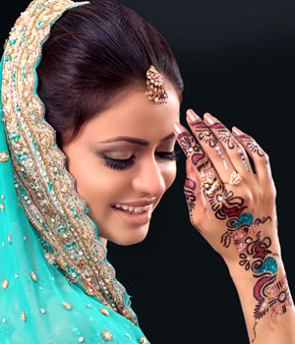
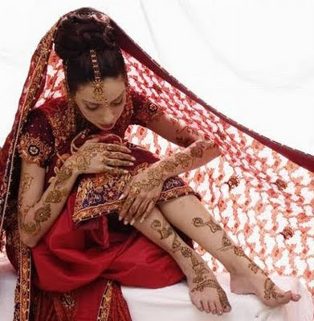
Mehndi design

Slide 16
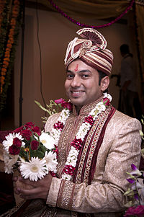
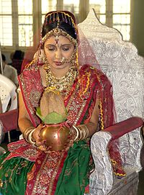
HINDU MARRIAGE
http://www.youtube.com/watch?v=j42prjIQCdQ

Slide 17
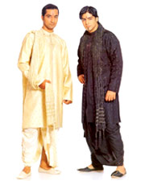
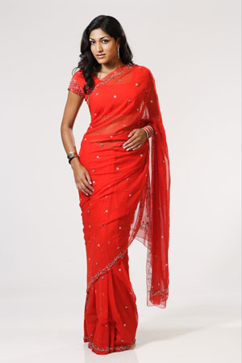
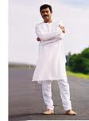
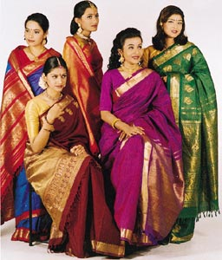
Dressing

Slide 18
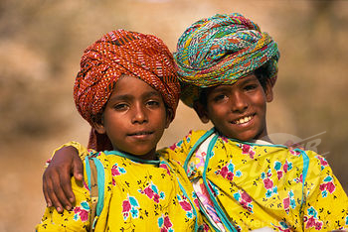
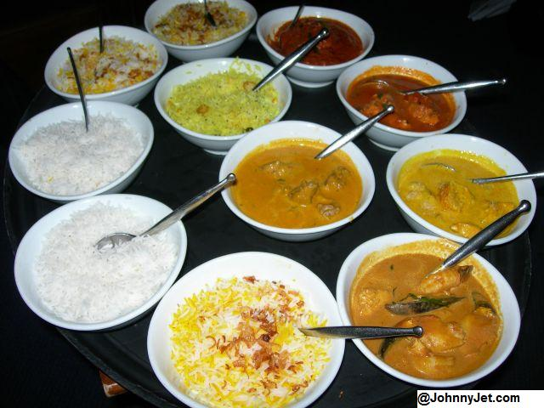
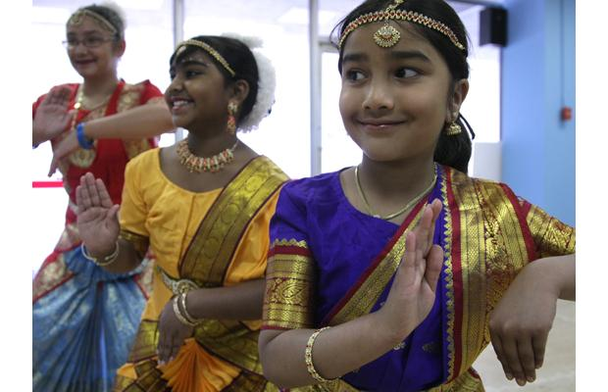
East Indian Lifestyle
Music & Dance
Diet & Nutrition
Clothing
Social Structure
Family Structure
Women’s Health
Culture & Tradition’s

Slide 19

Summary
Things to consider as a healthcare provider
Patients are more comfortable with Same sex-heath providers
Be sensitive to situations that may cause embarrassment
Mental illness is a stigma, concealed and somatic expression such as headaches, stomach pain instead of anxiety and depression
Women more passive
Many do not believe in modern medication

Slide 20
References
http://www.californiacollegeofpharmacy.org/home/shareddocs/eMuseum/StudentCultural/EastIndianHandoutTeam4.pdf
http://www.kwintessential.co.uk/resources/global-etiquette/india-country-profile.html
http://www.indianetzone.com/39/east_indian_languages.htm

