Slide 1
Madeleine Leininger
By: Chelsea Infante
Danielle Dill
Jerome Jimenez
Jessica Key
Lacey Halley

Slide 2
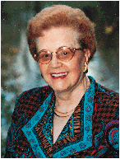
Madeleine Leininger
Bone: July 13, 1925
Died: August 10, 2012
Education: University of Washington

Slide 3
Transcultural Nursing
She developed the concept of Transcultural Nursing.
In 1850 Madeleine Leininger experienced what she describes as culture shock
This experience led her to become the first professional nurse in the world to earn a doctorate in anthropology and led to the development of Transcultural Nursing as a subfield of nursing.

Slide 4
My Websites
http://www.contemporarynurse.com/archives/vol/15/issue/3/article/631/madeleine-leininger
http://www.reflectionsonnursingleadership.org/Pages/Vol38_3_Note_Leininger_obit.aspx

