Slide 1
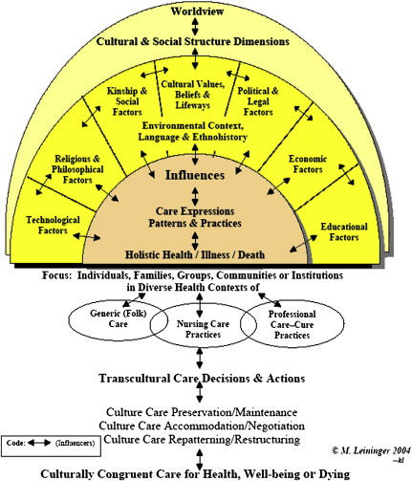
Sunrise Enabler to Discover
Cultural Care

Slide 2
Assumptions
Care is the essence . . . and unifying focus of nursing;
Culture care expressions, meanings, patterns . . . are diverse but some commonalities (universalities) exist among and between cultures;
Every culture has generic (emic) and usually some professional (etic) care to be discovered and used for culturally congruent care practices (pp. 18–19).

Slide 3
Modes of Action
Preservation and/or maintenance
  Decisions which maintain or preserve values and beliefs
Accommodation and/or negotiation
  Care adapted to fit the patient’s culture/beliefs
Repatterning and/or restructuring
  Decisions made mutually during modification of practice

Slide 4
References
Leininger, M. M. (2006). Culture Care Diversity and Universality and evolution of the ethnonursing method. In M. Leininger & M. McFarland (Eds.), Culture care diversity and universality: A worldwide nursing theory (pp. 1–41). Sudbury, MA: Jones & Bartlett.
Sagar, P. S. (2011). Transcultural nursing theory and models, application in nursing education, practice, and administration. Springer Pub Co. Retrieved from http://www.springerpub.com/samples/9780826107480_chapter.pdf

