Slide 1
Biography of Madeleine Leininger
Is the founder and leader of the academic field of transcultural nursing with focus on comparative human care, theory, and research.
Professor at Emeritus, College of Nursing, Wayne State University, Detroit, Michigan, and Adjunct professor, College of Nursing, University of Nebraska Medical Center, Omaha Nebraska.
Internationally known transcultural nursing lecturer, educator, author, theorist, administrator, researcher, and consultant in nursing and anthropology.
Living Legend of the American Academy of Nursing and an Emeritus Member of the American association of Colleges of Nursing.
She was one of the first to graduate professional nurses prepared with a PhD in cultural anthropology.

Slide 2
Biography Continued
She initiated the Nurse Scientist and several transcultural nursing programs in the 1970s and 1980s.
Editor of the Journal of Transcultural Nursing and started the Transcultural Nursing Society.
She is a distinguished Professor and Lecturer in over 90 universities and has given over 1200 public addresses in the USA and overseas.
Author and editor of 28 books and has published over 220 articles
She published the first qualitative nursing research book (1985), an early psychiatric nursing book (1960) and the first Culture Care Diversity and Universality Theory book.
Leininger resides in Omaha, Nebraska and is active as a worldwide transcultural nursing consultant, educator, lecturer, and writer.

Slide 3
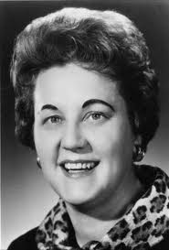

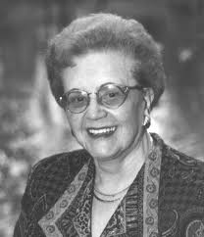
Madeleine Leininger
Rides in Omaha, Nebraska and is 86 years old

Slide 4
Development Of Theory
Developed -from clinical experience
Evolved- over 3 decades
Recognized- Culture was missing a link in nursing knowledge and practice
Concept f of culture>>> anthropology (enthonursing)
Concept of care>>>nursing practice

Slide 5
Culture and Caring
Theory developed through 2 concepts:
1. Caring
2. Culture
1. 40s-Worked as a student nurse & a hospital staff nurse and gained a lot of experience here.
50s-Was a psychiatric nurse for children of different backgrounds. Realized there was missing link and experienced culture shock.
2. Caring in some form was universally present in all cultures but some practices of care were different. Ethnonursing was a tool used to explore the transcultural concept (understands the diversity and universality of care). As a result, her theory came to be called The Culture Care Theory.

Slide 6
Transcultural Nursing
Many nurses have limited knowledge about culture
Demand for transcultural nursing knowledge will continue to increase, Leininger wants nurses to have a willingness to learn about cultural differences

Slide 7
Cultural Beliefs
When handing Saudi Arabian patients medications, do not use left hand as it is seen as unclean
Using high-tech equipment may be seen as a cultural taboo to the Amish
Patient may refuse help if we do not respect their beliefs

Slide 8
Cultural Practices
The use of folk healers is now widely accepted in the hospital setting, as long as it does not harm or interfere
Herble medicines and teas are now used in conjuction with western medicine as long as it does not interact
Nurses who are aware of Madeleines teachings about cultural practices are looked highly upon as hospitals are looking for those who are culturally aware

Slide 9
How It Helps
Makes nursing easier and more acceptable
Makes it more rewarding to patient
  Builds trust faster if nurse is aware of their belifes
Makes it easier for nurse
  Knowledge base for different cultural belifs towards pain and death
  Easier to make nursing diagnoses towards pain and healing

Slide 10
Implementations
Nurses strive to discover insights about our own cultural background
Nurses discover the clients cultural beliefs
Nurses will gain an appreciation for cultural commonalties and differences

Slide 11
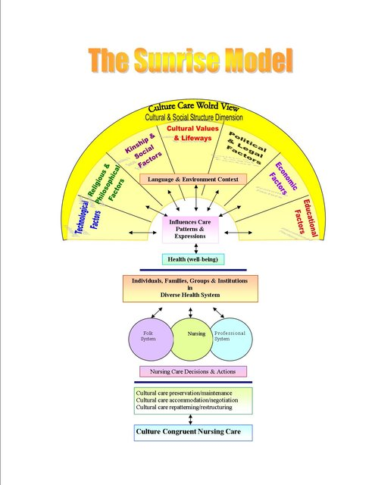

Slide 12
Main Concepts
“Care is (or should be) the essence and central domain of nursing.”
Madeleine Leininger also stated that caring is the moral of nursing.
She wanted to develop a plan care that was universal and fit for all cultures around the world.
Care is a basic essential for human needs, growth, development, and survival.

Slide 13
Predictive Tents Essentials
Commonalities
Worldview and Social Structure
Professional and Generic Care
Modalities

Slide 14
Assumptions
Care is essential for growth, development, and survival
Care is essential in curing and healing
Forms, expressions, and patterns will vary
Every culture has both types of care
Culture care, values, and beliefs are embedded with in the culture

Slide 15
Assumptions cont.
Therapeutic nursing can only occur under certain circumstances
Differences within must be understood
Culturally congruency, specific, or universal care are essential
Nursing is an essential

Slide 16
References
Leininger, M., & McFarland, M. R. (2002). Transcultural nursing: Concepts, theories, research, & practice. New York, NY: McGraw-Hill.

