Slide 1
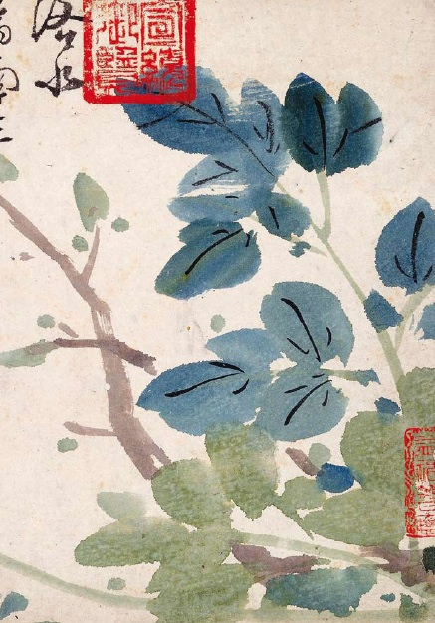
Korean American Culture
Ashley Black
Sandra Guiterrez
Andrea Fabiano
Katie Kropschot
Janet Perez
v

Slide 2
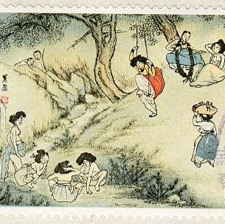
Korean Culture
Since today's society is very diverse, it is important for nurses to be culturally competent in order to provide the best quality of care
The purpose of this presentation is to demonstrate an understanding of Korean Americans in order to practice as a culturally competent nurse.

Slide 3
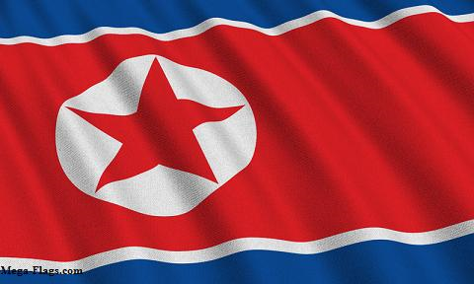
Demographics
Korean-Americans are the fastest growing subgroup of Asian-Americans
In the 2000 census, over one million U.S. residents (1,076,872) identified their “race” as Korean.
Population growth rates of 35.1% from 1990 to 2000 and 134.8% from 1980 to 1990.
44% live in the West, 23% in the Northeast, 19% in the South, and 14% in the Midwest

Slide 4
Demographics cont
Population – Leading States
California - 345,882
New York - 119,846
New Jersey - 65,349
Illinois - 51,453
Washington - 46,880
Texas - 45,571
Virginia - 45,279
Maryland - 39,155
Pennsylvania - 31,612
Georgia - 28,745
78% speak Korean as their main language
35% have bachelors degree or higher.
48.9% of foreign-born and 61.8% of native-born Korean-Americans have a bachelors degree.
32% are white-collar professionals.

Slide 5
Cultural preferences
Tend not to have health-care insurance and frequently cannot afford medical visits.
Women are unlikely to openly volunteer significant medical history, current symptoms, and home remedies.
In traditional Korean medicine, diagnoses are made based on making visual observations, obtaining a history, listening to the patient’s voice, and taking the patient’s pulse.
Traditional herbal medicine may have harmful effects.
Usually use both traditional medicine and Western medicine simultaneously for acute illness.

Slide 6
Cultural Preferences cont’
Traditional medicine (hanbang) is thought to be especially effective for certain incurable or chronic diseases that other treatments have not helped.
Hanbang includes four common treatment methods: chi’m (acupuncture), hanyak (traditional herbal medication), d’um (moxabustion), and buhwang (cupping).
Lack of health insurance is associated with lack of preventive screening tests.
Immigrant women rarely participate in Papanicolaou’s test (Pap test) or breast screening tests because of cultural emphasis on women’s modesty and their busy schedules.

Slide 7
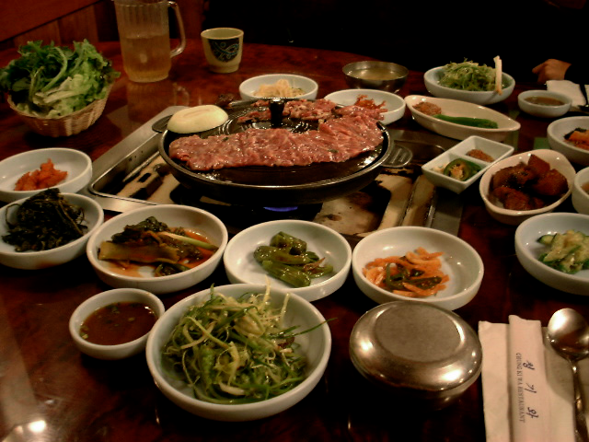
Korean Diet
Chinese and Japanese
Vegetables
Meats
Nuts
Spices
Noodles
Drinks

Slide 8
Common Health Problems
Vitamin A
Iodine Deficiency
Iron Deficiency and Anemia
Lactose Intolerance
Emerging conditions
Notes:
Dairy products are not normally used in Asia contributing to the prevalence of lactose intolerance. Increased exposure of the western society has lead to increased tobacco use and a decreased sedentary lifestyle. There is an increase in diabetes, cardiovascular disease, obesity, and high blood pressure.

Slide 9
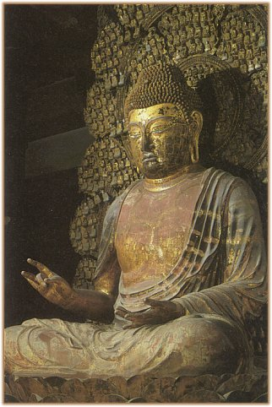
Religion
Korea is a society with many religions. Buddhists, Confucianists, Catholics, Moslems, and Protestants dominate the many religions.
Thus, many different holidays are celebrated.
A blend of the Eastern and Western culture comes together in Korea.
Religions do not represent Korean culture.
Notes:
Although Korea is the most actively Christian society in East Asia, it predominantly consists on Buddhists. They celebrate many holidays including, New Years, Christmas, Foundation Day, Buddha’s Birthday, and The Harvest Festival. Western culture has been assimilated into Korean culture. Korea’s multiple religions coexists without major problems. Citizens can converge and maintain harmony, despite religious differences.

Slide 10
How cultures preferences impact nursing care
Nurse must not use first name because it leads to ill fortune.
If patient doesn’t know English a child can’t be used as a translator.
Cannot perform certain care because of physical contact.
Difficult for nurse to engage in a conversation and gain trust because of no eye contact.
Women have to be put in rooms away from sunlight

Slide 11
Cultures impaction on care
Nurse can’t have a one-to-one relationship with patient because family is always involved in the plan of care.
Difficult to care for a sick patient because they believe in using time wisely.
Refuse to have additional care or tests if they feel they have finished their task in life.
May refuse some surgeries or transplants because their bodies must be kept intact.
Nurses expect cooperation in matters involving time, but they need a schedule.

Slide 12
Cultures impaction on care cont’
Hard to test because many refuse to have blood drawn.
There aren’t many Oriental medical doctors in hospitals, so they might refuse any treatment.
The herbs contain toxin’s that can cause anemia and intestinal hemorrhage.
A nurse can’t bring any negative energy into the room if a woman is pregnant.
Pregnant women are instructed to have 21 days of bed rest with mainly seaweed soup.

Slide 13
Cultures impaction on Care cont’
Many refuse any therapy or exercise because sweating is considered loss of energy.
Their diet can be different because 90% of Asians are lactose intolerant.
Aren’t treated for mental illnesses because it’s a family shame.
It’s hard to treat them when they delay treatment until it is too late.
Medical staff can’t help prolong patient’s life because they want to die at home.

Slide 14

Summary
Korean Americans are becoming more prevalent the U.S.
As health care providers we need to be aware of Korean traditional practices
Woman are more guarded
Korean medicine is less objective
In treatment traditional & Western medicine is used
Koreans tend to use more complementary alternative therapies

Slide 15
Summary
Diets & food preferences are different from traditional American foods & many are lactose intolerant
Koreans are predominantly Buddhists but many are also Christians
Can be difficult to treat for many refuse treatments & drawing blood
Important to incorporate family in care
Remember to be respectful of cultural differences

Slide 16
References
Ameredia. Korean american demographics. (2008). Retrieved November 28, 2010, from http://www.ameredia.com/resources/demographics/korean.html
Hill, P., Lipson, J., & Meleis, A. (2003). Caring for women cross-culturally. Philadelphia, PA: F.A. Davis Co.
Giger, J. N., & Davidhizar, R. E. (2008). Transcultural Nursing: Assesment and Intervention (5th ed.). St. Louis, MO: MOSBY ELSEVIER.
http://www.asianinfo.org/asianinfo/korea.rel/overview1.htm
http://www.faqs.org/nutrition/Ar-Bu/Asians-Diet-of.html

