Slide 1
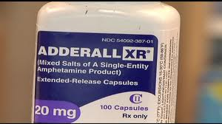
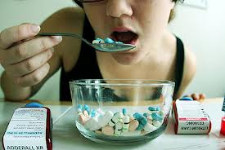
ADDERALL
Adderall contains a combination of amphetamine and dextroamphetamine.
Both these medicines are central nervous system stimulants that affect chemicals in the brain and nerves that contribute to hyperactivity and impulse control.
Adderall is used to treat narcolepsy and attention deficit hyperactivity disorder (ADHD).

Slide 2
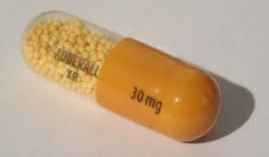
ADDERALL
It is a dopamine releasing agent, a norepinephrine releasing agent, and can be mildly serotonergic
It is available in two formulations: IR (Instant Release) and XR (Extended Release)
The immediate release formulation is indicated for use in attention deficit hyperactivity disorder (ADHD) and narcolepsy, while the XR formulation is approved for use only with attention deficit hyperactivity disorder (ADHD)

Slide 3
ADDERALL (SIDE EFFECTS)
Important side effects of therapeutic dextroamphetamine includes:
stunted growth in young people
occasionally a psychosis can occur at therapeutic doses during chronic therapy as a treatment emergent side effect.
When abused at high doses, the risk of experiencing side effects and the severity of side effects increases.
Sweating or shaking.
headache, weakness, dizziness, blurred vision;
feeling restless, irritable, or agitated,
sleep problems (insomnia);
dry mouth or an unpleasant taste in your mouth;
diarrhea, constipation, stomach pain, nausea, vomiting;
fever;
hair loss, loss of appetite, weight loss; or
loss of interest in sex, impotence, or difficulty having an orgasm.

Slide 4
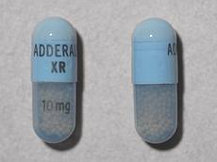
ADDERALL ADVERSE EFFECTS
fast, pounding, or uneven heartbeats;
pain or burning when you urinate;
talking more than usual, feelings of extreme happiness or sadness;
tremors, hallucinations, unusual behavior, or motor tics (muscle twitches); or dangerously high blood pressure
chest pain, shortness of breath, uneven heartbeats, seizure.

Slide 5
CONTRAINDICATIONS, PRECAUTIONS, AND INTERACTIONS
Taking a CYP2D6-inhibiting drug along with amphetamine will lead to an elevated level of amphetamine in the system, resulting in the drug's remaining in the body for a longer period, which can lead to undesirable and possibly serious side effects
MAOIs (monoamine oxidase inhibitors, e.g., phenelzine, selegiline, iproniazid, etc.) —There is a high risk of a hypertensive crisis if amphetamine is administered within two weeks after last use of an MAOI type drug.
NRIs (norepinephrine reuptake inhibitors, e.g., atomoxetine, etc.) — NRI medications and amphetamine both enhance noradrenergic activity. Possible augmentation/potentiation of effects.
The combination of tricyclic and amphetamine compounds/other direct-acting sympathomimetics has been associated with increased sympathetic action
Antihypertensives
Diuretics
Lithium
Phenytoin
Ascorbic Acid (Vit-C)

Slide 6

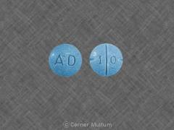
Heart disease or moderate to severe high blood pressure (hypertension)
Arteriosclerosis
Overactive thyroid
Glaucoma;
Severe anxiety, tension, or agitation; or
Hx of drug or alcohol addiction
Congenital heart defect;
Heart failure, heart rhythm disorder, or recent heart attack;
A personal or family history of mental illness, psychotic disorder, bipolar illness, depression, or suicide attempt;
Epilepsy or other seizure disorder; or
Tics (muscle twitches) or Tourette's syndrome

Slide 7
SAFETY INFORMATION
Take the missed dose as soon as you remember.
Skip the missed dose if it is almost time for your next scheduled dose, or if it is already evening.
Taking this medicine late in the day can cause sleep problems.
Do not take extra medicine to make up the missed dose.
Seek emergency medical attention or call the Poison Help line at 1-800-222-1222.
An overdose of Adderall can be FATAL.
Overdose symptoms may include severe forms of some of the side effects listed in the previous Slide
Avoid drinking fruit juices or taking vitamin C at the same time you take Adderall. These can make your body absorb less of the medicine.

