Slide 1
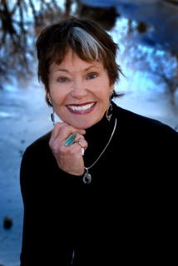
Dr. Jean Watson
NURSING THEORIST
(Oakland University, 2011)
N200: Theories and Issues in Nursing
Kristina Bailey, Hope Dunn, Stacey Johansen
Madeline Petcoff, Krystal Rose, and Kara Thomas

Slide 2
Dr. Jean Watson – Background
Born and Raised in Southern West Virginia
BSN degree from University of Colorado- 1964
MS degree from University of Colorado- 1966
PhD from University of Colorado- 1973
Black, B.P., & Chitty, K. K. (2011). Professional Nursing: Concepts and Challenges. Maryland Heights, MO: Saunders
.

Slide 3

Dr. Jean Watson – Accomplishments
Published her first book, The Philosophy and Science of Caring, in 1974
Founder of the Center for Human Caring at the University of Colorado
Currently a Professor in Nursing and a Chair in Caring Science at the University of Colorado Denver
Founder and Director of a new non-profit foundation: Watson Caring Science Institute
University of Colorado Denver. (2008). Caring: About Dr. Jean Watson. Retrieved from http://www.ucdenver.edu/academics/colleges/nursing/caring/Pages/DrJeanWatson.aspx

Slide 4
References
Black, B.P., & Chitty, K. K. (2011). Professional Nursing: Concepts and Challenges. Maryland Heights, MO: Saunders
University of Colorado Denver. (2008). Caring: About Dr. Jean Watson. Retrieved from http://www.ucdenver.edu/academics/colleges/nursing/caring/Pages/DrJeanWatson.aspx
.

