Slide 1
Physiology
Inhaling smoke is fast and effective
Nicotine is a stimulant that is abosorbed into the blood stream via alveoli
It travels to the heart & brain, which effects the CNS
The effects of smoking can be felt seconds after inhaling

Slide 2
Physiological effects
Nicotine targets neurons in the brain
Causes the release of adrenaline in the brain which constricts blood vessels, and increases BP, heart rate, and metabolism
The body creates more nicotine receptors in the brain
Feelings of irritability, anxiety, depression and craving for nicotine are present when these receptors are not activated

Slide 3
What’s in a cigarette?
Cigarettes contain harmful chemicals such as tar, carbon monoxide, ammonia, arsenic (rat poison), and many more
Contain nicotine, which is the addictive substance in tobacco
Contain carcinogens that cause damage to our DNA, or cause cells to divide faster than their normal rate, thus causing cancer

Slide 4
Facts according to the CDC
20.6% of all adults in the United States smoke cigarettes
Smoking causes cancer, heart disease, stroke, and many lung diseases
There are 443,000 deaths related to smoking every year in the United States, and over 5 million world-wide
Smokers typically die 13-14 years earlier than non-smokers

Slide 5
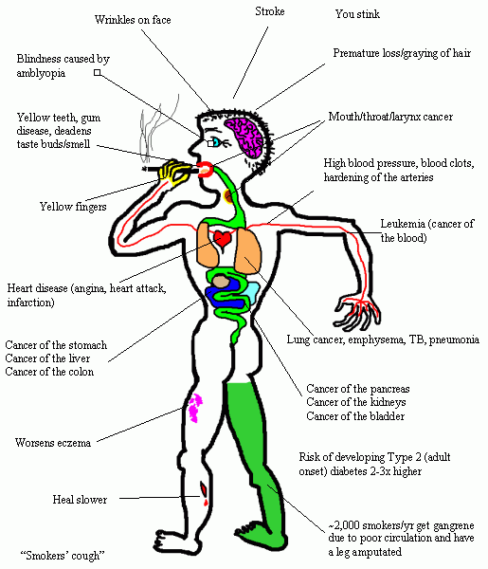
Risk Factors
Smoking harms nearly every organ of the body
It can lead to:
  Heart disease
  Stroke
  Acute myeloid leukemia
  Bladder cancer
  Cancer of the cervix
  Cancer of the esophagus
  Kidney cancer
  Cancer of the larynx (voice box)
  Lung cancer
  Cancer of the oral cavity (mouth)
  Cancer of the pharynx (throat)
  Stomach cancer
  Cancer of the uterus
Smoking is also associated with
  Miscarriages
  Premature births
  Low birth weight
  Sudden infant death syndrome

Slide 6
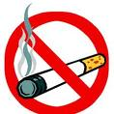
Risk Factors
In the United States, about 90% of lung cancer deaths in men and almost 80% of lung cancer deaths in women are due to smoking
The heart attack rate for smokers is 70% higher than for non-smokers. But, believe it or not, just one full day after quitting smoking, your risk for heart attack will already have begun to drop.
On average, smokers die 13 to 14 years earlier than nonsmokers
More deaths are caused each year by tobacco use than by all deaths from HIV, illegal drug use, alcohol use, motor vehicle injuries, suicides, and murders combined.
On average, it causes one in every five deaths in the United States each year

Slide 7
Social Stigmas
American Sociologist Erving Goffman defined Social stigma as a severe social disapproval of personal characteristics or beliefs that are perceived to be against cultural norms.

Slide 8
Cigarette smoking was once seen in American society as a classy, even healthy pastime. Smoking was hobby that could be enjoyed by everyone. It was a celebrity pleasure that even the workingman could afford.

Slide 9
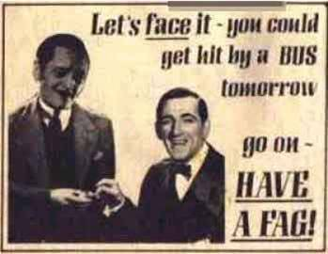

Slide 10
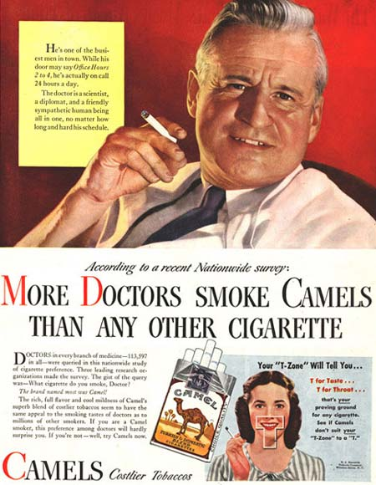

Slide 11
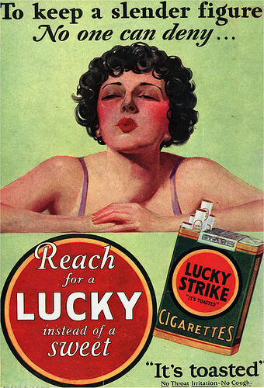

Slide 12


Slide 13


Slide 14
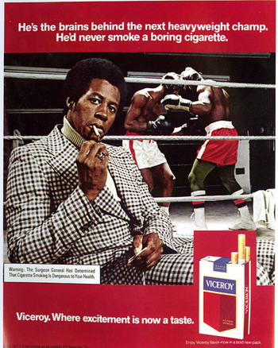

Slide 15
Times have since changed and now that research has proven that smoking leads to many health related illnesses, smoking is no longer looked at as such a glamorous luxury.

Slide 16
Modern anti-smoking campaigns are working just as hard as cigarette companies once did to promote their agenda: Tobacco companies not only lied to their consumers but that they also contributed to the deaths of millions of Americans.

Slide 17


Slide 18


Slide 19
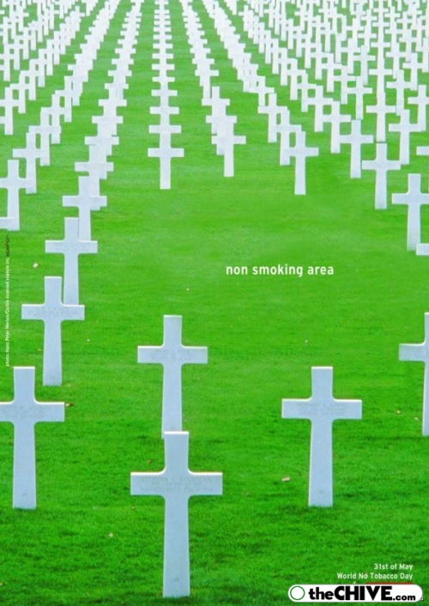

Slide 20
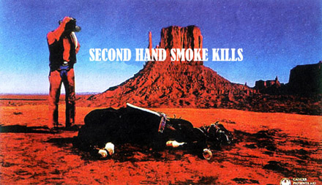

Slide 21
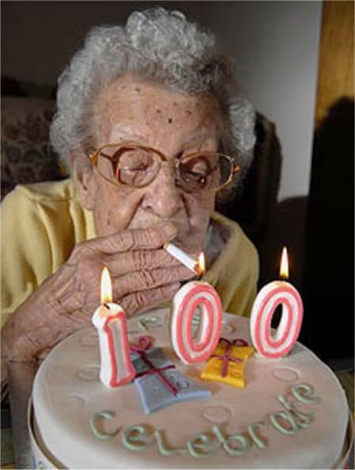

Slide 22
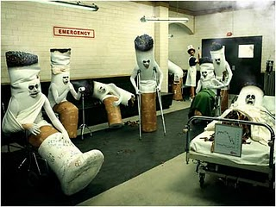

Slide 23


Slide 24
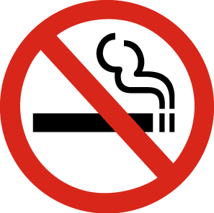

Interventions to reduce smoking
Group Therapy
The functions of group therapy consist of analyzing motives for group members behaviors, provide an opportunity for social learning, and generate emotional experiences.
Provide Pharmacotherapy
NRT Gum dosages can be tailored to the individual’s level of nicotine dependency.
NRT Patch come in a range of strengths and are worn for various hours of therapy per day for the duration of a smoking cessation. Wearing a patch for 16 hours during waking hours is as effective as a 2 4 hour patch.

Slide 25


INTERVENTION OF ANTI-SMOKING
The purpose of an anti smoking intervention is to improve, reverse or correct the condition because of its impairment of life and threatening factor’s associated with a person’s health or lifestyle.
With smoking causing permanent destruction of the tiny sacs and narrowing of the small blood vessels in lungs, its quite imperative to reduce the amount of cigarette usage. Nicotine affects the nerve-muscle junctions causing tremors and shaking. These severe consequences of smoking should causes one to rethink of whether this harmful product was worth it in the ending result.

Slide 26

Smoking Support Groups
Key ingredient to successful,
long-term quitting
Online and in-person options
Stay positive, quitting does not happen over night. Take care of body’s needs; exercise daily, drink plenty of fluids, add daily vitamins, avoid stress, and avoid alcohol.
Most memberships are free!

Slide 27

Smoking Support Groups
Quitsmoking.about.com
(smoking cessation, health risks, quitting options, after quitting, browse topics, must reads, quick facts)
Makesmokinghistory.org
(find in-person support in your area, quitting, youth, second-hand smoke, cost of smoking)
Lung.ca/home-accueil_e.php
(excellent source on HOW TO quit, lung facts, lung diseases, how to get involved)

Slide 28
Reason for Presentation
Power Points are clear, easy
Familiar to adolescents
Smoking is something nurses can impact
Some non-smokers, smokers, ex-smokers

Slide 29
Group Process
The identifiable structural development of the group that is needed for a group to mature

Slide 30
Group Process
Forming
  Done mainly in class
  Started as strangers
  Leadership roles explored
Storming
  Very little in our group
  All of us had different schedules, made it incredibly difficult to meet

Slide 31
Group Process
Norming
  Keep each other on track
  Natural leader
  Standards set for the group
  Encouragement for others to participate
Performing
  Work dependently on what needs to be brought to the group

Slide 32
Group Process
  Put ideas together to form one presentation
  Share with each other in class to accomplish goals
  Help each other out to make best presentation
Adjourning
  Stage not yet reached
  Summarizing what worked, didn’t work, can do better

Slide 33
Group Roles
Leadership Role
  Influence group spirit, commitment
  Problem solver
Task Role
  Moves group towards goal of finishing project
  Initiator, Clarifier, Summarizer
Maintenance
  Makes sure everyone in group is happy
  Harmonizer, Gatekeeper, Summarizer, Compromiser

Slide 34
Group Roles & Dynamics
Communications between members were good
All group roles were present and functioning
Roles were shared, none were dominated by any single person

Slide 35
Differences
Start earlier
Work more together
Have more fun with it

Slide 36
References
Arnold, E. & Boggs, K (2007). Interpersonal relationships: Professional communication skills for nurses (6th ed). Philadelphia: Elsevier Saunders
Bryant, J., Bonevski, B., Paul, C., O'Brien, J., & Oakes, W. (2010). Delivering smoking cessation support to disadvantaged groups: a qualitative study of the potential of community welfare organizations. Health Education Research, 25(6), 979-990. Retrieved from EBSCOhost.
Centers for Disease Control and Prevention. (2011). Risk factors. Centers for disease control and prevention: Your online source for credible health information. Retrieved from http://www.cdc.gov/cancer/lung/basic_info/risk_factors.htm
Holland, J. (2010, June 26). The benefits of joining a quit smoking support group. Retrieved February 16, 2011, from http://ezinearticles.com/?The-Benefits-of_Joining-a-Quit-Smoking-Support-Group&id=4555315
Thompson., Barnett, J., & Pearce, J (2009). Scared straight? Fear-appeal anti-smoking campaigns, risk, self-efficacy and addiction. Health, Risk, & Society, 11(2), 181-196. Retrieved from EBSCOhost.
Whitehead, E. (1995). Prejudice in practice... stigma raises many uncomfortable issues about our attitudes towards patients, colleagues, and all the people whom we meet. Nursing Times, 91(21), 40-41. Retrieved from EBSCOhost

Slide 37
References cont…
Academy of Family Physcians. (2000). Smoking: Don't Let It Steer You Wrong:
Facts for Teens -- familydoctor.org. Health information for the whole family -
familydoctor.org. Retrieved February 16, 2011, from http://familydoctor.org/
online/famdocen/home/common/addictions/tobacco/274.html
Centers for Disease Control. (2010). Smoking and Tobacco Use : Fact Sheet : Fast Facts :
Office on Smoking and Health (OSH) :: CDC. Centers for Disease Control and
Prevention. Retrieved February 16, 2011, from http://www.cdc.gov/tobacco/data
Foundation for Cancer Research. (2010). What Happens When You
Smoke a Cigarette. National Foundation for Cancer Research.
Retrieved February 16, 2011, from http://www.nfcr.org/index.php?
option=com_content&view=article&id=431%3Awhat-happens-when-you-smoke-
a-cigarette&catid=43%3Aon-your-health&Itemid=26

