Slide 1

Bullying
A presentation brought to you by student nurses of Lakeview College of Nursing - Amanda Hubner, Jerome Jimenez, Megan Johnson, Sitara Siverls, Victoria Williams, Shelby Young

Slide 2
What is Bullying ?
Intentional conduct, including verbal, physical, or written conduct, or an intentional electronic communication that creates a hostile educational environment by substantially interfering with a student’s or staff member’s educational benefits, opportunities, or performance, or with their physical or psychological well-being and is:

Slide 3
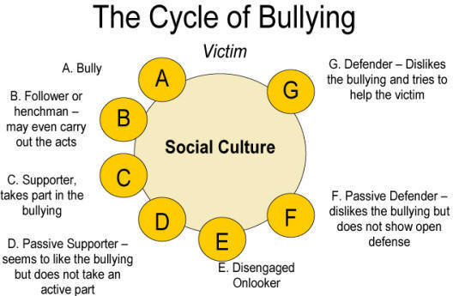

Slide 4
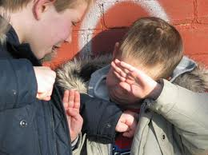
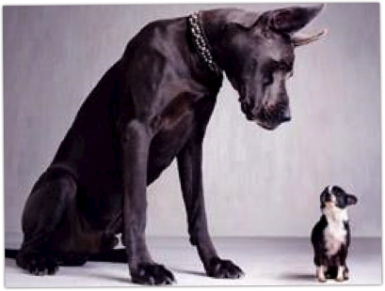
Intimidation Bullying
Intimidation: Subjection to intentional action that seriously threatens and induces a sense of fear and/or inferiority which adversely affects one’s ability to participate in or benefit from the educational or work setting.

Slide 6


Slide 7
Social Alienation
People will not like you if you are not like them
Mostly happens during lunch or recess
Can include spreading rumors, publicly humiliating, social rejection, threat of exclusion from peer group, isolation, and ethnic slurs

Slide 8
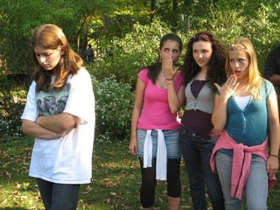
What is she wearing?!

Slide 9
Verbal bullying
Definition: Bullying by saying or writing something hurtful about someone else

Slide 10
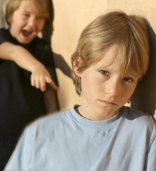
Example:
An example of verbal bullying would be making fun of someone for what they look like or are wearing.

Slide 11
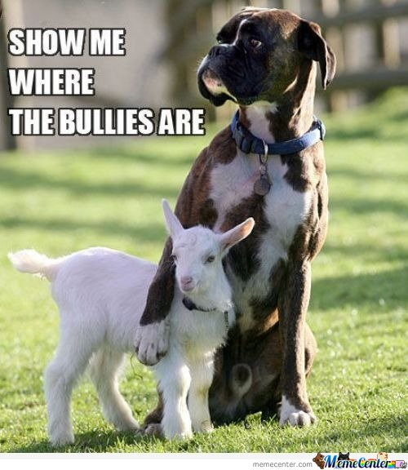
Physical Bullying
In general, bullying is behavior by one person that intimidates another. Often, bullying involves a real or implied threat of physical aggression and is directed by a physically larger or older person toward someone smaller or younger.
Notes:
http://connection.ebscohost.com/education/bullying-schools/definition-bullying-schools

Slide 12
Cyberbullying
"Cyberbullying" is when a child, preteen or teen is tormented, threatened, harassed, humiliated, embarrassed or otherwise targeted by another child, preteen or teen using the Internet, digital technologies or mobile phones.
Ex: Any mean messages or threats that are sent to a person’s cell phone, email, or any social network site

Slide 13
Cyberbullying: Why is it a problem?
Children have killed each other or committed suicide after having been involved in a cyber bullying incident

Slide 14
Cyberbullying happens often
Over 1/2 teens
Girls more than boys
1 out of 5 pictures

Slide 15

Indirect Bullying

Slide 16


Indirect bullying includes the spreading of rumors, gossip and excluding other people from your “groups” or cliques. It can also include negative body language and “dirty looks.”
This type of bullying is most common in females.

Slide 17
How to prevent bullying
Learn to walk away
Report any activity
Be the bigger person
Do not partake in any type of bullying
No rumor generating
Proper social network etiquette

Slide 18

Resources
PACER
National bullying prevention organization
October is national bullying prevention month!
http://www.pacerteensagainstbullying.org/#/act

Slide 19
References
Cyber Bullying Statistics - Bullying Statistics. (n.d.). Bullying Statistics - Teen Violence, Anger, Bullying, Treatment Options. Retrieved from http://www .bullyingstatistics.org/content/cyber-bullying-statistics.html
Menzer, M., & Torney-Purta, J. (2012). Individualism and socioeconomic diversity at school as related to perceptions of the frequency of peer aggression in fifteen countries. Journal Of Adolescence, 35(5), 1285-1294.

