Slide 2
What is Bullying ?
Intentional conduct, including verbal, physical, or written conduct, or an intentional electronic communication that creates a hostile educational environment by substantially interfering with a student’s or staff member’s educational benefits, opportunities, or performance, or with their physical or psychological well-being and is:

Slide 3
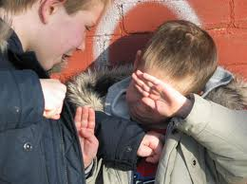
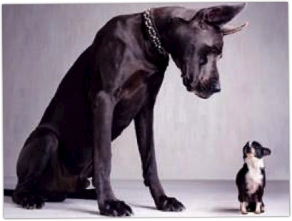
Intimidation Bullying
Intimidation: Subjection to intentional action that seriously threatens and induces a sense of fear and/or inferiority which adversely affects one’s ability to participate in or benefit from the educational or work setting.

Slide 5
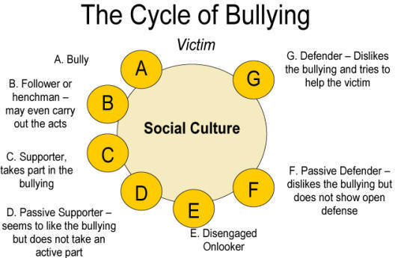

Slide 6


Slide 7
Learn to WALK AWAY
Most socially initiated problem behavior is maintained by peer attention.
Victim behavior inadvertently maintains taunt, tease, intimidate, harassment behavior.
Build social reward for victim for “walking away”
Do not reward inappropriate behavior.

Slide 8
Social Alienation
People will not like you if you are not like them
Mostly happens during lunch or recess
Can include spreading rumors, publicly humiliating, social rejection, threat of exclusion from peer group, isolation, and ethnic slurs

Slide 9
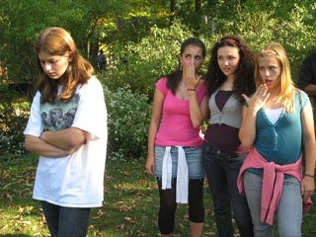
What is she wearing?!

Slide 10
Verbal bullying
Definition: Bullying by saying or writing something hurtful about someone else

Slide 11
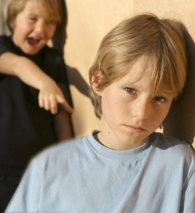
Example:
An example of verbal bullying would be making fun of someone for what they look like or are wearing.

Slide 12
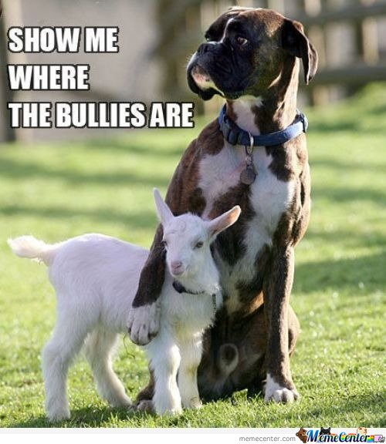
Physical Bullying
In general, bullying is behavior by one person that intimidates another. Often, bullying involves a real or implied threat of physical aggression and is directed by a physically larger or older person toward someone smaller or younger.
Notes:
http://connection.ebscohost.com/education/bullying-schools/definition-bullying-schools

Slide 13
References

