Slide 1
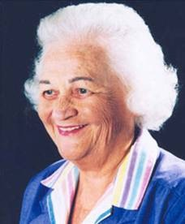
Imogene King, EdD, RN, FAAN
By: Gentry Scott, Adam Moon, Ashley Winnett, Theresa Pollum, Sara Uphoff, Morgan Murphy, Amanda Michalec

Slide 2

Biography
Born
Midwest
upbringing
Death

Slide 3

Education
BSN
MSN
Doctorate

Slide 4
Accolades
Honorary Doctorate of Philosophy
Jessie M. Scott Award
ANA Hall of Fame

Slide 5
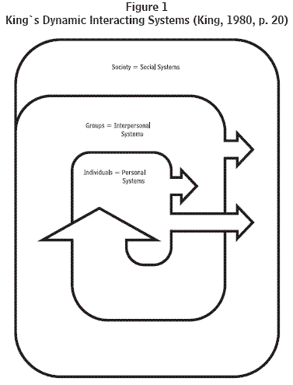
Imogene’s Goal Attainment Theory
Introduced in 60’s
Nurse-patient interactions are vital for attainment of patient’s health goals.

Slide 6
Development of Theory
Experience as nurse and reflection
Director of outpatient clinic @ St. Johns

Slide 7
Basic Concepts of Goal Attainment Theory
Transaction
-interaction
-perception
-communication
-role
-stress
-growth and development

Slide 8
Implementation of Theory into our nursing practice
1.) Person
2.) Environment

Slide 9
Implementation of Theory into our nursing practice
3.) Environment
4.) Nursing

Slide 10
Summary of Theory
Perception
Transaction
Satisfaction
Growth and Development

Slide 11
References
Erratum... "Viewpoint: use of King's conceptual system, nursing informatics, and nursing classification systems for global communication" by Mary B. Killeen, PhD, RN, CNAA, BC, and Imogene M. King, EdD, RN, FAAN. (2007). International Journal of Nursing Terminologies & Classifications, 18(4), 156. Retrieved from EBSCOhost.
Chitty, K.K., & Black, B.P. (2010). Professional nursing: Concepts and challenges (6th Ed.), St. Louis, MO: Saunders Elsevier.
Hanucharurnkul, S. (1989). Comparative analysis of Orem's and King's theories. Journal of Advanced Nursing, 14(5), 365-372. Retrieved from EBSCOhost.
Lavin, M., & Killeen, M. (2008). Tribute to Imogene King. International Journal of Nursing Terminologies & Classifications, 19(2), 44-47. Retrieved from EBSCOhost.

