Slide 1
HPV-Human Papillomavirus
Most common
40 types
No symptoms
Notes:
HPV stands for the Human papillomavirus. This is the most common sexually transmitted infection. At least half of all sexually active people will get it at some point in their lives. There are 40 different strands of the virus. Both men and women are often asymptomatic with this infection. The CDC estimates that in 90% of all cases, the body’s immune system fights HPV within 2 years. This virus usually affects the genital region, throat, and mouth.

Slide 2
HPV in Men
Genital Warts
Cancer
Penis
Anus
Head
Neck
Notes:
HPV can cause genital warts and cancer. One strand of the virus will not produce both disorders. Cancers in men are less common but have been linked to HPV

Slide 3
HPV in Women
Genital Warts
Cancer
Cervical
Vulvar
Vaginal
Notes:
The same strands that cause genital warts in men, also cause genital warts in women. Other strands can lead to cancers of the cervix, vulva, and vagina. Cervical caner is the most common. Every year, 12, 000 women will get diagnosed with cervical cancer. There usually aren’t any symptoms for any of the cancers I have mentioned until it gets advanced.

Slide 4
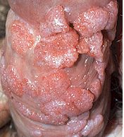


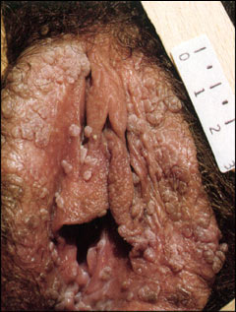
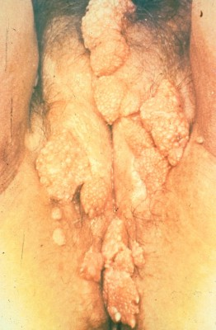
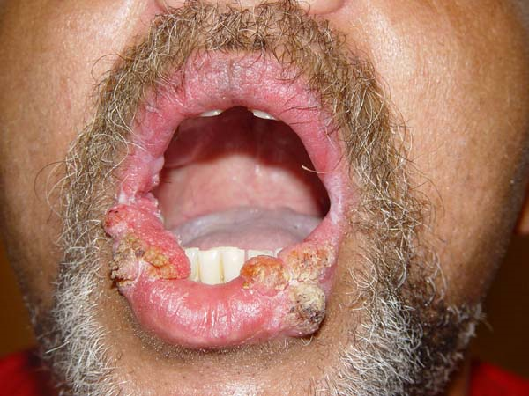
Pictures (WARNING! These are graphic!)
Notes:
http://www.cara-online.org/services/health/images/genital_warts.jpg
http://boysunderattack.com/images/genital_warts.jpg
http://www.wrongdiagnosis.com/phil/images/4151.jpg
http://www.stdhelp.org/images/gallery/genital-warts-56.jpg
http://www.hsvfree.com/vigenitalwartslips

Slide 5
Vaccines
Gardasil
Females
Males
Cervarix
Females
Notes:
Both vaccines protects females against strands of HPV that cause cervical cancer. Gardasil also protects against most genital warts, thus males are encouraged to get the Gardasil vaccine. Other ways to prevent HPV are condom use and being in a monogamous relationship. Condoms lower the risk of getting HPV and the related diseases but it does not fully protect against HPV. HPV can infects the body by skin contact and those areas that may not be covered by a condom.
http://www.cdc.gov/std/HPV/STDFact-HPV.html#common

