Slide 1
Impact of Hispanics on providing nursing care
By the year 2000, Hispanics will outnumber African Americans and become the majority minority. Statistics reveal that health problems of Hispanics in the United States (Caudle ,1994)
.
Diabetes,
Injuries and violence
Substance abuse
HIV/AIDS
Limited access to health care, and many other problems shared by the poor and disenfranchised.
Notes:
Interventions with Hispanic population require nurses to be knowledgeable about customs, beliefs, and language of the Hispanics. The journal article Providing culturally sensitive health care to Hispanic clients talked about how nurses also need to be alert to and active in health care policy making that will improve access to health care for the growing Hispanic population (Purath ,1994)

Slide 2
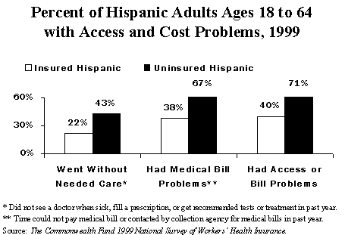
Impact of Hispanics on providing nursing care

Slide 3
Impact of Hispanics on providing nursing care
Mexican women promote healthy behaviors by diagnosing sick family members, and prescribe home remedies(Waldstein ,2010)
Familism is a strong sense of family care and obligation, it is considered an important Mexican American cultural value.
Research shows that older Latina women view health not as the absence of illness; rather, they see the decline of health as natural and anticipated. Hispanic elderly expect care from family as they become more frail (Padilla&Villalobos ,2007)
Notes:
Interventions for a Hispanic patient require a more complex understanding of Mexican American culture. For nurse to treat Hispanic clients they need integrate cultural factors into health promotion activities. According to Padilla&Villalobos, 2007 journal article Cultural Responses to Health Among Mexican American Women and Their Families family support for the elderly is important and family is often turn to for every day health needs .

