Slide 1
Module 7
Palliative Care Final Presentation

Slide 2
Part A:
Required Readings
  In Palliative Care by Linda L. Emanuel and S. Lawrence Librach read chapter 2 entitled HIV/AIDS.
  Read the research article entitled The changing face of HIV/AIDS by Bersch & DiRamio.
  Read the research article by Gilbert and Walker.

Slide 3
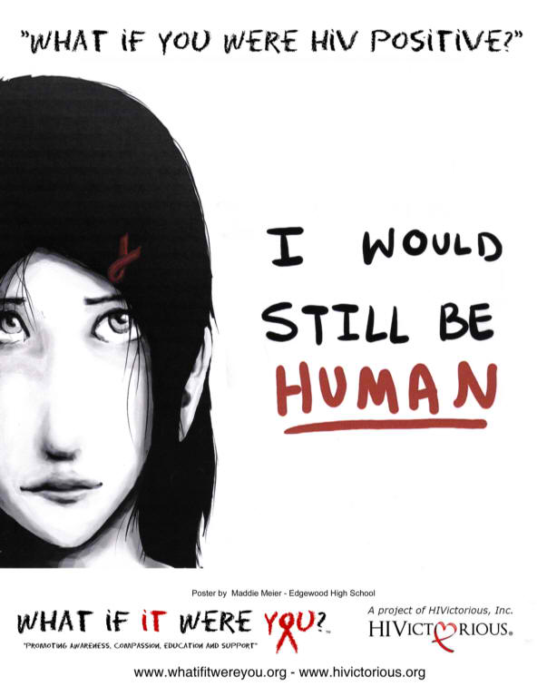
Part B:
Reflection activity
  Look at the picture and answer the question “What if you were HIV positive?”

Slide 4
Part C
Mini Lecture

Slide 5


Slide 6
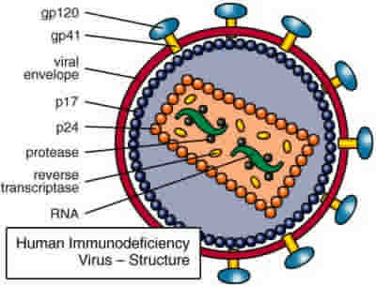
What is HIV?
HIV or human immunodeficiency virus is a sexually transmitted disease that damages the immune system and interferes with the body’s ability to fight the organisms that cause disease.

Slide 7
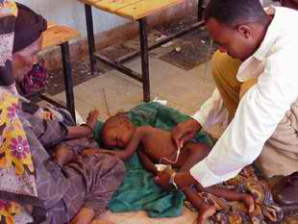
What is AIDS?
AIDS is a chronic, potentially life-threatening condition caused by HIV.

Slide 8
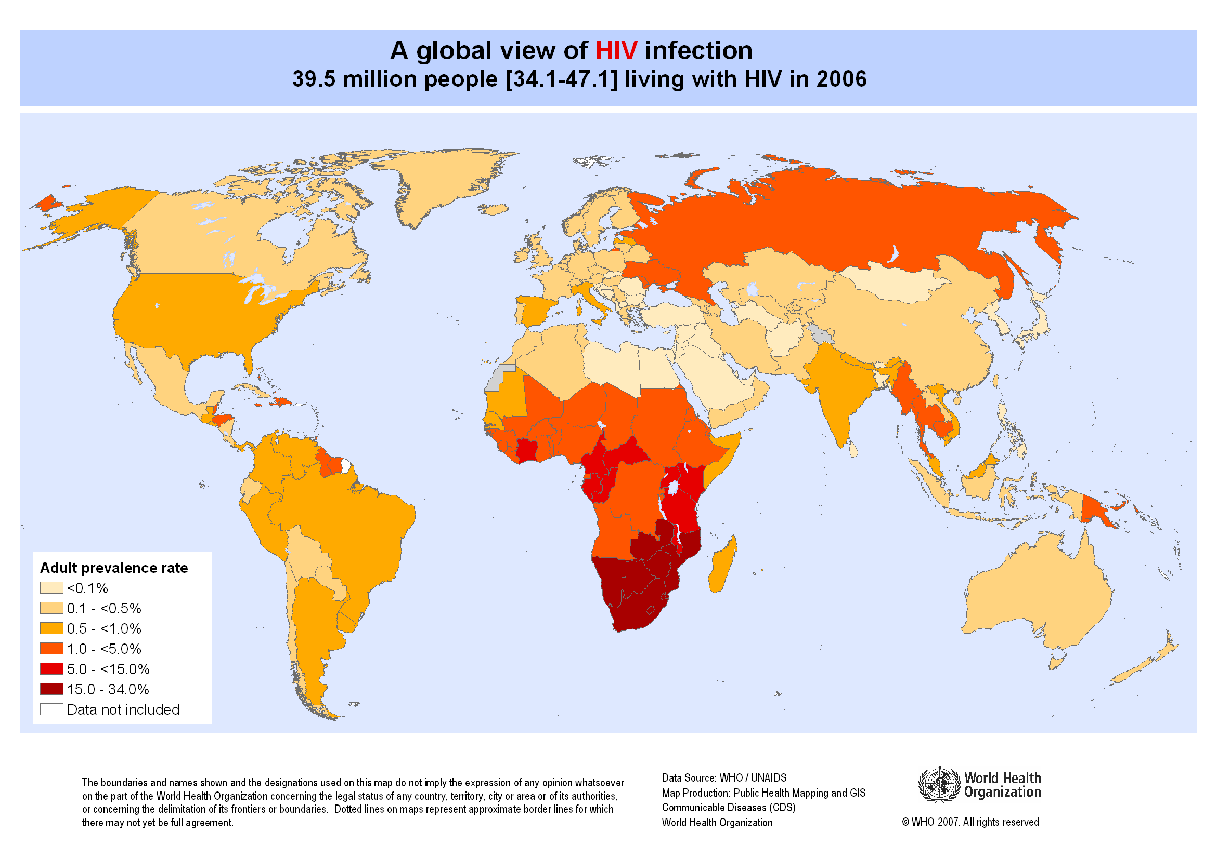
Notes:
Pursue

Slide 9
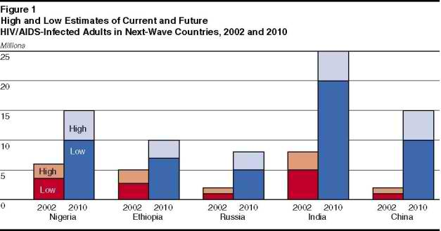

Slide 10
Symptoms
First few weeks:
  Fever
  Headache
  Sore throat
  Swollen lymph glands
  Rash
Years later
  Swollen lymph nodes
  Diarrhea
  Weight loss
  Fever
  Cough and shortness of breath

Slide 11
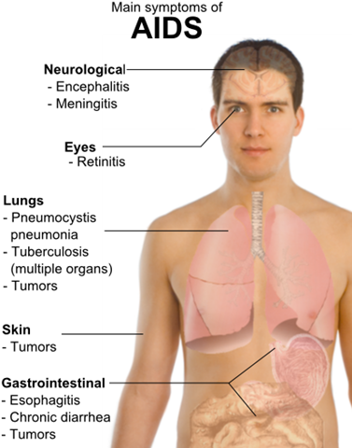

Slide 12
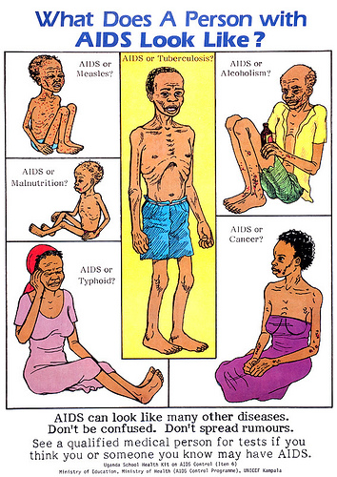
Progression to AIDS
If no treatment is given for HIV, the disease typically progresses to AIDS in approximately 10 years.

Slide 13
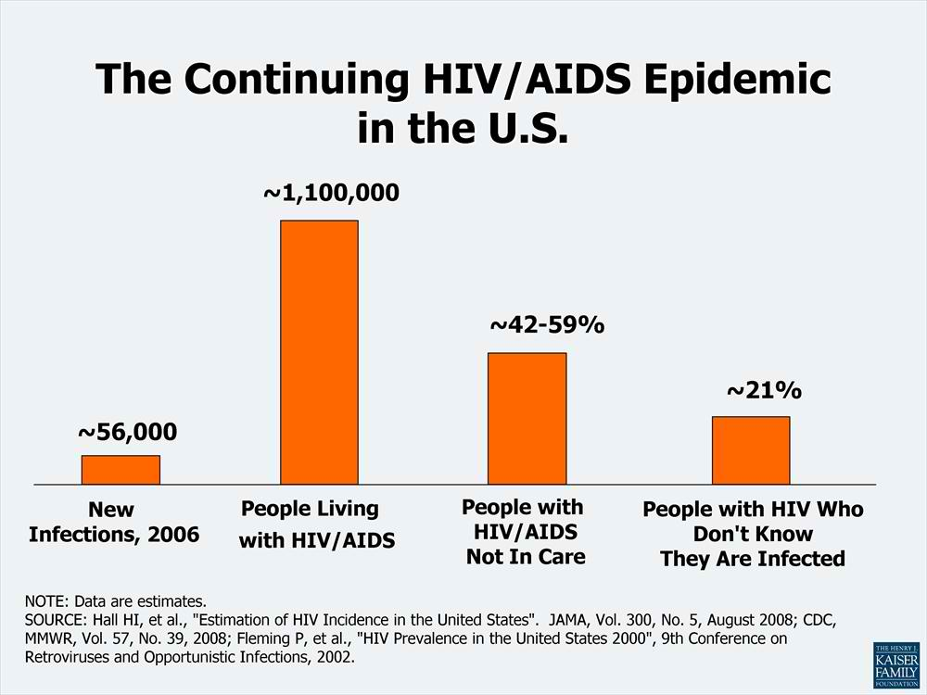

Slide 14
Advanced Symptoms
Soaking night sweats
Shaking chills or fever > 100 F for several weeks
Cough and shortness of breath
Chronic diarrhea
Persistent white spots or unusual lesions on tongue or mouth
Headaches
Persistent, unexplained fatigue
Blurred and distorted vision
Weight loss
Skin rashes or bumps

Slide 15
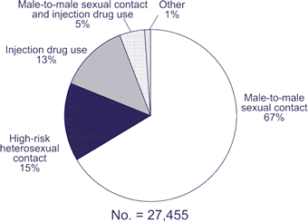
How is HIV transmitted?
During sex
Blood transfusions
Sharing needles
From mother to child

Slide 16
Risk Factors
Any age, race, sex or sexual orientation
Having unprotected sex
Previous STD
Use of IV drugs
Uncircumcised males

Slide 17
Treatments
There is no cure for HIV/AIDS. Drugs can be used to control the virus. Combining at least three drugs from two different drug classes helps to avoid creating any immunity of the virus to a single drug.
Drugs often used:
  Non-nucleoside reverse transcriptase inhibitors (NNRTIs)
  Nucleoside reverse transcriptase inhibitors (NRTIs)
  Protease inhibitors (Pis)
  Entry or fusion inhibitors
  Integrase inhibitors

Slide 18
Coping & Support
Emotional
Social
Financial
Support group
Social workers
Counselors
Nurses

Slide 19
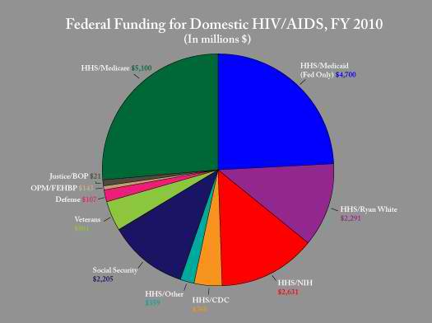

Slide 20
Part D
Learning activity
  Go to http://www.avert.org/ . Navigate through the different learning activities and tabs along the top of the page. Complete the HIV/AIDS quiz when you are finished.

Slide 21
Part E
Learning Evaluation
  Answer the following questions.
    What do you think obstructs nurses from caring for HIV patients?
    List 3 interventions that you would perform while caring for an HIV/AIDS patient.
    Create a teaching plan for an HIV/AIDS patient.

