Slide 1
Habit 3 “Put First Things First”
Effective Time Management
Question 1: What one thing could you do (which you aren't doing now) that if you did on a regular basis, would make a tremendous positive difference in your personal life?
Question 2: What is one thing in your professional life that would bring similar results?

Slide 2
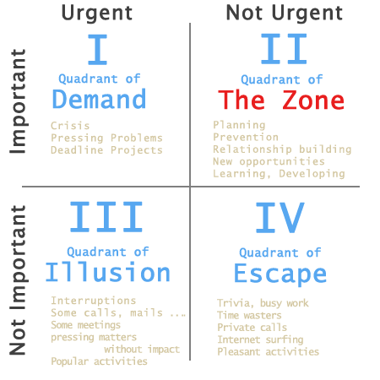
Time Management Matrix

