Slide 1
Windle, et al. (2006) Study Sample
Selection method – random sampling by lottery method from surgery schedule (outpatients and same-day admit patients)
Study inclusion criteria:
18 or older
Able to read and write English
IV insertion was performed on an upper extremity
Study exclusion criteria:
Participants with neuropathy and/or needle phobias
Renal patients
IV insertions not achieved on first attempt
Notes:
The selection method that was used in this quantitative experiment was random sampling by the lottery method from a surgery schedule, which included outpatients and same-day admit patients. The study inclusion criteria that was used was that the participant had to be 18 years of age or older, was able to read and write in the English language, and the IV insertion was performed on an upper extremity. The study exclusion criteria that was used included participants with neuropathy and/or needle phobias, renal patients, and if the IV insertion was not achieved on first attempt (Windle, et al., 2006).

Slide 2
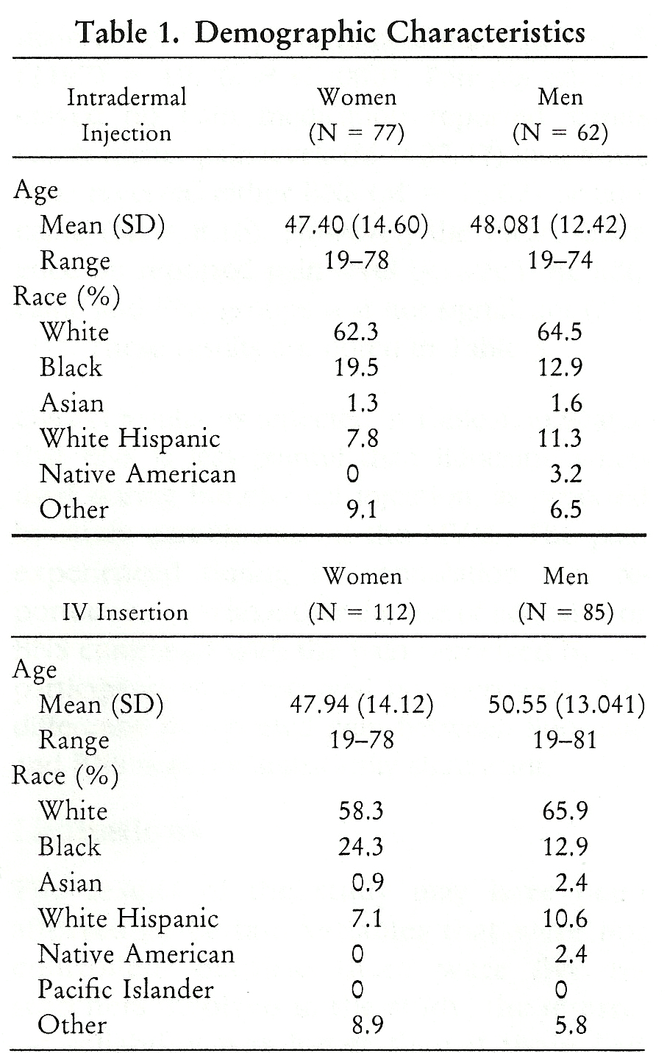
Windle, et al. (2006) Study Sample
221 total participants
More female participants than males
Predominantly Caucasian participants
No Native American female participants
Greater percentage of Black female participants compared to Black male
Is sample size sufficient? Yes
Windle, et al. (2006)
Notes:
There were 221 total participants in this study. While looking at Table 1, it is apparent that there are more female participants than men, more Caucasian participants than those of any other race, there are not any Native American female participants, and there is a greater percentage of Black female participants compared to Black male participants (Windle, et al., 2006). This sample size is sufficient, as the sampling was done randomly, with a large number of participants. Random sampling increases the likelihood that participants with various extraneous variables are included and evenly dispersed (Burns & Grove, 2009).

Slide 3
Windle, et al. (2006) Data Collection
Informed consent obtained
Participants randomly assigned to three groups
1% lidocaine
0.9% bacteriostatic normal saline with benzyl alcohol
No intradermal anesthesia
Participant questions and concerns addressed
Demographic information recorded by nurse performing IV cannulation
Notes:
Burns and Grove (2009) define data collection as “the precise, systematic gathering of information relevant to the research purpose or the specific objectives, questions, or hypotheses.” In order to collect data, informed consent must be obtained (Burns & Grove, 2009). Participants were randomly assigned into three specific groups. The first group received 1% lidocaine, the second group received 0.9% bacteriostatic normal saline with benzyl alcohol, and the third group did not receive any type of intradermal anesthesia (Windle et al., 2006). The participants were then asked if all questions and concerns were addressed. They were also assured that they would be given the same standard of care whether they participated in the study or not (Windle et al., 2006). All demographic information was then recorded by a nurse who was going to perform the IV cannulation (Windle et al., 2006).

Slide 4
Windle, et al. (2006) Data Collection
Participants blindfolded during procedure
29-gauge needle
0.05-0.1 mL of 1% lidocaine or 0.9% bacteriostatic normal saline with benzyl alcohol solution
Insertion of 20- or 18-gauge IV catheter directly over wheal
Waiting 30-60 seconds before IV cannulation
Notes:
The participants were blindfolded in order for the study to be blind, and they would not know what solution was being used (Windle et al., 2006). This was done so that the patient could not have any bias, and so knowledge of what solution was used would influence a pain rating. A 29-gauge needle was used to inject 0.05-0.1 mL of either the 1% lidocaine or 0.9% bacteriostatic normal saline with benzyl alcohol solution to the back of the hand or forearm to produce a wheal (Windle, et al., 2006). A 20- or 18-gauge IV catheter was then inserted directly over the wheal, and the nurse waited 30-60 seconds before performing IV cannulation (Windle et al., 2006).

Slide 5
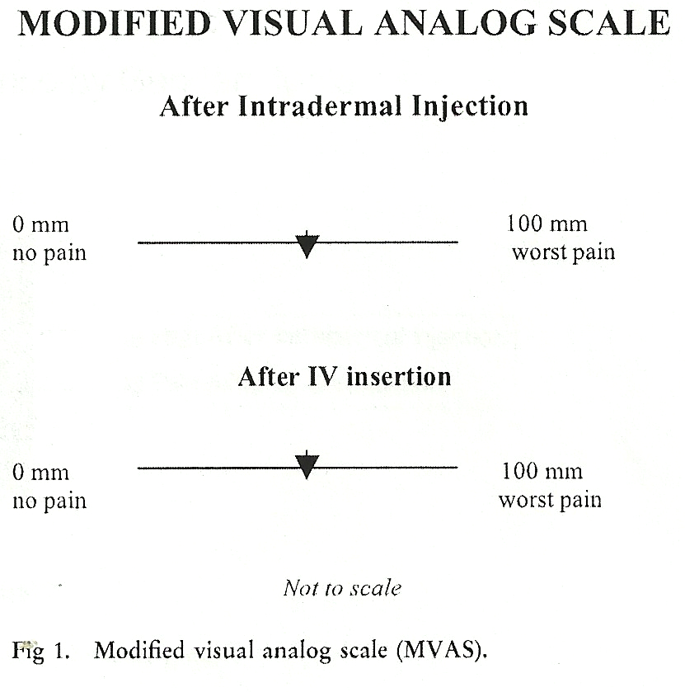
Windle, et al. (2006) Data Collection
Participants who received intradermal injection used modified visual analog scale to represent pain rating
Participants used modified visual analog scale again to represent pain after receiving IV cannulation
Windle, et al. (2006)
Notes:
The participants who received the intradermal injection drew a vertical line on the first line on the modified visual analog scale that best represented their level of pain (Windle et al., 2006). After receiving the IV cannulation, the participants drew another line on the modified visual analog scale that best represented their level of pain (Windle et al., 2006). This scale uses a 0-100 scale, with 0 being no pain and 100 being the worse possible level of pain.

Slide 6
Eggenberger, et al. (2010) Study Sample
77 participants from an adult acute care nursing practice course
Scheduled to require a simulation experience as part of curriculum
Eight clinical groups from which the sample was derived were composed of:
Four traditional undergraduate (n = 36)
Four accelerated undergraduate (n = 41)
Notes:
In this study, there were 77 total participants who were in an adult acute care nursing practice course at a university in Florida, which was scheduled to require a simulation experience as part of their curriculum (Eggenberger et al., 2010). There were eight total clinical groups that the sample was derived from. This included four groups of traditional undergraduates, which totals 36 participants in those four groups. There were four groups of accelerated undergraduate students, which totaled 41 participants for these four groups. Accelerated students are described as students who had a bachelors degree in another discipline (Eggenberger et al., 2010).

Slide 7
Eggenberger, et al. (2010) Study Sample
Traditional students: 26 were 18-25, 7 were 26-35, 3 were 36-45
12 traditional students with previous healthcare experience
Accelerated students: 19 were 18-25, 15 were 26-35, 5 were 36-45, 2 were 46-60
7 accelerated students with previous healthcare experience
Accelerated students: majority had a previous degree in biology, psychology, or business
“Purposeful” sample size, sufficient
Notes:
Eggenberger et al. (2010) states that out of the traditional students, 26 participants were between the ages of 18 and 25, seven were between the ages of 26 and 35, and three were between the ages of 36 and 45. Out of this group of traditional students, 12 had previous experience in healthcare. Out of the accelerated students, 19 participants were between the ages of 18 and 25, 15 were between the ages of 26 and 35, five were between the ages of 36 and 45, and two were between the ages of 46 and 60. Out of this group of accelerated students, seven had previous healthcare experience. Therefore, compared to the traditional student group, the accelerated students had an older population of students, and less experience in healthcare. Eggenberger et al. (2010) also states that this sample size is “purposeful”. This sample size is sufficient, as there is a large number of total participants, and the sample size from both types of students (traditional and accelerated) were almost equal.

Slide 8
Eggenberger, et al. (2010) Data Collection
Group leader for semi-structured group sessions
Anonymous program evaluations
Students were asked whether they would be interested in participating in a study focused on evaluating caring behaviors using simulation technology
Participation not a criterion for obtaining a grade
Created emergent situation scenario
Patient - “Mr. Silver”
Notes:
There was a group leader who moderated semi-structured group sessions, with the purpose of obtaining opinions, beliefs and attitudes about a designated topic (Eggenberger et al., 2010). There were anonymous program evaluations that were completed by the participants, which included an open-ended question area where the students had the opportunity to write about what they felt regarding the simulation experience (Eggenberger et al., 2010). At the start of the class, students were asked whether or not they would be interested in participating in a study that would be focused on evaluating caring behaviors by means of using simulation technology (Eggenberger et al., 2010). They study process was then explained, and it was made clear to the students that participating in the study was not required to obtain a satisfactory grade. Eggenberger et al., (2010) then created a scenario that was an emergent situation, and all of the simulation groups received the same introduction. They referred to the patient as “Mr. Silver” (Eggenberger et al., 2010).

Slide 9
Eggenberger, et al. (2010) Data Collection
Processes that provided the structure for the simulation experience: briefing, encountering, and debriefing
Briefing
“Mr. Silver”
Overview of guidelines
Orientation to equipment
Encountering
Nursing situation
Students respond with technological competencies
Debriefing
Groups were guided through discussion and reflection regarding clinical effectiveness
Focus group
Notes:
The three main processes for data collection were briefing, encountering, and debriefing. The briefing part was the teaching experience that was directed toward appreciating the nursing situation. Briefing included setting the scene with the patient Mr. Silver, having an overview of the 2005 American Heart Association Guidelines for Cardiopulmonary Resuscitation and Emergency Cardiovascular Care, and an orientation to the crash car, simulation room, and equipment (Eggenberger et al., 2010). The encountering part was experiencing the scenario in a situation that was created to be as realistic as possible. Encountering included the nursing situation, which was the male patient experiencing chest pain with his wife present and a rapidly deteriorating condition, and the students needed to respond with technological competencies, such as cardiopulmonary resuscitation, pharmacological intervention, and defibrillation (Eggenberger et al., 2010). The debriefing part was an occasion for allowing the students to share their experiences in order to understand the caring nursing process between the nursed and the nurse. This included groups guided through a short discussion and reflection prior to leaving the patient’s room regarding their clinical effectiveness, and a focus group gathered to discuss how they came to know the patient (Eggenberger et al., 2010). Questions that were asked during this discussion group were, “How did you come to know the person nursed?”, “What nursing interventions were grounded in caring?”, and “How does studying nursing in this situation enhance competancies in caring?” (Eggenberger et al., 2010).

