Slide 1
Analyzing & Critiquing Research Papers
Todd Johnson, Amanda Jones, Omololu Kafisanwo, Briana Kennett, & Tara Kutz
Lakeview College of Nursing
N302 – Nursing Research
September 25, 2011

Slide 2
Objectives
To identify components
To critique the value
To identify the informed consent process
To compare the methodologies
Notes:
The purpose of this project is to identify the components of a quantitative and qualitative research article, to critique the value of assigned articles to the nursing profession, to identify the informed consent process used in the articles, and to compare the methodologies of a quantitative and a qualitative research article.

Slide 3
The Research Question
Windle et al.
Pain management during:
Venipuncture
Intradermal Injection
Lidocaine vs. BNS
Eggenberger, Keller, & Locsin
Coming to know patients
Expression of caring in simulations
Notes:
The first research study that was reviewed was conducted by the American Society of PeriAnesthesia Nurses. “The purpose of this study was to determine whether a difference existed in pain with intradermal injection and pain with venipuncture when intradermal anesthesia was used” (Windle et al., 2006, p. 251). Bacteriostatic normal saline, lidocaine, and no local anesthesia were the three test groups that were used in this study. The researchers not only wanted to find out if the local anesthesia reduced pain during venipuncture and IV insertion, but also which of the two local anesthetics tested would reduce the pain the most. (Windle et al., 2006, p. 251)
The second research study that was reviewed was conducted by the Florida Atlantic University. “This study was conducted to explore how students come to know persons as caring and how caring is expressed using a high-fidelity human simulator in emergent nursing situations” (Eggenberger, Keller, & Locsin, 2010, p. 23). The authors wanted to see how nursing students got to know their patients as caring people as well as how the students showed caring towards their patients. The researchers believed that this is more difficult to do in the simulation environment, but that the simulation experience is an important one. Therefore, the focus was on creating a simulation experience that was as lifelike as possible to see how the students exhibited caring and getting to know the patient. (Eggenberger et al., 2010, pp. 23-26)

Slide 4
Variables & Concepts
Windle et al.
Independent & dependent variables
Eggenberger et al.
Analyzed concepts
Notes:
Research studies have both an independent and dependent variable so that a hypothesis may be formed (Burns & Grove, 2009, p. 177). According to Burns and Grove (2009), “an independent variable is a stimulus or activity that the researcher manipulates or varies to create an effect on the dependent variable” (p. 177). In the study by Windle et al. (2006), the independent variables were the type of anesthesia used. There were three different groups: lidocaine, BNS, and no anesthesia. (Windle et al., 2006, p. 251) “A dependent variable is the response, behavior, or outcome that the researcher wants to predict or explain. Changes in the dependent variable are presumed to be caused by the independent variable” (Burns & Grove, 2009, p. 177). In the same study by Windle et al. (2006), the dependent variable is the level of pain felt by the research participants. The researchers were able to predict which local anesthetic would produce the greatest pain relief as well as if the local anesthetics would be rated greatly helpful compared to the group with no local anesthetic. (Windle et al., 2006, p. 251)
“A concept is a term that abstractly describes and names an object, a phenomenon, or an idea, thus providing it with a separate identity or meaning” (Burns & Grove, 2009, p. 126). In the study by Eggenberger et al. (2010), many concepts were being analyzed. First, the researchers wanted to know how nursing students came to know their patients as caring individuals. Viewing the patient as an individual is very important. (Eggenberger et al., 2010, p. 23) According to Eggenberger et al. (2010), one concern was that simulation technology may reduce “…the focus of nursing as knowing persons as participants in their care rather than as objects of our care” (p. 23). Second, the researchers wanted to know how nursing students showed caring to their patients. They wondered how instructors made sure that students actually viewed the simulator as a person and exhibited caring behaviors during the simulation experience. (Eggenberger et al., 2010, p. 23)

Slide 5
Study Samples
Eggenberger et al.(2010)
Sample size
Demographics
Significance of sample size
Windle et al. (2006)
Sample size
Inclusion/exclusion criteria
Significance of sample size
Notes:
Eggenberger et al. (2010) obtained their sample from an adult acute care nursing practice course from a Florida university. The sample size was 77 and consisted of both traditional and nontraditional students. The demographics of the traditional students showed that 26 were between the age of 18 and 25, seven were between the age of 26 and 35, and three were between the age of 36 and 45. The demographics of the nontraditional students were 19 between the age of 18 and 25, 15 between the age of 26 and 35, five between the age of 36 and 45, and two between the age of 46 and 60. (Eggenberger et al., 2010, p. 25) According to Burns and Grove (2009), the sample size required in qualitative research is dependent on the amount of information needed to understand the subject of study. Furthermore, the number of participants is adequate when “saturation of information is achieved in the study area” (Burns & Grove, 2009, p. 361). Three factors must be used to determine whether a sample size has achieved saturation of data: scope of the study, nature of the topic, and quality of the data. Smaller sample sizes are appropriate if the scope of the study is narrow, if the topic is clear, or if the quality of data is high. (Burns & Grove, 2009, p. 361) Upon review of Eggenberger et al. (2010), the scope of the study is narrow, focusing on the development of caring using simulation technology. Furthermore, Eggenberger et al. (2010) discussed the topic in detail, and they obtained high quality data with subjects participating in an emergent situation and focus group discussion. (p. 25)
Windle et al. (2006) sampled 221 participants. Participants were selected using random sampling by lottery method. Inclusion criteria included: patients 18 years of age and older, patients who could read and write English, and patients whose IV insertion occurred on an upper extremity. Exclusion criteria included: patients with neuropathy, patients with needle phobias, renal patients, and patients whose IV insertion did not occur on first try. (Windle et al., 2006, p. 254) According to Burns and Grove (2009), power is used to determine if a sample size is adequate (p. 357). The design of the study, as well as the number of variables affects the sample size. For example, variables such as age and gender can lead to an increase by a factor of five to ten. (Burns & Grove, 2009, p. 360) Thus, the sample size of 221 used by Windle et al. (2006) is sufficient.

Slide 6
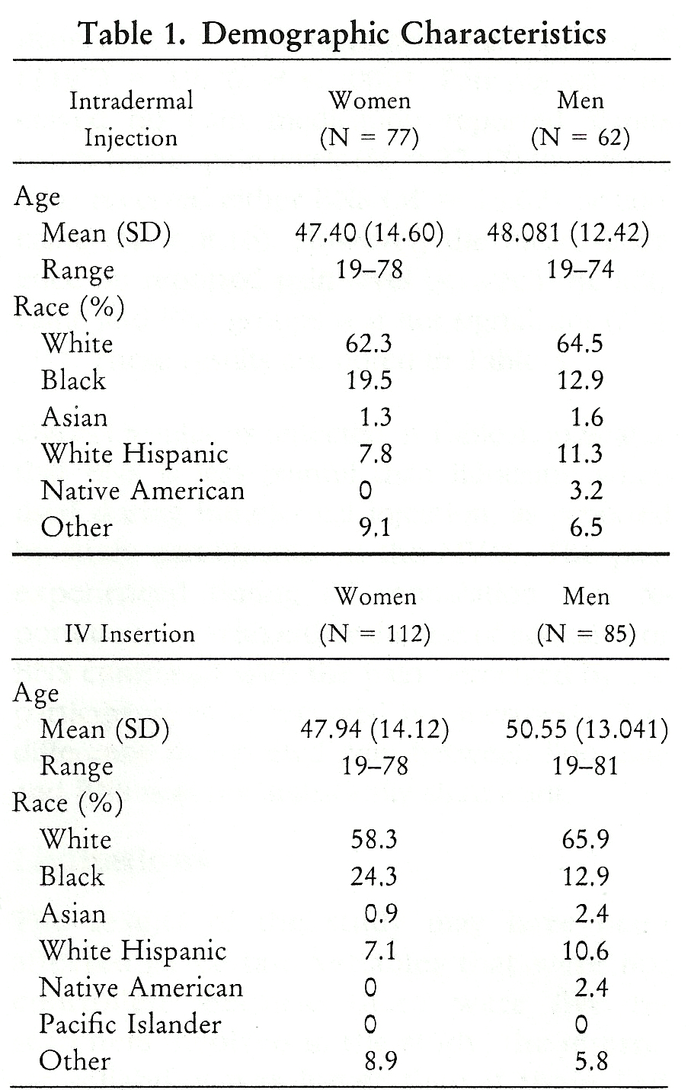
Demographics of the Windle et al. Study
doi:10.1016/j.jopan.2006.05.007
Notes:
Here, the demographics of the study by Windle et al. is broken down nicely. It is very easy to see the number of men and women in the study as well as the different races and ages of participants.

Slide 7
Data Collection
Eggenberger et al. (2010)
Structure of simulation experience
Focus group discussions
Windle et al. (2006)
Random assignment
Use of 0- to 100-mm modified visual analog scale
Medication administration
Notes:
Students were asked to voluntarily participate in study. They were informed that participation was not part of the course requirements. An emergent situation was created and all groups received the same instructions. Structure for the simulation process was established using three processes: briefing, encountering, and debriefing. In the debriefing, students were asked to discuss and reflect upon their simulated experience. Later, a group of students, which included 9-11 participants, assembled in a focus group (Eggenberger et al., 2010, p. 25). According to Burns and Grove (2009), “one of the assumptions underlying the use of focus groups is that group dynamics can help people express and clarify their views…” (p. 513). Eggenberger et al. (2010) used questions such as, “What nursing interventions were grounded in caring? Which theoretical concepts were you able to link to the situation?” (p. 25). Furthermore, Burns and Grove (2009) states that the focus group should consist of 6 to 10 participants to support adequate discussion (p. 513). Thus, Eggenberger et al. (2010) meet this criterion because they have included 9 to 11 participants in their focus group.
Windle et al. (2006) used the following methodology in their data collection. Subjects that met their inclusion criteria were randomly assigned to three groups: 1% lidocaine, 0.9% BNS with benzyl alcohol, and no intradermal anesthesia. Pain was evaluated using a modified visual analog scale. Participants’ pain was evaluated at two points: immediately after intradermal injection, and after IV cannulation. The lidocaine or BNS was injected using 29-gauge needle. The injection site was either the back of the hand or the forearm. A 20-gauge or 18-gauge IV catheter was then inserted directly over the wheal. (Windle et al., 2006, pp. 254-256).

Slide 8
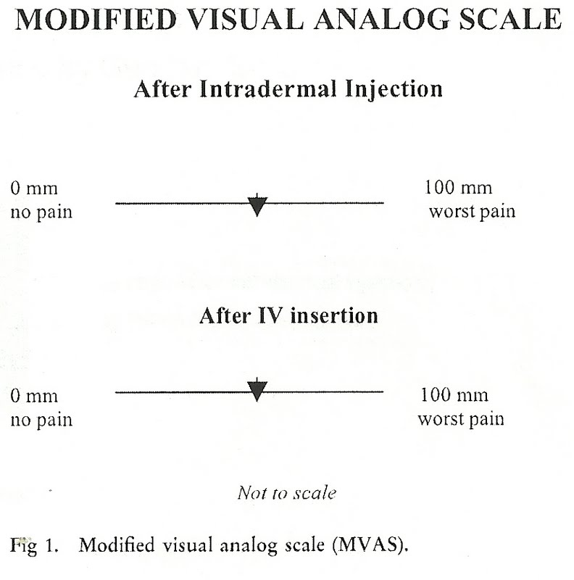
Pain Scale in Windle et al.
doi:10.1016/j.jopan.2006.05.007
Notes:
Pain was rated by drawing a line on the MVAS after the intradermal injection and then after IV cannulation (Windle et al., 2006, pp. 254-256). Here, you can see a representation of the visual analog scale used in the Windle et al. (2006) study.

Slide 9
Eggenberger et al.: Findings
Knowing through others
Ways of knowing of nursing
Carper’s Framework
Empirical knowing
Aesthetic knowing
Personal knowing
Ethical knowing
Nursing calls and responses
Notes:
There are two aims to the study by Eggenberger et al. (2010), “(a) to describe how students come to know the person being nursed as caring and (b) to explore how caring is expressed within an emergent nursing situation using a high fidelity simulator.” The authors used the words, phrases and statements made by the students involved in the study to determine themes.
These themes were knowing the person being cared for through descriptions of them by significant others such as present family members, using the ways of knowing in nursing and the nursing calls and responses. (Eggenberger et al., 2010, pp. 25-26) Knowing the person receiving the care through others was achieved through watching the interaction of family members with the patient, as well as listening to verbal communications. Participants said the significant other was also helpful in providing information when the patient was not able to communicate. (Eggenberger et al., 2010, p. 26)
Ways of knowing is based on Carper’s (1978) framework of knowing in nursing. Students seemed to echo Carper’s patterns of empirical knowing, aesthetic knowing, personal knowing, and ethical knowing. (Eggenberger et al., 2010, p. 26) Empirical knowing is technical knowledge of nursing such as medications, procedures, and identification of signs and symptoms. Aesthetic knowing is the awareness and understanding of the situation, surroundings, and environment. This knowledge allows a nurse to react with an appropriate demeanor. One study subject described it as maintaining “a sense of composure and finding that way of being in that moment” (Eggenberger et al., 2010, p. 26).
Personal knowing involves interaction and development of a trusting therapeutic relationship with the client and significant others. Ethical knowing involved recognition and protection of the patient’s rights and requests as well as those of family. Participants felt these were important to truly caring about the patient. (Eggenberger et al., 2010, p. 26)
Nursing calls identified in the study included the need for the nurse to be fully present, engagement with family members, and offering hope. Nursing responses included providing education and information for the patient and family member, managing pain, and close monitoring of vitals and what the patient is saying. (Eggenberger et al., 2010, p. 26) The students involved in the study felt they were able to express caring for the patients by being present with and listening to the family member, entering their world to better understand their needs, questions and feelings, trying to help the other students involved in the nursing scenario, prioritizing care and safety, and treating the high tech mannequin as if he were a real patient (Eggenberger et al., 2010, p. 27).

Slide 10
Eggenberger et al: Conclusion
Conclusions on High Tech Simulations
Students can know “patients”
Useful tool for teaching and evaluation
Notes:
Eggenberger et al. (2010) came to the following conclusion from this study: students involved in high tech simulations of nursing situations get to know their patients through family members, nursing ways of knowing, and the nursing actions and interventions that they carry out. The caring demonstrated by students involved in the study showed it is possible for high tech simulations to be used to teach and evaluate caring practices in nursing education. (Eggenberger et al., 2010, p. 28) These conclusions and the reported findings compared to the stated aims of the study both support the fact that the researchers did answer their research questions.

Slide 11
Windle et al: Findings
During IV insertions
Lidocaine or BNS vs. No anesthesia
mean pain less for lidocaine or BNS
Lidocaine vs. BNS
no significant difference
During intradermal injections
Lidocaine vs. BNS
mean pain levels less for BNS
Notes:
The goal of Windle et al. (2006) was to compare the use of lidocaine and bacteriostatic normal saline solution (BNS) as an intradermal anesthesia for patients during IV insertion. A third group in the study received no anesthesia (Windle et al., 2006, p. 254).
Findings from this study showed that patients receiving either lidocaine or BNS reported lower mean pain levels from venipuncture than no anesthesia to a statistically significant degree. When lidocaine and BNS were compared after IV catheter insertion, mean pain levels for the BNS group were higher, but there was no statistically significant difference between the two. There was no difference in regards to gender. (Windle et al., 2006, p.257)
However, patients reported higher mean pain levels after receiving an intradermal injection of lidocaine compared to BNS. This difference was statistically significant. Again, there was no difference in regards to gender. (Windle et al., 2006, p. 256)

Slide 12
Windle et al.: Limitations
Number of researchers
Different techniques
Distractions as pain relief
Notes:
Limitations to the results of the study could have been caused by the number of researchers involved in putting in the IV catheters. Techniques by the researchers may have differed and some may have been less painful than others. Also, distraction during IV insertion was not controlled and could have resulted in lowered pain reporting levels. (Windle et al., 2006, p. 257)

Slide 13
Windle et al.: Conclusion
Change in current practice
Use of BNS considered hospital wide
Lower cost
Lower risk of adverse events
Outcomes improvements
Notes:
Windle et al. (2006) conclude that the use of BNS as intradermal anesthesia prior to IV insertion should be considered hospital wide. Based on the results of the this study comparing BNS to lidocaine, as well as the lower cost and lower risk of adverse events associated with BNS, the authors believe “a change in our current practice is warranted to improve both patient and hospital outcomes” (Windle et al., 2006, pp. 257-258). The systematic design of the study and statistical significance of the results show the research question comparing pain control with either lidocaine or BNS was answered.

Slide 14
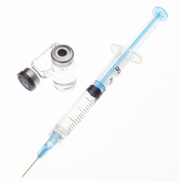
Secondary Sources & Relevance to Nursing Practice
Windle et al.
How were secondary sources used?
Validate study
Was this study relevant to nursing practice?
Improved outcomes
http://hghsupplementstalk.com/hgh-injections/learn-hgh-injections.html
Notes:
Windle et al, (2006) used secondary sources to validate the research being done. Burns & Grove (2009) define a secondary source as something that "summarizes or quotes content from primary sources" (p. 93). The primary source will paraphrase the secondary source in order to validate the work. The problem involved with this is an issue of bias from the author when paraphrasing secondary sources (Burns & Grove, 2009, p. 93). In one such study, “Klieber et al, conducted a comparative study between ELA-Max (Ferndale Laboratories, Fernadale, MI) and eutectic mixture of local anesthetic equivalence (Windle et al, 2002, pg. 252). Each study that was reviewed in this article was used to concrete the idea that there was a need for the research in this article. Also, each source that was used in this paper did not have an apparent problem with paraphrasing.
“Pain management is one of the top priorities for nurses, especially in the perianesthesia setting. The main goal is to provide positive patient outcomes” (Windle et al, 2002, pg. 257). This statement directly shows the relevance of this study. While pain management remains a cornerstone of nursing, this also infers that this study is current. This study is relevant to nursing practice because this study found that there is a need for a change in nursing practice to improve both patient and hospital outcomes. (Windle et al, 2002, pg. 258)

Slide 15
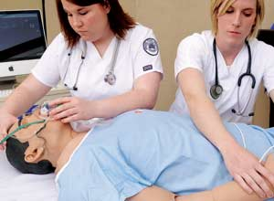
Secondary Sources & Relevance to Nursing Practice
Eggenberger et al.
How were secondary sources used?
Validate study
Was this study relevant to nursing practice?
Improved outcomes
http://www.boundtreeuniversity.com/news/1109702-Fla-company-foresees-growing-popularity-of-medical-dummies/
Notes:
Eggenberger et al. (2010) also used secondary sources to validate the study that was conducted. The use of Sinclair & Ferguson (2009) demonstrated that “nursing has been primarily focused on the use of learning theories. Numerous studies were used to demonstrate that “program development, and the implementation of simulation in laboratory settings” are primarily being used in nursing instruction (Eggenberger et al., 2010, pg. 23). The paper concluded from secondary sources that “there are a small number of studies that have addressed the evaluation of simulation. However, no studies were found that were specifically directed at the evaluation of caring behaviors during simulated experiences with nursing students” (Eggenberger et al., 2010, pg. 23). This statement directly shows that there is relevance in this article to nursing practice. This also shows that there is a need for this research to happen which makes is current and relevant research. As with the other study, each source that was used in this paper did not have an apparent problem with paraphrasing.
Caring is a cornerstone of nursing and it was once thought that caring could not be taught. However, through simulation caring was taught and could be evaluated. This is something that the article thought should be included in all nursing schools.

Slide 16
Informed Consent Process
Eggenberger et al.
Explained process
Voluntary participation
Options of further clarification
Windle et al.
Random selection
Counseled participants
Elements of sufficient Informed Consent
Human rights
Ethical principles
Notes:
Informed consent in the study, International Journal of Human Caring, was obtained by first explaining to the participants what the study was all about. The researcher made the participant understand that participation was not mandatory but voluntary. He also acknowledged the fact that participants for this study were students and as a result, he further explained to them to avoid any misconception that participation will not earn them a grade, nor will non-participation affect their grade. A verbal document was read to group during the introduction and then the study was discussed. Finally, the researcher gave the group an opportunity to seek further clarification to any aspect of the study that was unclear. (Eggenberger et al., 2010, p. 25)
Unlike the study in the previous article, the study in the Journal of PeriAnesthesia Nursing selected their participants randomly by lottery. The researchers in this study excluded patients with needle phobias, renal condition and patient’s whose IV insertion was not achieved on the first trial. Informed consent was obtained after the participants had been counseled. (Windle et al., 2006, p. 254)
Important elements to determine if an informed consent is sufficient are respect for human rights and ethical principles. In addition to the fact that an informed consent in a study must to be voluntary, human rights such as the right of privacy, confidentiality, fair treatment, and protection from harm and discomfort must to be respected. In addition, principles of ethics such as autonomy, beneficence, justice, veracity, and paternalism have to be abided by. (Burns & Grove, 2009, pp. 194-199) It can be difficult to tell if an informed consent is sufficient because one may not know how much information was shared or how much the participants know about the study. If all the information was not shared, an informed consent obtained in this kind of situation becomes meaningless. (Beecher, 2001, p. 368) Based on these, the informed consent obtained in both studies was sufficient because it was not only voluntary but also, the process was explained, provisions were made for further clarification and incompetent patients were excluded.

Slide 17
Methodologies
What is a quantitative study?
What is a qualitative study?
Comparison and contrast of qualitative and quantitative study
Notes:
Research method can either be quantitative or qualitative. A quantitative study is a conventional and schematic process in which numerical information are used to explain the relationship or the cause and effect of uncertain situations. A qualitative study on the other hand is a systemic and interactional approach to explain wide variety of life and human experiences such as comfort and caring. (Burns & Grove, 2009, p. 22)
Although both studies were conducted using different methodological technique, they both were aimed at refining an existing knowledge with the purpose of delivering a better evidence-based nursing practice. (Burns & Grove, 2009, p. 3) The methodological technique used by Eggenberger et al. (2010) was the qualitative method. Because the study was done by a group of participants supervised by a leader with the aim of gathering perspectives, judgments and beliefs about how student can express care to patients through the use of simulators. (Eggenberger et al., 2010, p. 24) In contrast, a quantitative method was used in the study by Windle et al. (2006). A selected number of people were put into three groups to determine the number of people who felt pain when a bacteriostatic normal saline is used in comparison to lidocaine or no anesthetic. (Windle et al., 2006, p. 252)

Slide 18
Summary
Eggenberger et al. (2010)
Type of study
Qualitative
Methods
Subjective
Informed consent
Windle et al. (2006)
Type of study
Quantitative
Methods
Objective
Informed consent
Notes:
Eggenberger et al. (2010) was a qualitative analysis designed to examine caring exhibited by students during high-tech simulations. The study identified themes and recorded student participants thoughts and feelings after participation in a focus group. Such a study is valuable to nursing in determining effective teaching and evaluation methods. Informed consent was secured through voluntary participation and procedural information to potential participants.
In comparison, Windle et al. (2006) was a quantitative analysis of patient response using data derived from a patient pain scale to determine which procedure produced less pain in the patient. This type of study makes use of more objective information such as measurements and numerical data to determine results. Results of such data are useful in developing treatment plans and changing or updating current nursing interventions. Participation through random selection helps to enhance objectivity. Informed consent is secured after inclusion and exclusion criteria are met through voluntary agreement, informing of the study process, and guarantee of standard care regardless of participation.

Slide 19
References
Beecher, H.K. (1966). Ethics and clinical research. Bulletin of the World Health Organization, 79(4), 367-373. Retrieved from http://www.ncbi.nlm.nih.gov/pmc/articles/PMC2566401/pdf/11368058.
Burns, N., & Grove, S. (2009). The evolution of evidence-based practice nursing. In The practice of nursing research: Appraisal, synthesis, and generation of evidence (6th ed.). St. Louis, MO: Saunders Elsevier.
Eggenberger, T., Keller, K., & Locsin, R., (2010). Valuing caring behaviors within simulated emergent nursing situations. In International Journal of Human Caring, 14(2), 23-29. Retrieved from EBSCOhost.

Slide 20
References
HGH Supplements Talk. (2011). How to learn about HGH injections. HGH Supplements Talk. Retrieved from http://hghsupplementstalk.com/hgh-injections/learn-hgh-injections.html
Pollick, M. (2011). Fla. company foresees growing popularity of medical dummies. BoundTree University. Retrieved from http://www.boundtreeuniversity.com/ news/1109702-Fla-company-foresees-growing-popularity-of-medical-dummies
Windle et al. (2006). Comparison of bacteriostatic normal saline and lidocaine used as intradermal anesthesia for the placement of intravenous lines. In Journal of PeriAnesthesia Nursing,21(4), 251-258. doi:10.1016/j.jopan.2006.05.007

