Slide 1
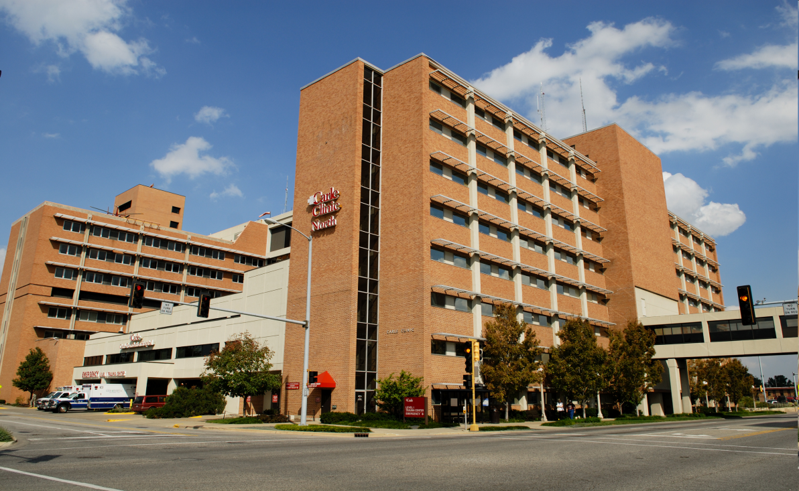
Carle Hospital Policy and Protocols Related to Heart Failure
Group Project 4:
Grace Suh
Brianna Pieri
Samantha Hammis
Jessica Cooper
Anna-Joy Schneeloch
http://www.carle.org/about/newsroom/media-photos.aspx

Slide 2
Introduction
Overview of Carle Hospital
The Joint Commission’s Standards for Heart Failure
Research Articles
Carle’s Performance
Carle’s Protocols for Heart Failure
Carle’s Protocols Vs. Joint Commission’s Protocols
Notes:
The purpose of the presentation is to provide information about Carle hospital’s evidence based practice regarding heart failure (HF) core measures. In this presentation, these students will provide background information about Carle hospital. Next, these students will give information about the Joint Commission’s standards for heart failure. In addition, a list of research articles that contributed to the development of the heart failure core measure will be provided. Then, these students will summarize Carle hospital’s performance related to heart failure, and provide an overview of Carle hospital’s protocols for heart failure. Finally, these students will compare Carle hospital’s protocols with the protocols of the Joint Commission.

Slide 3
Overview of Carle Hospital
Carle Hospital is a 325 bed hospital with a Level I trauma center and offers Level III perinatal services
Located in Urbana, Illinois
In 2009, Carle admitted more than 19,900 patients and treated more than 56,700 patients in their Emergency Room
Not-for profit and Magnet Hospital
Notes:
Carle Hospital is also known as Carle Foundation Hospital which is a not-so-profit hospital located in Urbana, Illinois. It is the region’s only Level I trauma unit with a 325 bed tertiary care facility comprised of more than 25 departments which including surgical, cardiac, neurological, and neonatal intensive care units. (Carle Foundation Hospital, 2010)

Slide 4
The Joint Commission’s Standards for Heart Failure
Heart Failure Measure Sets:
HF-1: Discharge Instructions
Activity level, diet, discharge medications, weight monitoring, etc.
HF- 2: Evaluation of LVS Function
LVS (left ventricular systolic)
HF-3: ACEI or ARB for LVSD
ACEI (angiotensin-converting enzyme inhibitor)
ARB (angiotensin receptor blocker)
LVSD (left ventricular systolic dysfunction)
HF-4: Adult Smoking Cessation Advice/Counseling
Notes:
The Joint Commission has four measure sets for HF. First, HF- 1 entails information regarding discharge instructions. Second, HF-2 is a core measure for evaluation of left ventricular systolic (LVS) function. Third, HF-3 describes ACEI or ARB for LVSD. Finally, HF-4 gives information about adult smoking cessation advice/counseling. Citation?
HF-1 requires that all patients that are discharged with HF receive necessary discharge instructions regarding follow-up care. The Joint Commission and Centers for Medicare and Medicaid Services (2010) specifications manual requires that the discharge instructions encompass “activity level, diet, discharge medications, follow-up appointment, weight monitoring, and what to do if symptoms worsen” (p. HF-1-1). These authors state that the rationale for this measure is that “patient non-compliance with diet and medications is an important reason for changes in clinical status” (p. HF-1-1).
As for the second measure, HF-2, the Joint Commission and Centers for Medicare and Medicaid Services (2010) specifications manual requires that all patients with HF undergo an evaluation of LVS function “before arrival, during hospitalization, or is planned for after discharge” (p. HF-2-1). These authors state the rationale for the measure is to identify patients that have low LVS function, in order to adequately treat them with the appropriate medications to reduce the chance of death. Jessup (2009) and HFSA (2006) state that the evaluation of LVS function is the most important diagnostic test for HF patients (as cited in The Joint Commission and Centers for Medicare and Medicaid Services specifications manual, 2010, p. HF-2-1).
The third measure, HF-3, requires that all HF patients who have left ventricular systolic dysfunction (LVSD) be prescribed angiotensin-converting enzyme inhibitor (ACEI) or angiotensin receptor blocker (ARB) medications at discharge. The Joint Commission and Centers for Medicare and Medicaid Services (2010) specifications manual describes LVSD as “ as chart documentation of a left ventricular ejection fraction (LVEF) less than 40% or a narrative description of left ventricular systolic (LVS) function consistent with moderate or severe systolic dysfunction” (p. HF-3-1). These authors explain that ACEI or ARB medications will reduce the death rate in HF patients with LVSD (p. HF-3-1).
Lastly, the Joint Commission and Centers for Medicare and Medicaid Services (2010) specifications manual requires that patients with HF that smoke receive education regarding smoking cessation or counseling for smoking cessation for the fourth core measure HF-4. These authors state “a smoker is defined as someone who has smoked cigarettes anytime during the year prior to hospital arrival.” (p. HF-4-1). In addition, these authors explain the rationale for this measure is that “ smoking cessation reduces mortality and morbidity in all populations [and] patients who receive even brief smoking-cessation advice from their care providers are more likely to quit” (p. HF-4-1).

Slide 5
Research Articles
Heart Failure Society Of America. Development and implementation of a comprehensive heart failure practice guideline. J Card Fail 2006 Feb;12(1):e3-9.
Hunt S., Abraham W., Chin M., Feldman A., Francis G., Ganiats T., Jessup M., Konstam M., Mancini D., Michl K, Oates J., Rahko P., Silver M., Stevenson L., Yancy C. 2009 focused update incorporated into the ACC/AHA 2005 guidelines for the diagnosis and management of heart failure in adults. J Am Coll Cardiol 2009 April 14;53(15):e1-90.
Notes:
According to U.S. Department of Health and Human Services (date) , the shown articles were used in order to develop the core measures stated by the Joint Commission regarding policies for heart failure patients in the hospital setting.

Slide 6
More Research Articles
Shaddy RE, Webb G. Applying heart failure guidelines to adult congenital heart disease patients. Expert Rev Cardiovasc Ther 2008 Feb;6(2):165-74.
Jeacocke D, Sprogis A, Lowe J, Heller R. Adopting guideline review criteria as part of a reginal project to improve heart failure management in general practice. Br J Clin Govern 2002;7(2):104-11.
Notes:
According to U.S. Department of Health and Human Services (date) , the preceding articles were used in order to develop the core measures stated by the Joint Commission regarding policies for heart failure patients in the hospital setting.

Slide 7
Heart Failure Core Measure: Discharge Instructions
Joint Commissions top decile in 2009 was 99.1%
In 2008 the average was 65.6% raising to an average of 89.3% in October of 2009
Process Improvement Initiatives for Discharge Instructions:
02/09 Met with Case Management staff to discuss metric for improvement
05/09 CHF education PI project on Rogers 8
05/10 HF booklets for AICD placements for HF discussed at Cardiology Staff Meeting
Notes:
Discharge instructions are to be given to every heart failure patient before they leave the hospital to instruct them on how to manage their chronic condition (Quality Indicators for Congestive Heart Failure, 2010). In 2009 only 89.3% of patients received these instructions. Carle plans to improve this percentage by giving each patient a booklet entitled “Living Well With Heart Failure” and documenting the action (CHF Core Measure CC-1, 2010).
The distribution of hospital quality scores is categorized into deciles to identify top performers for each condition. Hospitals in 20% of performers (first two deciles) for a give condition are given a financial payment for as a reward for the quality of their care. Hospitals in the top decile receives 2% bonus of their medicare payments for the measured condition, and hospitals in the second decile are paid in 1% bonus. If by the third year the hospital does not show improvements higher than the baseline, their Medicare payments will be adjusted. (Joint Commission Resources, 2005, p. 118).
You obtained some amazing and very interesting information here! You took the treasure hunt to a new level.

Slide 8
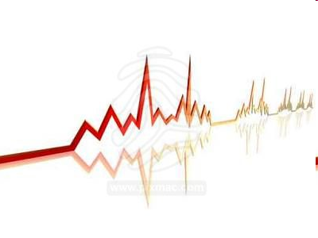
Heart Failure Core Measure: LVF
Joint commission top decile in 2009 was 100%
LVF assessment average in 2008 and 2009 was 100%
http://www.pixmac.com/picture/ekg+linie+3/000000187369
Notes:
This core measure states that each heart failure patient is to receive a left ventricular systolic function test to allow physicians to evaluate the extent of failure in each patient. This test allows physicians to individualize care to the particular needs to each client (Quality Indicators for Congestive Heart Failure, 2010). In 2008 and 2009 100% of Carle’s heart failure clients received this test (CHF Core Measure CC-1, 2010).

Slide 9
Heart Failure Core Measure: ACEI/ARB for LVSD
Joint Commissions top decile for 2009 was 100%
In 2008 the average was 86.3% rising to an average of 94.1% in February of 2009
Process Improvement Initiatives for ACEI/ARB for LVSD:
05/09 Carle implemented a best practice alert in EPIC
06/09 Provided Core Measure documentation training to residents
Notes:
This core measure states that each heart failure client should be given a prescription for an ACE inhibitor or ARB before being discharged from the hospital (Quality Indicators for Congestive Heart Failure, 2010). These medications are highly beneficial for heart failure patients and each patient should be evaluated for the proper medication before they leave the hospital. In 2009 94.1% of patients received a prescription for a one of these medications to help them control their heart failure (CHF Core Measure CC-1, 2010). Carle has implemented training sessions to try to increase this number.

Slide 10
Heart Failure Core Measure: Smoking Cessation Counseling
Joint Commissions top decile in 2009 was 100%
In 2008 and 2009 Carle Hospital had an average of 100%
Ranked in top decile for both 2008 and 2009
Notes:
This core measure requires all congestive heart failure patients to be given information regarding smoking cessation before they are discharged from the hospital (Quality Indicators for Congestive Heart Failure, 2010). In 2008 and 2009 100% of patients at Carle hospital received this information (CHF Core Measure CC-1, 2010)

Slide 11

Overview of Carle’s Protocols: Discharge Teaching
http://www.davita.com/diet-and-nutrition/diet-basics/exercise-for-people-with-chronic-kidney-disease/a/497
Activity level
Diet
Medications
Follow-up appointment
Monitoring daily weight
What to do if symptoms get worse
Notes:
Before patients leave the hospital, the staff is responsible for providing specific discharge instructions. These include information regarding activity level instructions including what patients can and cannot do; diet instructions including what patients should, and shouldn’t eat or drink; medications; follow-up appointment; monitoring daily weight; and what to do if symptoms get worse. This information is meant to help patients manage their symptoms after discharge. Carle gives written instructions to the patient or caregiver at discharge or during the hospital stay. (Carle Foundation Hospital, 2010).

Slide 12
Overview of Carle’s Protocols – Left Ventricular Function Testing
Evaluation of the Left Ventricular Systolic (LVS) Function
Other ways to determines heart status:
Medical history
Physical Examination
Auscultating heart sounds
Diagnostic tests
EEG, chest x-ray, blood work, ECG
Notes:
Carle uses the test called evaluation of the left ventricular systolic (LVS) function to determine how well the heart is pumping. The LVS function test determines whether the left side of the heart is pumping properly. Carle indicates that this test is important because it determines what area of the heart is affected. Other ways Carle determines how well the heart is pumping include the patients’ medical history, a physical examination, auscultating heart sounds, and diagnostic tests including an electrocardiogram, chest x-ray, blood work, and echocardiogram. (Carle Foundation Hospital, 2010).

Slide 13
Overview of Carle’s Protocols – ACE Inhibitors or ARBs
ACE Inhibitors | ARBs
For heart attack and/or heart failure | For decreased heart function
Notes:
To treat patients with heart failure, Carle uses ACE inhibitors and ARBs. Carle indicates that ACE inhibitors and ARBs are beneficial in treating patients with HF and a decreased function of the left side of the heart. In addition, Carle indicates that using these medications after a heart attack reduces the risk of death from future heart attacks. Carle indicates that using ACE inhibitors and ARBs helps the heart lower blood pressure and reduces the work the heart has to perform. Because the mechanism of action is different between ACE inhibitors and ARBs, the doctor determines which medication patients will be prescribed. For patients who have had a heart attack and/or heart failure, Carle prescribes ACE inhibitors . Patients who have a decreased heart function, Carle prescribes ARBs. (Carle Foundation Hospital, 2010).

Slide 14

Overview of Carle’s Protocols – Smoking Cessation Counseling
Before Discharge:
Patients receive smoking cessation counseling
http://www.yroma.com/wp-content/uploads/2010/02/stop-smoking.gif
Notes:
Before discharge, patients are given information to help them quit smoking. Carle indicates that smoking cessation counseling is important because smoking increases the risk of developing heart failure by increasing clots in blood vessels and worsening heart disease. (Carle Foundation Hospital, 2010).

Slide 15
Carle’s Protocols vs. Joint Commission Core Competencies
Discharge instructions
Joint Commission (2010) states that all patients or caregivers must be presented with information at the time of discharge.
Carle Foundation Hospital (2010) states that patients will be given information prior to or at the time of discharge regarding heart failure.
Notes:
The Joint Commission (2010) addresses many issues in the discharge teaching that should be given to heart failure patients. These areas that are addressed include activity level, discharge medications, diet, follow-up appointments, monitoring of patient’s weight, and what to do if symptoms get worse. By giving the patient’s the proper education regarding discharge instructions, patients can be more aware of the consequences of not following dietary and activity restrictions, and the importance of monitoring of a patient’s weight. (Joint Commission, 2010)
Carle Foundation Hospital (2010) also includes many of the same areas in the discharge teaching. The areas that Carle Foundation Hospital focuses on include daily weight, what the patient should and shouldn’t eat, what the patient is allowed to drink, what to do if symptoms worsen, and information on follow-up appointments. This information is presented to the patient either during their stay at the hospital or at the time of discharge. (Carle Foundation Hospital, 2010)
In comparing the protocols of Carle Foundation Hospital and the core competencies written by the Joint Commission, there are many similarities. Both organizations address the same areas of interest in the discharge instructions as well as how they present the information, written information. The only difference found in the two policies is the fact that Carle Foundation Hospital presents the information to the patient either during the hospital stay or at the time of discharge, while Joint Commission presents the information only at the time of discharge.

Slide 16
Carle’s Protocols vs. Joint Commission Core Competencies
Evaluation of LVS Function
Joint Commission (2010) states that left ventricular systolic (LVS) function must be evaluated on heart failure patients either before, during, or after hospitalization.
Carle Foundation Hospital (2010) states that evaluation of LVS function will be completed, however no specific time period is given.
Notes:
According to the Joint Commission (2010), left ventricular systolic (LVS) function is tested for all heart failure patients. This testing can be done before hospitalization, during hospitalization, or scheduled to be completed after discharge. This test will give the health care providers an idea of what medications patients should be prescribed based on the results of the LVS functioning test. (Joint Commission, 2010)
Carle Foundation Hospital (2010) states that LVS functioning should be evaluated for every heart failure patient, however, it is not clear as to when this testing should be done. This test is used to see how well the left side of the heart is functioning. Other measures of how the heart is functioning are also used at Carle Foundation Hospital, including medical history of the patient, a physical examination, auscultating heart sounds, and other tests. (Carle Foundation Hospital, 2010)
While Carle Foundation Hospital does not specify a time when LVS functioning should be evaluated as the Joint Commission does, the protocol and the core competency have the same description and the same purpose for heart failure patients, determining if the patient’ s heart if functioning properly.

Slide 17
Carle’s Protocols vs. Joint Commission Core Competencies
ACEI or ARB for LVSD
The Joint Commission (2010) prescribes ACEI or ARB’s for patients with heart failure and left ventricular systolic dysfunction (LVSD) at the time of discharge.
Carle Foundation Hospital (2010) states that patients with heart failure and LVSD should be prescribed ACE inhibitors or ARB’s before leaving the hospital.
Smoking Cessation Counseling
The Joint Commission (2010) provides counseling for adult smokers with heart failure while hospitalized.
Carle Foundation Hospital (2010) counsels adult smokers with heart failure.
Notes:
The Joint Commission (2010) describes left ventricular systolic dysfunction (LVSD) as a left ventricular ejection fraction (LVEF) of less than forty percent. ARB and ACEI’s have been shown to be very effective in the treatment of LVSD for heart failure patients. Thus, the Joint Commission prescribes these medications at the time of discharge. (Joint Commission, 2010)
Carle Foundation Hospital (2010) prescribes ACE inhibitors or ARB’s before a patient with heart failure and LVSD leave the hospital. The rationale for this protocol states that early treatment with these medications can reduce the chance of a heart attack in the future for patients with heart failure. If these medications are prescribed before the patient is discharged, the compliance will be increased. (Carle Foundation Hospital, 2010)
These protocols and core competencies state very similar goals and treatments. Both Carle Foundation Hospital and the Joint Commission prescribe ARB and ACE inhibitors for the same condition and at the same time, before the patient is discharged from the hospital.
The Joint Commission (2010) states that counseling will be provided to all adult smokers while in the hospital and diagnosed with heart failure. The definition used of a smoker is any patient who has smoked a cigarette within the past year prior to being hospitalized. If the counseling leads to smoking cessation, those patients will have decreased mortality rates. (Joint Commission, 2010)
Carle Foundation Hospital (2010) ensures that patients with heart failure who smoke cigarettes receive counseling regarding their smoking habits. They state that smoking has not only been shown to cause heart disease and heart attacks, but also lung disease and mortality. Therefore, with counseling, smokers can be aware of the consequences of their choices. (Carle Foundation Hospital, 2010)
Both Carle Foundation Hospital and the Joint Commission have very similar reasoning and policies regarding the counseling of smokers while hospitalized with heart failure. The consequences are explained to the patient and information is given regarding how smoking can affect the patient’s life.

Slide 18
Summary
The Joint Commission’s Protocols:
HF-1: Discharge instructions
HF-2: LVSD
HF-3: ACEIs or ARBs
HF-4: Smoking cessation
Carle Hospital’s Protocols:
Activity Level & Diet
Cardiac Functioning
Medications (ACEIs & ARBs)
Discharge Instructions
Notes:
In conclusion, these students used Carle hospital, which is a level II trauma center located in Urbana, Illinois, for the basis of this evidence based nursing research (add) presentation. The heart failure core measures were compared between the Joint Commission and Carle Foundation Hospital. The core measures used by the Joint Commission are: HF- 1, which entails information regarding discharge instructions; HF-2, which measures left ventricular systolic (LVS) function; HF-3, which describes ACEI or ARB for LVSD; and HF-4, which gives information about adult smoking cessation advice/counseling. The core measures used by Carle Hospital are: activity level, diet, medications, follow- up appointments, daily weight monitoring, and what to do if symptoms worsen.
The Joint Commission’s and Carle Hospital’s protocols were very similar to one another. For instance, both the Joint Commission and Carle Hospital entail all of the same principles into their discharge teaching. Also, both organizations teach about weight loss, cardiac monitoring, diet, exercise, and smoking cessation. In addition, both organizations use the same medications to treat LVSD (ARBs and ACEIs). The only discrepancy noted was that Carle hospital gives much of their education and discharge instructions prior to discharge, whereas the Joint Commission suggests giving them at the time of discharge.

Slide 19
References
Carle Foundation Hospital . (2010). Quality indicators for congestive heart failure. Retrieved from http://www.carle.org/about/why-choose/quality/congestive-heart-failure.aspx
The Joint Commission, & Centers for Medicare and Medicaid Services [CMS]. (2010). Specifications manual for national hospital inpatient quality measures discharges 10-01-10 (4Q10) through 03-31-11 (1Q11) manual (Version 3.2), pp. HF1-4. Retrieved from http:// http://www.jointcommission.org
U.S. Department of Health and Human Services. (DATE) National guideline clearinghouse: Annotated bibliographies. Retrieved November 29, 2010, from http://guidelines.gov/annotated-bibliographies/index.aspx

Slide 20
References (continued)
Joint Commission on Accreditation of Healthcare Organizations. (2005). Overcoming performance measurement challenges for hospitals. Oakbrook Terrace, IL: Joint Commission Resources. Retrieved on December 1, 2010, from http://books.google.com
Carle. November 30, 2010. CHF Core Measure. Urbana, Illinois: Carle Foundation Hospital.

