Slide 1
Evidence-Based Practice Related to Cardiac Patients at SwedishAmerican Hospital
Jamie Eveland
Melissa Kersey
Brett Reichart
Anna Loveland
Allison Brunk
Notes:
Just a suggestion…it will be helpful to you for future reference if you also include the college/course name and date on the title page.

Slide 2
Introduction
SwedishAmerican Hospital in Rockford, IL
Overview of the hospital
The Joint Commission core measure standards
List of research articles
Hospital’s profile and performance
Hospital’s protocols
Comparing protocols to those of The Joint Commission
(SwedishAmerican Hospital, 2010, Heart Hospital)
Notes:
SwedishAmerican Hospital in Rockford, IL, is a hospital devoted to providing excellent care among its patients. “The Heart Hospital at SwedishAmerican is the region’s only hospital that is devoted to hearts” (SwedishAmerican, 2010, Heart Hospital). However, in order for this hospital to maintain such a high profile, SwedishAmerican must sustain and use the current evidence-based practices involving cardiac patients. The purpose of this lecture is to explain how SwedishAmerican hospital uses evidence-based practice as it relates to cardiac patients and compared to standards developed by The Joint Commision via discussion the overview of the hospital, The Joint Commission core measure standards, the list of research articles cited by the Joint Commission, the summary of the hospital’s performance related to the core meausres, the hospital’s protocols, and comparing those protocols to those of The Joint Commission. (SwedishAmerican Hospital, 2010, Heart Hospital)-THIS SOURCE IS NOT IN THE REFERENCES PAGE.

Slide 3
Overview of the Hospital
“SwedishAmerican Hospital has three hundred and thirty three beds, full-service, non-profit hospital serving the greater Rockford region, northern Illinois and southern Wisconsin” (SwedishAmerican Health System, 2010, p. 1).
“SwedishAmerican has an exclusive affiliation with UW Health and is a teaching hospital that hosts the University of Illinois College of Medicine” (SwedishAmerican Health System, 2010, p. 1)
Notes:
Headquartered in Rockford, Illinois, SwedishAmerican Health System serves twelve counties in northern Illinois and southern Wisconsin. The reason for interest of researching this hospital came due to the hospitals focus of improving the cardiac aspects of care. The hospital has gone to great lengths to improve the care of patients that suffer from cardiac problems such as heart failure. (SwedishAmerican Health System, 2010)-WHICH SPECIFIC REFERENCE PAGE SOURCE?

Slide 4
The Joint Commission: Heart Failure Core Measure Standards
Discharge instructions
Evaluation of LVS Function
ACEI or ARB for LVSD
Adult Smoking cessation Advice/Counseling
(The Joint Commission, 2010, Core Measure Sets)
Notes:
The Joint Commission’s core measure standards for heart failure include four parts: discharge instructions, evaluation of left ventricular systolic (LVS) function, ACEI or ARB for LVSD, and adult smoking cessation advice/counseling. The main focus for discharge instructions is to compare, compile, and explain discharge medication lists. A comparison is made to check brands and trade names vs. generic names, medications listed that have the same action, if the patient is on insulin, discrepancies in dosage or frequency, required physician signatures present, and extra medications listed. This also includes instructions for patient diet, activity, follow-up, weight monitoring, and what to do if symptoms worsen. Evaluation of LVS function refers to making sure that the left side of the heart is pumping or at the best level possible. In addition, all evaluations must be documented. The third core measure, ACEI or ARB for LVSD, is to evaluate whether or not the patient is discharged on an Angiotensin Coverting Enzyme Inhibitor or an Angiotensin Receptor Blocker; however, if no ACEI or ARB is prescribed, the patient is given a reason for this decision. The adult smoking cessation advice/counseling core measure states that if the client is a smoker, upon discharge they are given advice on the advantages of smoking cessation. If a client would like additional information or would like smoking cessation counseling, arrangements can be made at this time. (The Joint Commission, 2010, Core Measure Sets)

Slide 5
Research Articles Used to Develop Core Measures
As listed on The Joint Commission website:
American College of Cardiology and American Heart Association (ACC/AHA):Guidelines for the Evaluation and Management of Chronic Heart Failure in the Adult, http:/www.acc.org/clinical/guidelines/failure/hf_index.htm. Accessed on December 3, 2001.
American College of Cardiology/American Heart Association (ACC/AHA):Guidelines for the Evaluation and Management of Chronic Heart Failure in the Adult, http:/www.acc.org/clinical/guidelines/failure/hf_index.htm. Accessed on December 3, 2001.
Heart Failure Society of America (HFSA); HFSA Guidelines for Management of Patients With Heart Failure Caused by Left Ventricular Systolic Dysfunction – Pharmacological Approaches. http://www.hfsa.org/pdf/lvsd_heart_failure.pdf. Accessed December 2001.
(The Joint Commission, 2010, p. 3)
Notes:
The references listed provide an overview “intended to summarize the challenges and decisions that impacted the development and testing of acute myocardial infarction (AMI) and heart failure (HF) hospital core measures, as well as to provide the clinical rationale that supported the measures” (The Joint Commission, 2010, p. 3).WHAT IS THE SPECIFIC JOINT COMMISSION REFERENCE SOURCE?

Slide 6
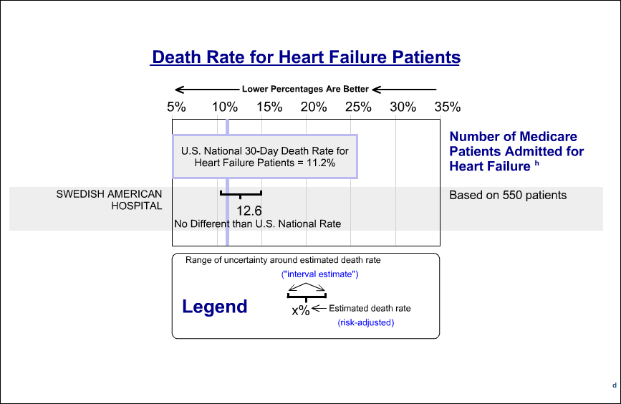
Hospital Profile
(Readmission graphs, 2010)
Notes:
This graph represents the data collected between July 01, 2006, and June 30, 2009, for SwedishAmerican Hospital. The graph shows that the SwedishAmerican Hospital has a 1.4% more death rate for patients with heart failure as an estimate, than the average for the U.S. National Rate. With the uncertainty interval, it is within the normal range for the U.S. (USDHHS, Readmission graphs, 2010)

Slide 7
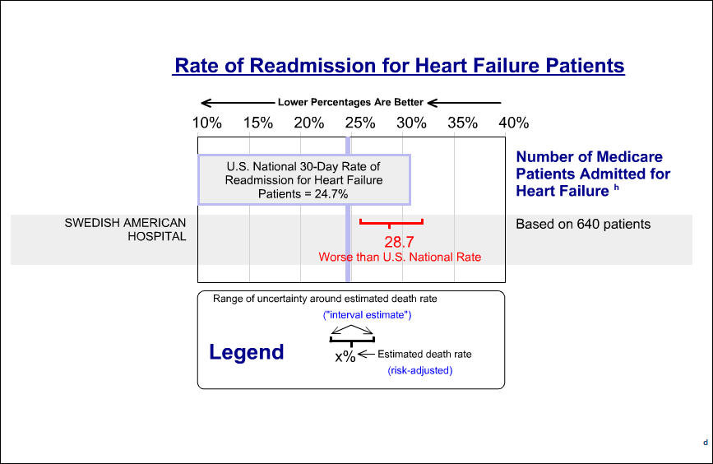
Continuation of Hospital Profile
(Readmission graphs, 2010)
Notes:
This graph represents the data collected between July 01, 2006, and June 30, 2009, for SwedishAmerican Hospital. In this graph, the results show that the average estimated readmission rates for patients with heart failure, is worse than the average in the U.S. This is represented by the red font. The average in the U.S. is 24.7%, where the American Hospital’s average is around 28.7%. The interval estimate for this data does not contain the average within it (the blue line should fall within the red ). (USDHHS, Readmission graphs, 2010)

Slide 8
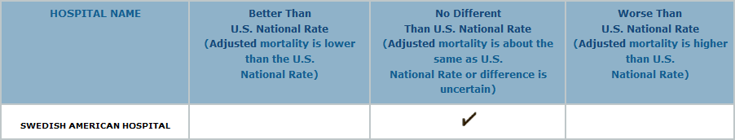
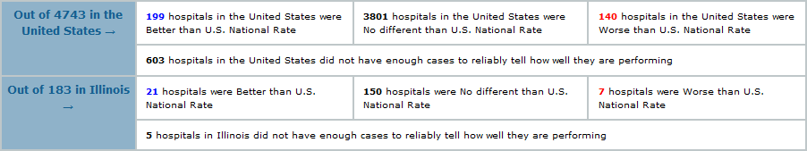
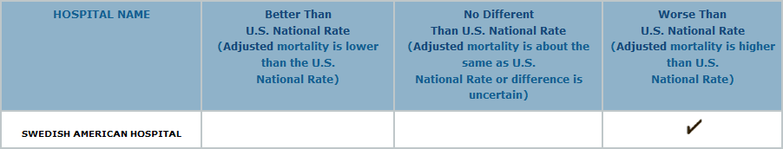
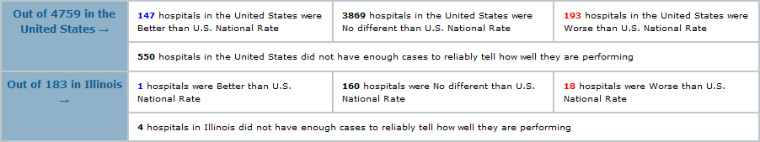
Continuation: Results
Mortality
Re-admission
(Readmission graphs, 2010)
Notes:
The results confirm that the SwedishAmerican Hospital is no different from the U.S. average for mortality, but it does fall into the category for “worse” than the average on readmission rates. Of the 4743 hospitals that were studied for the mortality rate, 3801 hospitals were in the average category covering 80.1% of the statistic. The SwedishAmerican Hospital was in this category. Though, of the 4759 hospitals studied for readmission rates, which covered 81.2%, the SwedishAmerican Hospital fell just below this number. They were one of the 193 hospitals that were below, which consisted of 4%. (USDHHS, Readmission graphs, 2010)

Slide 9
Hospital Protocols Addressing the Core Measures of Heart Failure
Daily patient education
Congestive heart failure coordinator
Diabetic educator
Cardiovascular coordinator
Dietitian
On-site education center
Extensive list of classes, events, and support groups
(SwedishAmerican Hospital- Rockford, IL., 2010, Hospital-Data.com: Hospital and Nursing Home Profiles)
Notes:
The Swedish American Health System provides patient education on a daily basis. Education is provided by a congestive heart failure coordinator, diabetic educator, cardiovascular coordinator, dietitian, and others. In addition, patients have access to an on-site education center that provides them with access to multiple different sources and media for their personal learning use. Patients are provided with an extensive list of classes, events, and support groups to attend during care and after discharge to help patients stay on track and learn about their situations and connect with others who are experiencing similar situations, as well. (Swedish American Hospital- Rockford, IL., 2010, Hospital-Data.com: Hospital and Nursing Home Profiles)

Slide 10
Continuation of Hospital Protocols
Affiliation with Preventative Medicine Research Institute
Discharge instructions
Medication regimen
Back up education
Quality and Safety Program
Goal: promote the best care
(SwedishAmerican Hospital- Rockford, IL., 2010, Hospital-Data.com: Hospital and Nursing Home Profiles)
Notes:
The hospital is affiliated with the Preventative Medicine Research Institute that provides information and research on the effects of diet and lifestyle choices for their patients. Through this organization, the hospital works to educate patients on discharge instructions, medication regimen prescribed prophylactically and upon discharge, and provides research to back up education given to patients on smoking cessation and other lifestyle changes. This hospital has a Quality and Safety Program in place. The goal of this program is to promote the best care before, during, and after admission to the hospital. A main focus for this group is to reduce medication error and provide the safest healthcare environment possible. (Swedish American Hospital- Rockford, IL., 2010, Hospital-Data.com: Hospital and Nursing Home Profiles)

Slide 11
Core Measures for HF Swedish American State Average National Average
____________________________________________________________________________________
1.Given discharge instruction 97% 71% 66%
--------------------------------------------------------------------------------------------------------------------------
2.Eval of LVS function 99% 90% 85%
--------------------------------------------------------------------------------------------------------------------------
3.ACEI or ARB for LVS 93% 85% 84%
--------------------------------------------------------------------------------------------------------------------------
4.Smoking Cessation A/C 98% 86% 86%
--------------------------------------------------------------------------------------------------------------------------
(SwedishAmerican Hospital- Rockford, IL., 2010, Hospital-Data.com: Hospital and Nursing Home Profiles)
Notes:
At the Swedish American Hospital, 99% of patients are given an evaluation of LVS function, 98% of heart failure patients are given smoking cessation advice/counseling, 93% of heart failure patients are give and ACEI or ARB for LVSD, and 97% of patients are given discharge instructions. Furthermore, compared to state and national averages for providing the four core measures of heart failure, this hospital has a high average. (Swedish American Hospital- Rockford, IL., 2010, Hospital-Data.com: Hospital and Nursing Home Profiles)

Slide 12
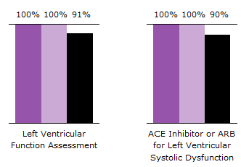

Quality Performance
(Swedish American Health System, 2010, Quality Performance)
Notes:
In these two charts, the SwedishAmerican Hospital is compared to the top 10% and 50% of other hospitals in the categories of Left Ventricular Function and ACE Inhibitor or ARB’s for medication of choice. This data was gathered from April 2010 to June 2010. According to these charts, the SwedishAmerican Hospital is meeting the standards in these two categories. The top 10% of the hospitals with this data, teach about the two topics 100% of the time. The SwedishAmerican Hospital solidly teaches what needs to be taught 100% of the time as well, which places them in the above 10%. (Swedish American Health System, 2010, Quality Performance)

Slide 13
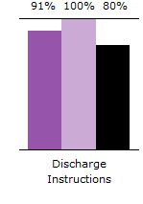
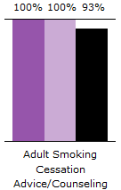
Continuation of Quality Performance
(Swedish American Health System, 2010, Quality Performance)
Notes:
In the two charts above, the SwedishAmerican Hospital released information about their discharge instructions and told patients about cessation of smoking. This data was gathered from April 2010 to June 2010. After someone had heart problems, to help the patient out, the hospital always did a smoking cessation program. They placed in the top 10% of hospitals who routinely do this. In the chart for the discharge instructions, the SwedishAmerican Hospital wasn’t 100% of the time telling people about discharge. They were doing it around 91%, which is still more than 50% of the hospitals. This is the only category that they weren’t giving the patients 100% of what they needed to meet the Joint Commissions standards. All of the categories they are doing better than average, except for the discharge instructions. (SwedishAmerican Health System, 2010, Quality Performance)

Slide 14
Summary
Improve cardiac patient care
Four heart failure core measures standards
The death rate equals that of the U.S. norm
Readmission rates are worse than the U.S. norm
Addressing protocols for heart failure patients
Meets standards for quality performance
Room for further improvement
Notes:
In conclusion, SwedishAmerican Hospital strives to improve the care among cardiac patients. In addition, the four core measures standards for heart failure by The Joint Commission, which include discharge instructions, evaluation of LVS function, ACE Inhibitor or ARB for LVSD, and adult smoking cessation advice/counseling, where portrayed in several research articles to demonstrate the challenges and decisions one faces when developing and testing these standards(The Joint Commission, 2010, Core Measure Sets; p. 3). However, although the death rate is equal to that of the U.S. average, the readmission rates at SwedishAmerican Hospital are worse than the norm (USDHHS, Readmission graphs, 2010). Therefore, SwedishAmerican Hospital has addressed several protocols for their patients who are admitted for heart failure, such as daily patient education, on-line education centers, extensive support groups, classes, and events (Swedish American Hospital- Rockford, IL., 2010, Hospital-Data.com: Hospital and Nursing Home Profiles). After evaluating their quality of performance, SwedishAmerican Hospital has met the protocols better than average compared to the top 10% and top 50% of all of the hospitals submitting data (Swedish American Health System, 2010, Quality Performance). Furthermore, the hospital, like most, has room for further improvement to better decrease the readmission rates among cardiac patients, and to teach 100% effective patient education. Without evidence-based practice, non of the previous statistics would have been known, and SwedishAmerican Hospital would not have known were improvement and focus was needed.

Slide 15
References
The Joint Commission. (2010). A comprehensive review of development and testing for national implementation of hospital core measures. Retrieved December 5, 2010, from http://www.jointcommission.org/assets/1/18/A_Comprehensive_Review_of_Development_for_Core_Measures.pdf
Joint Commission, The. (2010). Core measure sets. Specifications Manual for National Hospital Inpatient Quality Measures. (3.2). The Joint Commission. Retrieved on December 4, 2010, from www.jointcommission.org.
SwedishAmerican Hospital- Rockford, IL. (2010a). Hospital-Data.com: Hospital and Nursing Home Profiles. Retrieved on December 4, 2010, from www.Hospital-data.com.
SwedishAmerican Health System. (2010b). Quality Performance. Retrieved from http://www.swedishamerican.org/quality/performance/heart_failure.cfm
SwedishAmerican Health System. (2010c). Trust the best. Retrieved on December 1, 2010, from http://www.swedishamerican.org/heart_hospital/
Readmission graphs. (2010, December). Retrieved from U.S. Department of Health and Human Services website: http://www.hospitalcompare.hhs.gov/hospital-profile.aspx?pid=140228&lat=42.25019&lng=-89.08038&
Notes:
The author for the last reference source is: U.S. Department of Health & Human Services.
APA prefers that when we have reference sources by the same author, that we identify them as such: SwedishAmerican Hospital. (2010a)……..(2010b)…..etc. I edited your reference sources above to illustrate this. Obviously this will change your parenthetical citations in the text. You could have done this with the Joint Commission sources also.

