Slide 1
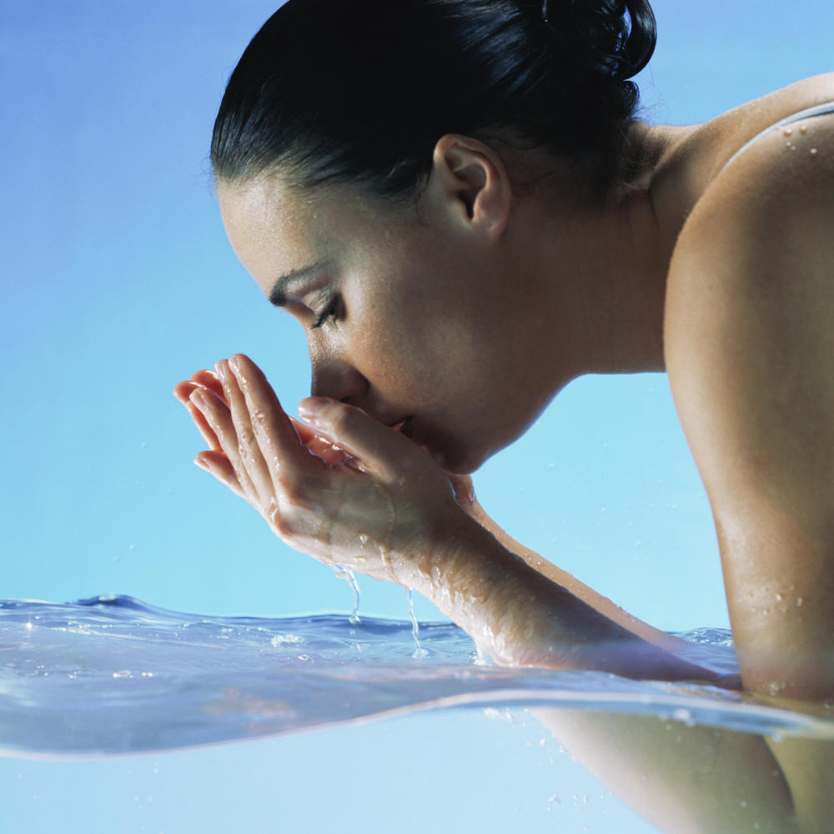
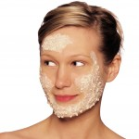
Dove, 2011.
Scrumptious Tidbits, 2011.
“The key to beautiful skin is taking care of it.”

Slide 2
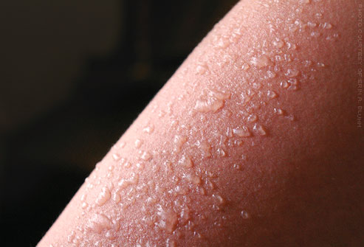
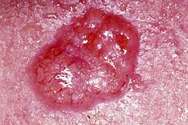
Wikipedia, 2011.
“Is the tan really worth the risk?”
Sunburn Home Remedies, 2011.

Slide 3

Causes of Skin Damage (Derrick, n.d.):
Sun Exposure
Smoking
Pulling and rubbing skin
Don’t forget to moisturize
Sporadically taking care of skin

Slide 4
“A Rainbow is only as beautiful, as the colors it is composed of.”
Arika Kay
Brittany
Staci
Jessica
Samantha
Sammi Jo

