Slide 1
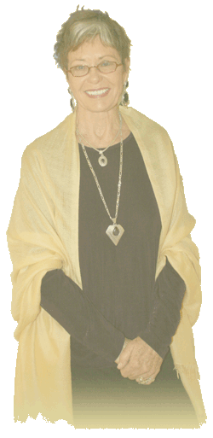
Jean Watson
Lakeview College of Nursing
RN 200 – Fall, 2010
Lori Lindsey-Clarkston, RN
Lori Turner, RN
Michael Kruse, RN
Nicole Steele, RN
Rachel Davis, RN
Sheila Roth, RN
Tenika McMillan, RN
Theory of Transpersonal Care
http://watsoncaringscience.org

Slide 2
Jean Watson
1940: Born in Appalachian Mountains of West Virginia.
1958-61: RN diploma, Lewis-Gale School Nursing, Roanoke, VA.
1962-64: BSN at University of Colorado, Boulder, CO
1964-66: M.S. Psychiatric Mental-Health nursing;
  Minor: Psychology, UOC Medical Center, Denver, CO
1969-70: Graduate School, University of Colorado, Boulder, CO
1969-73 Ph.D. Educational Psychology / Counseling UOC, Boulder, CO
Notes:
Jean Watson was born in the 1940 in West Virginia. She started her education in nursing and earned her R.N. Diploma from Lewis-Gale School of Nursing in in 1961. After graduation she went on to obtain her B.S. in nursing from the University of Colorado in Boulder in 1964. In 1966 she earned her M.S. in psychiatric mental-health nursing with a minor in psychology from the University of Colorado Medical Center in Denver. From 1996-1973 she worked on and received her Ph.D. in Education Psychology and counseling from the University of Colorado in Boulder. While working on her Ph.D. Watsons graduate study was focused on social and clinical psychology.(Watson Caring Science Institute, n.d)

Slide 3
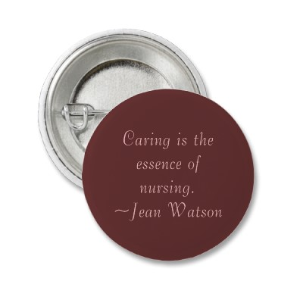
Jean Watson
Dr. Jean Watson;
  Distinguished Professor of Nursing.
  Holds an endowed Chair in:
    Caring Science at the University of Colorado, Denver.
    Anschutz Medical Center Campus.
Latest activities include:
  Founder and Director of non-profit foundation:
    Watson Caring Science Institute.
www.zazzle.com/caring_is...544655093/
Notes:
Jean Watson is still practicing at the University of Colorado Denver where she is a Distinguished Professor of Nursing and Endowed Chair in Caring Science. Watson is a published writer with of 14 books on caring. Watson is a distinguished lecturer, she has presented to numerous university's around the world. Watson is the founder of the original Center for Human Caring in Colorado. In 2008, Watson founded a new non-profit foundation called Watson Caring Science Institute, where she serves as the director.(Watson Caring Science Institute, n.d)

Slide 4
Development of Watson's theory
Developed in 1979, revised in 1985 and 1988b.
Watson began to develop research because she felt:
  Caring stance threatened by tasks and technology demands.
  Believed main focus should be on carative factors.
Focus of research on human caring and loss.
  Attempts define outcome nursing activity regarding humanistic aspects.
Notes:
Watson’s theory was “developed in 1979, and revised in 1985 and 1988b.” (Cara, 2003) Watson developed her research because she felt,“…the caring stance that nursing has always held is being threatened by the tasks and technology demands of the curative factors” (Current Nursing, 2010). She believed the main focus of nursing should be on the “carative” factors. The focus of her research is directed at human caring and loss. Current Nursing, (2010) states, “Watson’s philosophy of caring 1979 attempts to define the outcome of nursing activity in regard to the; humanistic aspects of life” (2010).

Slide 5
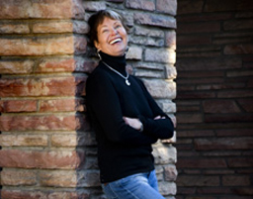
Watson's basic concept of theory
Philosophy and Science of Caring developed in 1979.
Theory of human caring considered a caring science.
  Includes the arts, sciences, and humanities.
Science of caring built on two basic premises:
  Centers on caring and existence in society.
  Explores discrepancy between theory and practice.
www.ucdenver.edu/academics/colleges/nursing/Pages/default.aspx
Notes:
The Philosophy and Science of Caring,” also known as human science, was developed in 1979. (Chitty & Black, 2011) The theory of human caring is considered a caring science that includes the arts, sciences, and humanities. The science of caring in nursing is built on two basic premises: The initial premise centers on caring (and nursing) and its ubiquitous existence in every society through the annals of history. The second premises explores the discrepancy that occurs between theory and practice, resulting in a disjunction between scientific and humanistic ideals of the nursing profession.(Bailey, 2009)

Slide 6
Watson's basic concept of theory (cont’d)
Seven basic assumptions of Caring:
  Caring effectively demonstrated and practiced only inter-personally.
  Carative factors resulting in satisfaction of human needs.
  Effective caring promotes health and individual or family growth.
  Caring responses accept a person as may become.
  Caring environment offers development of potential.
  Caring is more “healthogenic” than is curing.
  The practice of nursing is central to nursing.
Notes:
Watson's theory of Caring includes seven basic assumptions of caring. The assumptions are used as a self-reflection tool for the professional nurse to continually entrench him/herself in a humanistic values system. Caring can be effectively demonstrated and practiced only inter-personally.
Caring consists of carative factors that result in the satisfaction of certain human needs. Effective caring promotes health and individual or family growth. Caring responses accept a person not only as he/she is now but as what he/she may become. A caring environment is one that offers the development of potential while allowing the person to choose the best action for him/herself at a given point of time. Caring is more “healthogenic” than is curing. The practice of caring integrates biophysical knowledge with knowledge of human behavior to generate or promote health and to provide ministrations to those who are ill. A science of caring is therefore complimentary to the science of curing. The practice of nursing is central to nursing. (Bailey, 2009)

Slide 7
Watson's basic concept of theory (cont’d)
The Carative Factors:
  Formation of humanistic-altruistic system of values.
  Instillation of faith-hope.
  Cultivation of sensitivity to one's self and others.
  Development of a helping-trust relationship.
  Promotion/acceptance of expression, positive, and negative feelings.
Notes:
Watson established ten carative factors with her theory.

Slide 8
Watson's basic concept of theory (cont’d)
The Carative Factors (cont’d):
  Scientific problem-solving method used for decision making.
  Promotion of interpersonal teaching-learning.
  Provision for supportive, protective, and/or corrective:
    mental, physical, socio-cultural, and spiritual environment.
  Assistance with the gratification of human needs.
  The allowance for existential-phenomenological forces.

Slide 9
Implementation Theory into nursing practice
Theory imaginative grouping knowledge, ideas, and experiences.
Science of caring suggests nurses recognize and assist.
Indicates that needs are interrelated.
Study has shown:
  Increased job satisfaction among staff.
  Shortened hospital stay.
  Reduced health care costs
Notes:
Watson provides many useful concepts for implementation in nursing. The science of caring by Watson discussed in depth on the Current Nursing website (2010) shows us that interrelated needs must be meet to help out patients. Jean Watson’s theories ranges from the biophysical through the intrapersonal, each nurse takes an active role in the client’s struggle towards self-actualization. And finally with Watson theory as discussed in the Journal of Nursing Care and Quality in a study on dementia patients it helped significantly with everything from patient care to patient cost (Marchx, 1995).

Slide 10
Implement theory into nursing Practice (cont’d)
Nurses called to create an environment of trust.
Carative factors guide nurses.
Support human caring and provide for physical needs.
Spirituality is a strength.
Through trust, confidence is gained and friends are made.
The person-to-person relationship is priority.
Notes:
Jean Watson’s theory addresses the trusting relationship built between a nurse and their patient. Through creating an environment of trust, understanding, and openness, the patient and nurse can work together to meet the patient’s needs. The nurse is encouraged to share their true self to create a feeling of genuineness. This trusting relationship leads to the patient sharing their true thoughts and fears. Spirituality is a strength while creating this bond. Nurses pledge to maintain an environment that supports human caring as well as primary physical needs. This allows the nurse to respect life and realize the human to human relationship is priority. Clear professional boundaries are set in the beginning of the relationship, but by allowing this bond to take place, the nurse and patient’s relationship transforms into a one of a kind bond. (Chitty & Black, pp. 305-310)

Slide 11
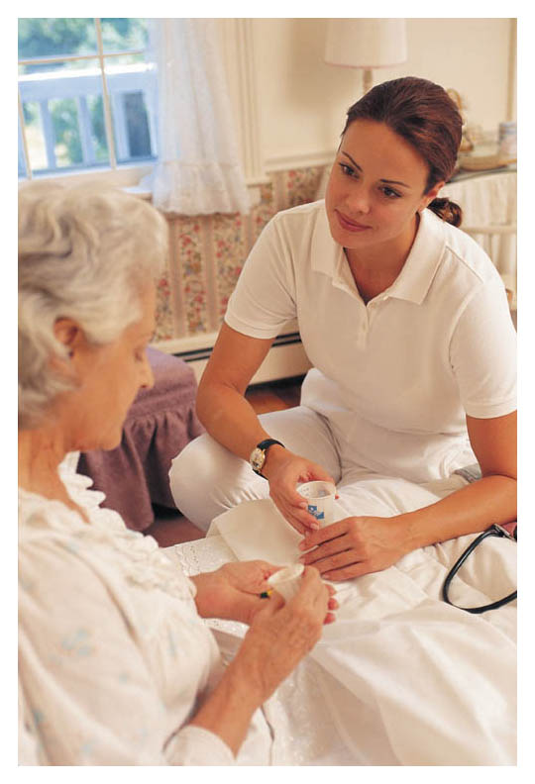
IMPLEMENT THEORY INTO NURSING PRACTICE (cont’d)
Nurses must be competent in technical and caring skills.
Interview process has changed due to Watson’s theory.
Nursing education now incorporates holistic care.
Through using carative factors, nurses can realize their impact.
Caring and emotional factors are tied into nursing diagnosis and interventions.
www.allcare.org/vna_index.shtml/
Notes:
There are many ways that Watson’s theory is implemented into the nursing practice today. Job descriptions are now calling for nurses that are both competent in technological skills and the carative factors of the caring theory. In the interview process, an employer usually asks the candidates to share a story that demonstrates how they had a positive impact on a patient’s outcome. Employers want their nurses to have a caring spirit and be able to relate to the patient. Nursing education now teaches students how to care for the body, mind, and spirit, not just physical ailments. In the future, computer documentation in hospitals will begin to link carative factors with nursing diagnoses and interventions. Allowing the nurse to see they are making a difference gives them the support and encouragement they need to build a true bond with the patient based on caring. (Ryan, pp. 26-30)
Ryan, L. (2005). The journey to integrate Watson’s caring theory with clinical practice. International Journal for Human Caring, 9(3): 26-30. Retrieved from http://search.ebscohost.com/eqproxy.lakeviewcol.edu:2048/login.aspx?direct=true&db=rzh&AN=20009021796.

Slide 12
Implementation Theory into nursing practice (cont’d)
Communication is key to establishing trusting relationship.
Getting to know the whole person;
  Beliefs, thoughts, and feelings.
  Helps to understand nature seeking care for.
Nurse must know ones own values and beliefs.
Environment to be conducive to holistic care;
  it must be supportive, protective, and spiritual.
Notes:
Jean Watson proposes, as part of her theory, that communication is the key to establishing a trusting relationship with patients (Anonymous, 2010). If the nurse understands every aspect of the patient, (i.e., beliefs, thoughts, feelings etc.), the nurse will be able to care for the patient more holistically. For the nurse to accomplish holistic care, he or she must be aware of her own beliefs, values, and feelings. Once the nurse is aware of these, he or she will be able to separate them from the patients; allowing for non-judgmental and respectful care. For the environment to be conducive to holistic care, the nurse must keep it clean and prevent it from chaos and disorder. The nurse must also honor the patients spiritual requests, quiet moments, prayer with family or healthcare providers, and any rituals that might be important to the patient. (Anonymous, 2010)

Slide 13
Jean Watson Summary
Jean Watson began her nursing education in 1958.
Graduated with PhD in education and psychology/counseling.
Holds multiple awards and distinguished positions.
Known for her theory and philosophy of caring.
Nursing becoming technical and task oriented less caring.
Notes:
Jean Watson’s nursing education began in 1958. She graduated 15 years later with her PhD in education, psychology, and counseling. Watson has been given multiple awards and distinguished positions throughout the years. She is best known for her theory and philosophy of caring. Her theory began to develop when she acknowledged nursing was becoming more technical, task oriented, and less caring.

Slide 14
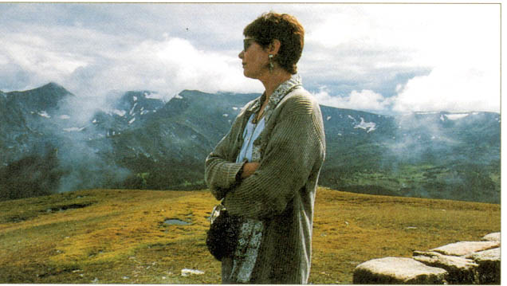
Summary (cont’d)
Concept of theories based on seven assumptions.
Ten carative factors.
Changed how nursing students are educated.
Employers seek candidates for hire with caring factors.
http://www.asu.edu/nursing/courses/nur361/leader24
Notes:
Watson’s theory is based on seven assumptions and ten carative factors. Through her theory, she has influenced a change in the approach used to educate nursing students. Students today are taught not only about the physical ailments but also that of the mind and spirit. She was also instrumental in changing how employers seek candidates for employment. Today, employers have placed an emphasis on candidates possessing caring attributes along with competence and intelligence.

Slide 15
References
Anonymous (2010). Jean watson philosophy of nursing. Faith and hope: Establishing a trusting relationship. Retrieved October 13, 2010
from http://currentnursing.com/nursing_theory/Watson.html.
Bailey, D.N. (2009). Caring defined: A comparison and analysis. International journal for human caring. 13(1), 17-18.
Retrieved from
http://web.ebscohost.com.exproxy.lakeviewcol.edu:2048/login.aspx?direct=true&db=rzh&AN=2010235968&s ite=nrc-live.
Cara, C. (2003). A pragmatic view of Jean Watson's caring theory. International journal for human caring. 7(3), 51-61
(22 ref). Retrieved from
http://www.cinahl.com/cgi-bin/refsvc?jid=1502&accno=2004070467.
Chitty, K. & Black, B. (2011). Nursing theory: the basis for professional nursing. In Professional nursing: Concepts & challenges.
Maryland Heights, MO: Sanders Elsevier
Current Nursing, (2010). Development of nursing theories. Current Nursing (2010, October 13). Retrieved from
http://currentnursing.com/nursing_theory/development_of_nursing_theories.html.

Slide 16
References (cont’d)
Current Nursing, (2010). Nursing Theories: A companion to nursing theories and models. Current Nursing (2010, October 13).
Retrieved from http://currentnursing.com/nursing_theory/watson.html.
Current Nursing, (2010). Jean Watson’s Philosophy of Nursing. Current Nursing (2010, October 15) . Retrieved from
http://currentnursing.com/nursing_theory/Watson.html.
Marchx, B. B. (1995) . Watson's theory of caring: a model for implementation in practice. Journal of Nursing Care and
Quality. 1995 Jul; 9(4):43-54 Retrieved from http://www.ncbi.nlm.nih.gov/pubmed/7640385.
[Photographs of nurses caring]. (n.d.). (October 16, 2010). Retrieved from www.allcare.org/vna_index.shtml/
[Photographs of Jean Watson]. (ca. 1958-2010). (October 15, 2010). Retrieved from http://www.asu.edu/nursing/courses/nur361/leader24.
[Photographs of Jean Watson]. (ca. 1958-2010). (October 15, 2010). Retrieved from
http://watsoncaringscience.org.00921796.
[Photography of Jean Watson]. (ca. 1958-2010). (October 16, 2010). Retrieved from
www.ucdenver.edu/academics/colleges/nursing/Pages/default.aspx

Slide 17
References (cont’d)
[Photographs of Jean Watson pin]. (n.d.). (October 16, 2010). Retrieved from www.zazzle.com/caring_is...544655093/
Ryan, L. (2005). The journey to integrate Watson’s caring theory with clinical practice. International Journal for Human Caring, 9(3):
26-30. Retrieved from
http://search.ebscohost.com/eqproxy.lakeviewcol.edu:2048/login.aspx?direct=true&db=rzh&AN=20
Sitzman, K.L. (2007). Teaching-learning professional caring based on Jean Watson's theory of human caring. International journal for
human care.11(4), 9-10. Retrieved from
http://search.ebcohost.com.ezproy.lakeviewcol.edu:2048/login.aspx?direct=tru&db=rzh&AN=2009 754494&site+nrc-live
Watson Caring Science Institute-International Caritas Consortium. (n.d.). Jean Watson. Retrieved from
http://www.watsoncaringscience.org/j_watson/index.html.
Watson, M. J. (2010). Watson caring science institute: International caritas consortium. Retrieved from http://www.wastsoncaringscience.org/j_watson/index.html

