Slide 1


Good Touch Bad Touch
What’s the Difference?
By Lakeview College of Nursing
Pediatrics Nursing Students

Slide 2
Lets Talk About Feelings
What Does Your Face Say When You Are
HAPPY?

Slide 3



Happy Face

Slide 4
What Does Your Face Say When You Are
SAD

Slide 5

BOO HOO

Slide 6
What Does Your Face Say When You Are
ANGRY

Slide 7

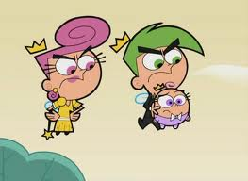

ANGRY FACE

Slide 8

What Does Your Face Say When You Are
EMBARRASSED

Slide 9
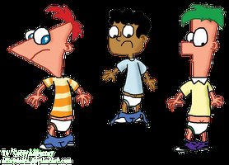
EMBARRASSED FACE

Slide 10
What Does Your Face Say When You Are
ASHAMED

Slide 11

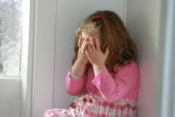
ASHAMED FACE

Slide 12
Who Can Tell Me What Ashamed Means

Slide 13
Ashamed Means
To Feel Bad About Yourself

Slide 14

Examples
Tripped on My Shoelaces
Broke mom’s favorite cup
Took my little brother’s toy.

Slide 15
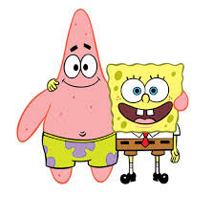
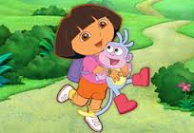

Let’s Talk about Good Touches
Examples: Hugs, Kisses, pat on the head, touch on the shoulder, handshake.

Slide 16

Let’s Talk About Bad Touch
Bad touch for me is:
Kicking
Hitting
Pinching
Being touched where you
not suppose to be touched.

Slide 17
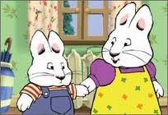

Good Touches VS. Bad Touches
Good touches = Good feelings.

Slide 18

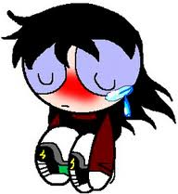

Good Touch VS. Bad Touch
Bad Touches = feelings that make us feel bad or Uncomfortable.

Slide 19
Tickling
How many of you like to be tickled?
How many do not like to be tickled?
Is tickling a good touch or bad touch?

Slide 20
Let’s Play Thumbs Up or Thumbs Down Game
Question 1: Tickling can be fun (thumbs up or thumbs down.)
Question 2: Its okay for people that you don’t know very well to tickle you. (Thumbs up or thumbs down).
Question 3: Its okay for people to tickle you for a long time or too hard. (thumbs up or thumbs down).

Slide 21
Video Short 1
http://www.youtube.com/watch?v=yA_Oe5JWf4k

Slide 22

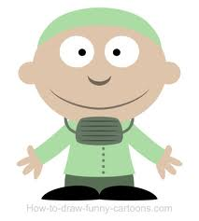
Body Parts Names
Doctors call certain body parts private parts.

Slide 23
Video Short 2
http://www.youtube.com/watch?v=4KWan3N-yhM

Slide 24


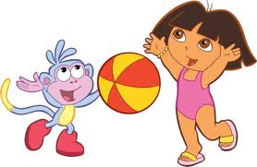
What Are These Kids Wearing?

Slide 25
Private Areas
Are covered by underwear and swimming suits.
Only Doctors and Nurses should touch you in private areas with Mommy and Daddy near by.
Mom and Dad can help if they are helping you change your clothes or take a bath.

Slide 26




Who Do I Trust and Who Can I Tell if Someone gives Me A Bad Touch
MOM and Dad,
Grandma and Grandpa
Teachers and school Counselors
School Nurse
Police

Slide 27



NOW SAY OUT LOUD
ITS
MY
BODY

Slide 28
STAND UP AND TAKE A BOW
YOU DID
GREAT !!!!!!!!
THANK YOU!!!!!

Slide 29
References
Kyle, T. & Carman. (2013). Essentials of Pediatric Nursing . (2nd Ed.) Philadelphia, PA: Lippencott Williams & Wilkins.
http://www.youtube.com/watch?v=yA_Oe5JWf4k
http://www.youtube.com/watch?v=4KWan3N-yhM

