Slide 1
Group Project
Questions 7 & 8
By Ashley Bushell

Slide 2
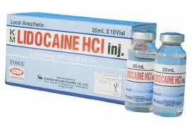
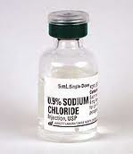
Comparison of Bacteriostatic Normal Saline and Lidocaine Used as Intradermal Anesthesia for the Placement of Intravenous Lines

Slide 3
Info from Secondary Sources & relevancy
Hard to keep up with new practices
Normal saline with benzyl alcohol has same use as lidocaine in local anesthesia
Lidocaine or BNS used before IV injection is better than no anesthetic
Notes:
Information from Brown states that the reasons why nurses did not offer lidocaine are because of the opinions the procedure would be more difficult, they realized it was not a part of their routine, or they simply did not think of it (Windle, 2006). In this source, the nurses were interviewed on whether or not they used the new practice. The source is fairly relevant depending on if the interviewees told accurate information (Burns & Grove, 2010). The information is considered current in the source because the data collected all relates to current practice and trends.
Information from McNelis proves that 0.9% sodium chloride containing benzyl alcohol is as effective as lidocaine hydrochloride in providing local anesthesia for IV access (Windle, 2006). This source is relevant because the researcher controlled the environment of the study making sure that all of the presurgical patients had two large-bore IV catheters placed: one insertion pretreated with lidocaine and the other with BNS. It is important that the environment be controlled so that it is consistent for all subjects (Burns & Grove, 2010, p.226). The source is current because it all applies to new, current practice.
Information from Fein et al indicates that saline with benzyl alcohol and 1% lidocaine were equally effective as intradermal anesthetics for IV placement in children (Windle, 2006). Once again the environment of the study was controlled and consistent with all subjects. A 27 gauge needle was used to inject 0.1 to 0.2 mL of the compound (Windle, 2006). The source is considered to be relevant because the children all had the same treatment as one another and then reported back to the researcher his or her experiences. Once again, the source is considered to be current because even though it took place in 1998, it all relates to current nursing practice and encouraging new effective practice to take place. Also, if the studies were done later on, it would still be based off the pain experiences of the subjects.

Slide 4
Secondary sources & relevancy cont’d
Lidocaine & BNS are least inexpensive
Lidocaine iontrophoresis has same relief as EMLA
Notes:
Information gathered from Patterson et al showed that there was a significant difference in cost and convenience between the four agents and that both BNS and lidocaine were the least expensive analgesic agents (Windle, 2006). The source is not entirely relevant because many times respondents fail to respond to all questions, thus threatening the validity of the instrument (Burns & Grove, 2010, p. 409). Source is of current information; but was conducted in 2000, so prices could be different among the four analgesic agents tested if any change in information.
Information received from Galinkin et al concluded that lidocaine iontrophoresis provides similar pain relief for insertion of Ivs as EMLA, and is an alternative to prevent pain among IV starts (Windle, 2006). There is a question of some relevancy of this source because the subjects were all children and had to report their pain experienced using the faces pain scale. With scales used as feedback, it relies completely on self report and always include both a random error and systematic error (Burns & Grove, 2010). The study was done in 2002, but even a few years back, it still contains relevant information for today’s practice and will help improve practice.
Overall, the secondary sources in this article seemed to be on top of keeping up with both currency and relevancy.

Slide 5
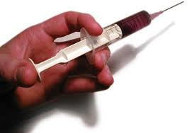
How it relates to nursing practice
Pain management is a top priority for nurses
Practice is always new and improved
BNS and lidocaine are both effective at preventing pain
BNS is less of a painful injection than lidocaine
Notes:
Pain management is one of the top priorities for nurses, especially in the perianesthesia setting. So finding a way to decrease the patient’s pain is important.
Administration of an analgesic agent before venipuncture helps increase patient comfort and prevent pain. However, changing practice can be difficult. Poor staff knowledge and skill can contribute to the lack of use of intradermal lidocaine. Both technology and practices are always changing and perfecting themselves. It is hard for some to keep up with the changing knowledge.
Nurses now know that both lidocaine and BNS are effective at preventing pain. BNS is a less painful injection than lidocaine.The study that Brown conducted stated that the reasons for not offering lidocaine included the opinion that it made the procedure more difficult, nurses knew it was not part of their routine, or they did not think to use it. Now, when a patient is experiencing a “needle phobia” then to prevent anxiety along with bradycardia or hypotension to occur, a nurse could inject lidocaine or BNS, so the patient will feel no pain when getting the IV done.
Overall, applying the results of the study and changing how IVs are started in the preoperative area will benefit both the hospital and patient. The low cost of BNS, low risks and side effects, make it a safe and cost-effective intradermal medication for IV line insertion. Not only will the use of this technique decrease pain, but it will improve satisfaction and cost- effective quality of care for all patients (Windle, 2006, p. 258).

Slide 6
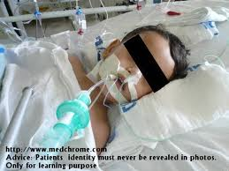
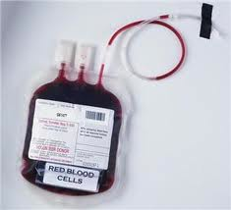
Understanding the Moral Distress of Nurses Witnessing Medically Futile Care

Slide 7
Info from Secondary Sources & Relevancy
Technology and treatments are always evolving
Many nurses are forced to go against their beliefs
Compassion is a necessity
Ethical care=nurturance, compassion & communication
Notes:
Information from Callahan, 2003 states that science and medicine have developed over the years so many new advancements: the use of a ventilator, advances in antibiotics and other pharmacologic agents, ability to perform diagnostic and therapeutic procedures, advancements in chemotherapy, blood transfusions, and organ transplants (Ferrel, 2006). The article was written in 2006 and this source is from 2003. The information is given within the last five years of the article, so there is not doubt about it not being current or not. This source comes from a relevant source, because the author is a senior research scholar and has a background in medicine and ethics (The Hastings Center, 2011). This source is indeed relevant because the author has reviewed relevant information of another author’s work and builds upon it (Burns & Grove, 2011).
Information from Puntillo et al, 2001 had a study that involved 906 critical care nurses. Thirty-four percent said they acted against their consciences sometimes; 6% had done it a significant amount (Ferrell, 2006). This source is considered fairly current because it is within the five year range and includes current information. The source would be considered to be relevant for the most part because it includes information directly from nurses who experience dying, struggling patients everyday. The only fall back about interviews however, are that interviews are a form of self- report, and the researcher must assume that the information provided is accurate (Burns & Grove, 2010, p. 405).
Information from Farley, 1990 states that nurses must have compassion when being around people experiencing severe illness (Ferrell, 2006). The source could be considered not current if the information is not completely current. This source is however relevant because it covers a wide variety of information from different sources, thus eliminating any biases (Burns & Grove, 2010).
Information from Welch, 2000 states that an alternate paradigm in practicing ethical care is by applying concepts such as nurturance, compassion, and communication (Ferrell, 2006). This source makes the current cut off if the information is still accurate even today. It is only slightly outdated, so it should still be considered current. However the source is not one- hundred percent relevant because the author is a feminist, so it contains some bias. Bias should be eliminated or avoided (Burns & Grove, 2010, p. 220).

Slide 8
Secondary sources & relevancy cont’d
Compromise between patients & clinicians about futility
Death can be avoided
Issues of futility has different meanings between staff and patients
Notes:
Information from Taylor, 1995 encouraged that the important role of nursing is negotiating compromise between patients and clinicians regarding futility (Ferrell, 2006). This source is not as current as it could be. This source is relevant because it comes from a knowledgeable researcher in that field, a nurse ethicist.
Information from Angus et al, 2004 states that the overall effect of technological advances has been that patients and healthcare professionals believe that death can be avoided (Ferrell, 2006). This article is considered current, because it is close to the year of the publication of the article. The source is not as relevant as it could be because not all states were included in the test of who provided intensive end of life care.
Information from Alspach, 1997 indicates that the issues of futility have a variety of different meanings in a personal situation for patients as well as families and raises a emotional responses and frustration by staff (Ferrell, 2006). This source is not as current as it could be, but for the most part if the responses of the staff are going to change at all, they are going to increase having stressful experiences with the increasing advancement of treatments to prevent death in dying patients. The source is a little biased because healthcare employees should realize that their opinions on the best treatment decisions are based on years of experience and education, where on the other hand most patients and families are left with life and death decisions with little or no previous knowledge. Since the source is biased and fails to include both sides of the question , it is considered irrelevant.

Slide 9
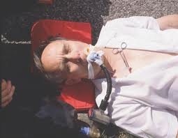
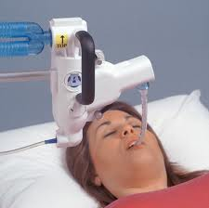
How it relates to nursing practice
Causes distress for nurses
Nurses feel forced into it
Can become an ethical problem
Certain experiences with patients impact nurses forever
Notes:
-Futile care creates distress for not only nurses, but the profession alone. Nurses feel horrible having to watch their patients go through tortuous treatments that will not help in the end. It is a debatable subject because many nurses feel like they should do everything in their power to save someone, and prevent negligence from occurring. Nurses often go against many of their beliefs in providing all the care they possibly can to a patient who is most likely going to die either way. Cancer is the example in this article. The girl is slowly dying from cancer because now she is experiencing organ failure. Yet the doctor comes in everyday doing a new treatment for her and hoping a miracle will happen. Once a patient is receiving higher treatment, it also later becomes an ethical issue whether or not to stop the procedure. Do you let the patient hold on to every last bit he or she has, or do you end it because this way is not really living? It is a tough call for many nurses and families.

Slide 10
References
Burns, N. & Grove, S. (2010). The practice of nursing research: Appraisal,
Synthesis, & generation of evidence (6th Ed.). St Louis, MO: Elsevier Saunders
The Hastings Center. (2011). Danial Callahan, PhD.
Retrieved from http://www.thehastingscenter.org/About/Staff/Detail.aspx?id=1282

