Slide 1
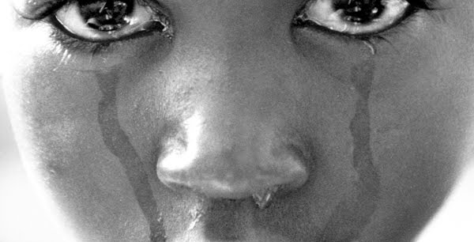
Female Genital Mutilation (FGM)
Presented by: Megan Aprile, Catherine Deters, Jamie Lowe, Lauren Magruder, & Julia McGraw

Slide 2
Objectives
Introduction
FGM & the World
Implications
Procedure
Ethical Considerations
Complications
Nursing Diagnoses
Nursing Interventions
Conclusion

Slide 3
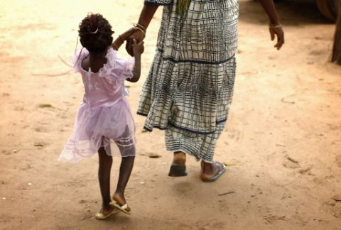
Introduction
World Health Organization (WHO) classification
“They Took It”
http://www.youtube.com/watch?v=sArcOzKpugk
(World Health Organization, 2012)

Slide 4
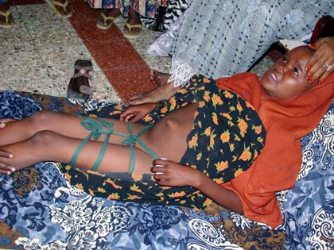
FGM and the World
140 million females world wide
Africa, Middle East, European, and Western civilizations
Females
Infancy to age 15
Wedding night
During first pregnancy
(Magoha & Magoha, 2000)

Slide 5
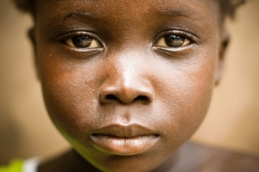
Implications
Social pressure
Economic security
Religious beliefs
Femininity and modesty
(Magoha & Magoha, 2000)

Slide 6
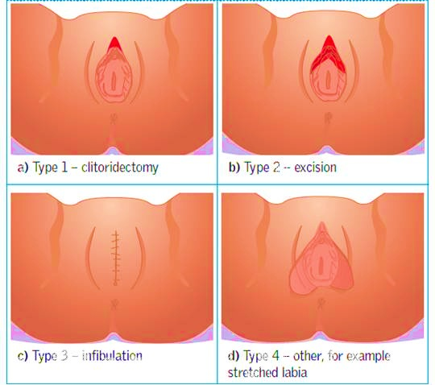
Procedure
4 types (Bikoo, 2007)
Utensils used (Kentenich & Utz-Billing, 2009)
Pain relief (Bikoo, 2007)
Post-procedure (Bikoo, 2007)

Slide 7
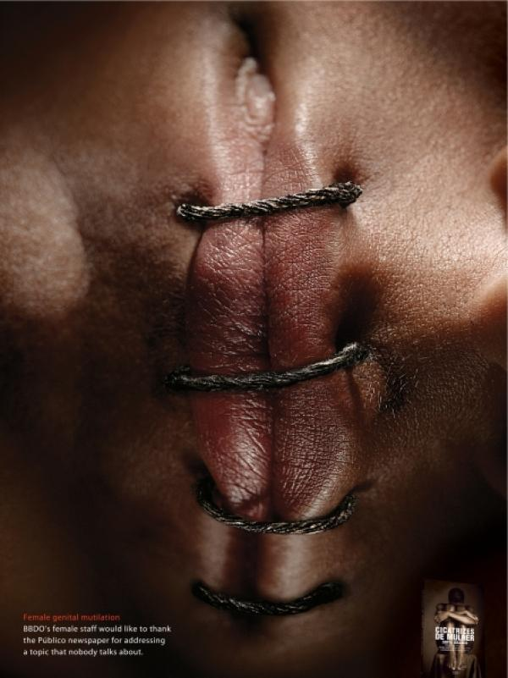
Ethics
Cost (Adam et al., 2009)
Human rights (Kentenich &
Utz-Billing, 2008)
Complications (Kentenich &
Utz-Billing, 2008)

Slide 8
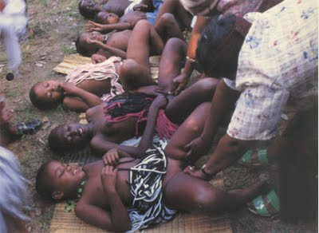
Complications
Infection
Hemorrhage
Infertility
Psychological effects
Mortality
(Kentenich & Utz-Billing, 2008)

Slide 9
Nursing Diagnoses
Risk for infection related to a site for organism invasion secondary to invasive surgery and poor hygiene practices.
Disturbed body image related to excision of part of the female genitalia as evidenced by patient verbalization, decreased sexual pleasure, and social isolation.

Slide 10
Nursing Interventions
Display and circulate materials
Maintain non-judgmental attitude
Assess patient’s attitude towards procedure
Refer affected patients to support groups
Educate self and colleagues
(Robinson, 2011)

Slide 11

Conclusion
Summary of viewpoints (World Health Organization, 2012)
Key points (World Health Organization, 2012)
Questions?

Slide 12
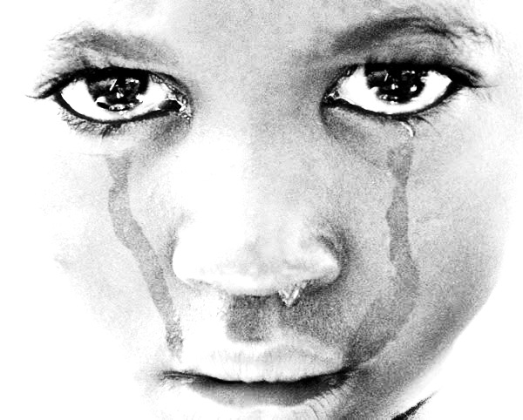
References
Adam, T., Bathija, H., Bishai, D., Bonnenfant, Y., Darwish, M., Huntington, D., Johansen, E. (2009). Estimating the obstetric cost of female genital mutilation in six African countries. Bull World Health Organ. 88, 281-288.
Bikoo, M. (2007). Female genital mutilation: Classification and management. Nursing Standard. 22(7). 43-49.
Kentenich, H. & Utz-Billing, I. (2008). Female genital mutilation: An injury, physical, and mental harm. Journal of Psychosomatic Obstetrics & Gynecology. 29(4), 225-229.
Magoha,G. & Magoha, O. (2000). Current global status of female genital mutilation: A review. East African Medical Journal, 77(5):268-72.
Robinson, E. (2011). Female genital mutilation: What can school nurses do about it?. British Journal Of School Nursing, 6(3), 113-114.
World Health Organization. (2012). Female genital mutilation: Fact sheet 241. Retrieved from http://www.who.int/en/

