Slide 1
FGM
Kirsten Wickman

Slide 2
What is FGM
Female Genital Mutilation
  the removal of all or part of the external female gentilia
  Done between birth and first pregnancy
Heitman 2000

Slide 3
Procedure
Due to poverty it usually done in a unsanitary environment with untrained people doing the procedure
Use tools such as scissors, broken glass, razor blade, or tin lids
Heitman 2000

Slide 4
Types of FGM
1. Sunna circumcision
2. clitoridectomy
3. infibuation
  In Africa 85% of FGM is a clitoridectpmy and 15% consists of infibulation.
Heitman 2000

Slide 5
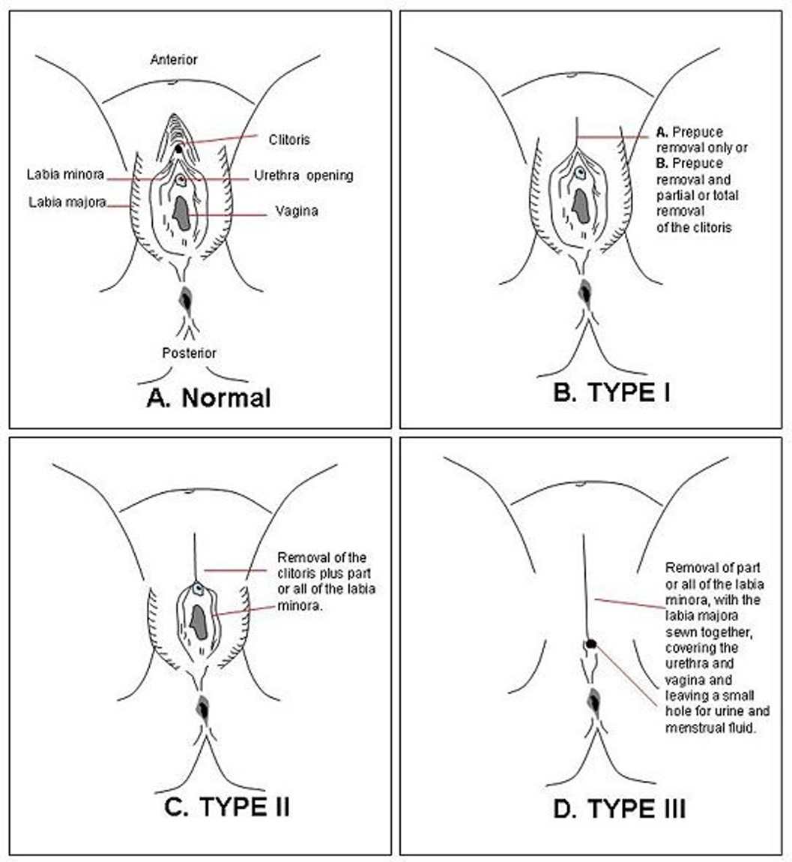
FGM, 2010

Slide 6
Heitman, R. (2000). Female genital mutation.
  Retrieved from http://www.members.tripod.
  com/~Wolvesdreams/FGM.html

