Slide 1
Languages of East India
The different states of India have different official languages.
For example; Bihar in east India has three official languages – Hindi, Urdu and Bengali.
Sikkim, also in east India, has four official languages of which only Nepali is recognized by the central government.
Central government decided that Hindi was to be the official language of India and therefore it also has the status of official language in the states.

Slide 2
Languages Cont…
East Indian languages comprise the likes of Bihari languages.
Bengali is the most overriding language of this part of the Indo-Gangetic Plain.
Hindi occupies the largest number of speakers at over 90 million, but owns trivial ethnic influence beyond Bihar.
East Indian languages owe their lineage to the Indo-Aryan language family.

Slide 3
East Indian Lifestyle
Music & Dance
Diet & Nutrition
Clothing
Social Structure
Family Structure
Women’s Health
Culture & Tradition’s

Slide 4
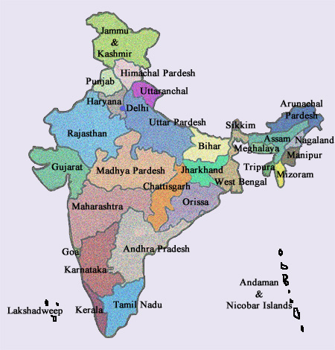

Slide 5
References I Used!!!!
http://www.indianetzone.com/39/east_indian_languages.htm

