Slide 1
National Drowning Prevention Alliance (NDPA) supports May as the national drowning prevention month

Slide 2
Education
NEVER leave children unsupervised in or around a body of water - even for a moment. Children can drown in as little as two inches of water in less than one minute
Teach children water and swimming skills.
Avoid keeping water in buckets or other large containers when toddlers are home
Remove any toys that may attract children to the pool area.
Install a self-closing gate around the pool.
Don't rely on flotation devices to protect your children in the water.
("Drowning prevention," 2002)

Slide 3
Drowning Prevention
Alarm every door leading to water to alert you if a child has gone outside.
During pool parties or family beach gatherings, designate an adult to watch the children.
Install a pool cover to securely cover the water area.
Install a poolside, cordless phone.
Keep lifesaving equipment - a pole, life preserver and rope - in the pool area.
Children with long hair should clip it back or wear a cap in the pool.
Parent/caregiver know CPR
("Drowning prevention," 2002)

Slide 4
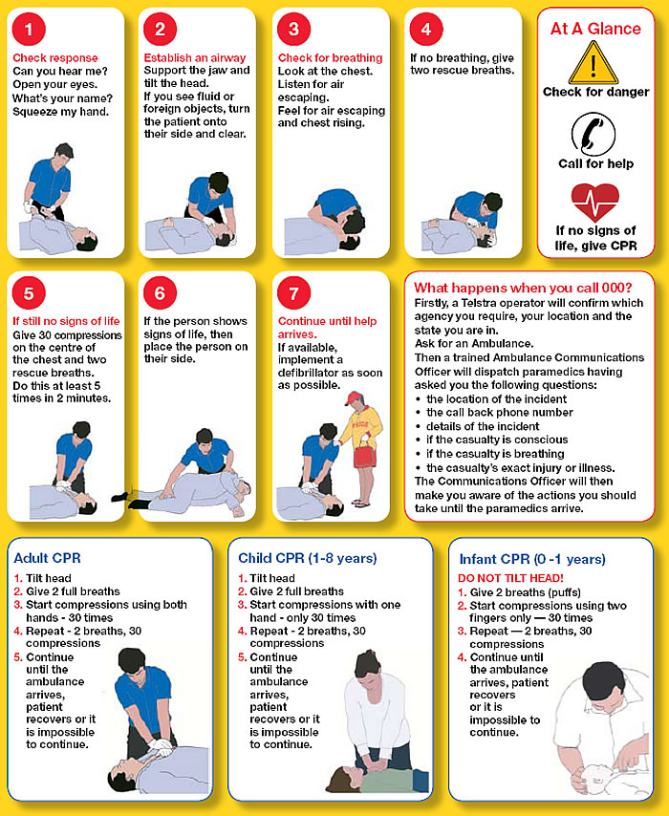

Slide 5
Citations
Broward Sheriff's Office, (2002). Drowning prevention. Retrieved from website: http://www.sheriff.org/safety/drowningprevent.cfm

