Slide 1
Driving Under the Influence
BY: Jonathan, Nina, Amanda, Cassie, Kelsey, Marcy, & Gary

Slide 2
Why Drinking and driving?
The purpose of this project is to inform teens
about the harsh reality of underage drunk driving. The key to prevention is education.

Slide 3
Goal
Our goal is to educate teens about the consequences of drinking and driving. We aim to equip teens with the proper knowledge to make wise and informed decisions.

Slide 4
Did you know…
Drunk drivers kill someone approximately every 48 minutes.
Drivers under the influence are responsible for over half of all driving accidents and more than 70% of all accidents that result in fatalities.
About three in every ten Americans will be involved in an alcohol-related crash at some point in their lives.

Slide 5
The 2009 Youth Risk Behavior Survey found that among high school students, during the past 30 days:
42% drank some amount of alcohol.
24% binge drank.
10% drove after drinking alcohol.
28% rode with a drunk driver.

Slide 6
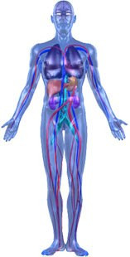
How Alcohol Effects Your body
BRAIN. Impaired function and judgment ability.
LUNGS. Infection; breathing can stop.
HEART. Irregular heartbeat.
LIVER. Alcoholic hepatitis and cirrhosis.
STOMACH. Irritation, peptic ulcers, bleeding lesions, cancer.
INTESTINES & PANCREAS. Intestinal tract and colon damage, inflammation, ulcers, and cancer.
BONES & MUSCLES. Weaker and thinner bones (osteoporosis); weaker and uncoordinated muscles.

Slide 7
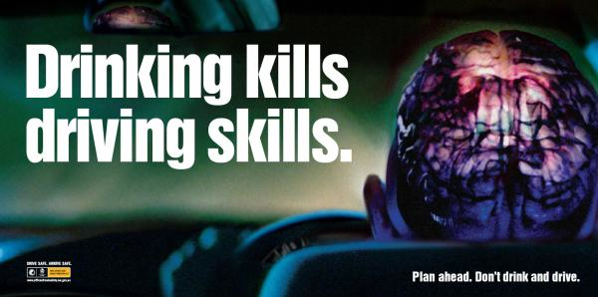
How Alcohol Affects Driving
Impaired Judgment
Impaired Coordination
Impaired Hearing & Vision
Impaired Comprehension
Impaired Concentration
Slowed Reaction Time

Slide 8
MADD
Founded in 1980 by a mother who lost her child in a drunk driving accident
Since then fatalities have declined by over 40% but in recent years have stalled
According to the MADD website, Illinois is ranked the 37th highest state in DUI related deaths
MADD has started a “Campaign Against Drunk Driving”. Everyone can take part in this campaign with three steps
  Supporting sobriety checkpoints, especially on holidays.
  Requiring previously convicted drunk drivers to take a breathalyzer before driving
  Cars detecting if the driver is over the limit and failing to operate
Every year 12,000 people are killed by drunk drivers so by going online to MADD’s webpage and taking the pledge to end drunk driving, more than 1,000 families may be spared the devastating tragedy of losing a family member due to drunk driving.
(www.madd.org)

Slide 9
MADD
Why wait until 21 to drink?
  Research shows that teens react differently to alcohol. They get drunk twice as fast and have trouble knowing when to stop
  Teens are more likely to binge drink than adults
  It has been proven that the drinking age being raised to 21 reduces drunk driving accidents
STATISTICS
  MADD has saved 27,000 young lives through passage of groundbreaking public health laws
  Since 1980 MADD has nearly saved 300,000 lives ...and counting.
  MADD serves a victim or survivor of drunk driving every nine minutes.

Slide 10
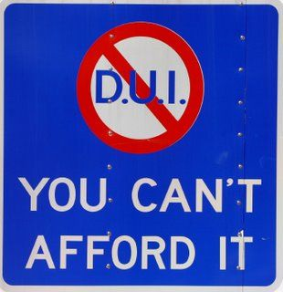
Consequences of dui
LOSS OF LIFE
LOSS OF WORK
EMBARRASSMENT
PRIDE
INCONVENIENCE TO OTHERS
IMMOBILITY
A POTENTIAL LIFE SENTENCE
IF A DEATH IS INVOLVED
SO DON’T BE A FOOL!!

Slide 11
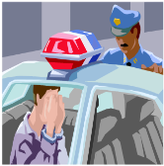

1st Illinois DUI Offense
First Drunk Driving Conviction
Jail – Up to 1 Year Possible
Jail – Add Up to 6 Months - (If Child under 16 in Vehicle)
Fine – Up to $2,500
Fine – Add $500 Minimum (BAC above .16)
Fine – Add $1,000 Minimum - (If Child under 16 in Vehicle)
License Suspension – Minimum 1 Year
Breath Alcohol Ignition Interlock Device (BAIID) Possible
Vehicle Registration Suspension
Community Service – 100 Hours Minimum - (BAC above .16)
Community Service – 25 Days - (If Child under 16 in Vehicle)
The typical Illinois DUI conviction costs the drunk driver $14,660.

Slide 12
How To Spot A Drunk Driver:
Drifting, weaving, or hitting curbs
Speeding or driving too slowly
Giving inconsistent signals
Braking erratically
Stopping for no apparent cause
Driving with the window rolled down in cold weather
Tailgating and passing dangerously close to other cars
Making wide turns and hitting objects near the road
When a drunk driver is on the road, we are all at risk.

Slide 13
What YOU Can Do About Drunk Driving
Report a drunk driver by calling 911.
Take the keys. Do not let a friend drive if they are impaired.
Be a helpful host. Serve food along with alcohol, offer non-alcoholic beverages, and help get your guests home safely.
Help advertise against drunk driving by putting up poster boards around the school.

Slide 14
Warning: The following clip contains images that some viewers may find disturbing.

Slide 15
Standup Against Drunk Driving
Who knows, you or your loved one may be the next victim. Do not sit back and let it happen. Take action now and help prevent drinking and driving!

Slide 16
References
Alcohol and Driving. (n.d.). Drug & Alcohol Services South Australia. Retrieved November 6, 2011, from http://www.dassa.sa.gov.au/site/page.cfm?u=121
Cost of a DUI Conviction Goes Far Beyond the Obvious - Total DUI. (n.d.). DUI Attorneys and Free DUI Case Evaluation Form. Retrieved November 7, 2011, from http://www.totaldui.com/ news/articles/court-cases/cost-of-dui-conviction.aspx
Gottesman, C. (n.d.). How Alcohol Affects Your Body | Eating Well. Healthy Recipes, Healthy Eating, Healthy Cooking | Eating Well. Retrieved November 6, 2011, from http://www.eatingwell.com/nutrition_health
Eaton DK, Kann L, Kinchen SA, et al. Youth Risk Behavior Surveillance—United States, 2009. CDC Morb Mort Surveil Summ 2010;59(SS-5):1–148. Available at http://www.cdc.gov/mmwr/PDF/ss/ss5905.pdf

