Slide 1
Dorothea Orem
By: Anna Barrera, Lisa Fresso, Peter Mbinglo, Chanelle Carley, Omololu Kafisanwo, Jamie Lowe

Slide 2
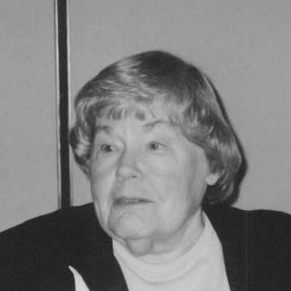
Born in Baltimore Maryland in 1914
Began nursing career at Providence Hospital Nursing in Washington D.C.
Received diploma of nursing in the early 1930s.
Received Bachelor of Science in Nursing Education and Master of Science in Nursing from The Catholic University of America (CUA) in 1939 and 1946, respectively.

Slide 3
Achievements
1971-published the first edition of her book Nursing: Concepts of Practice
Orem developed her definition of nursing practice in 1956
Held directorship of both the nursing school and department of nursing at Providence Hospital, Detroit from 1940 to 1949
Georgetown offered her honorary degree of Doctor of Science in 1976
Passed away on June 22,2007 shortly before 93rd birthday.
Her theory lives on to this day and it continues to be used in many nursing practices today.

Slide 4
Achievements
Received Doctor of Humane Letters from Illinois Wesleyan University in Bloomington, Illinois in 1988.
Catholic University of America Alumni Achievement Award for Nursing Theory (1980)
Completed the 6th edition of Nursing: Concepts of Practice that was published in Mosby (January 2001)

Slide 5
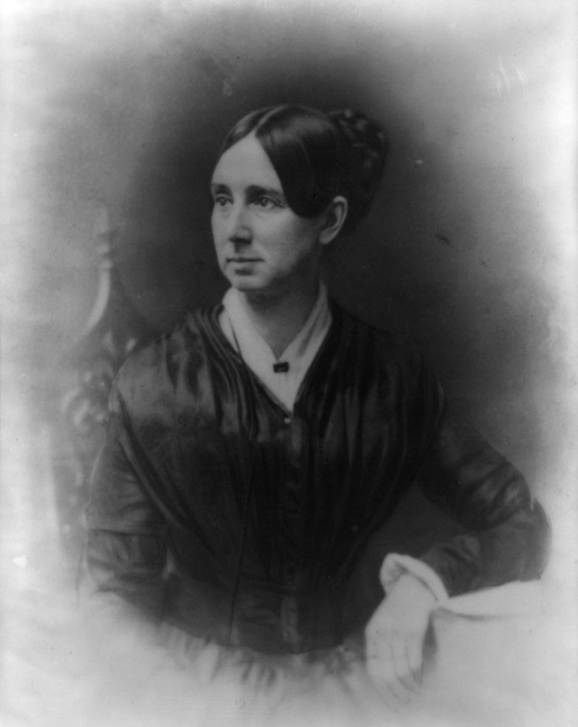
How the theory came to be
1949-1957: Nursing consultant at Division of Hospital and Institutional Services of Indiana State Board of Health
Goal: Upgrade the quality of nursing in general hospitals throughout the state
“Nursing involved both a mode of thinking and mode of communication” (Fawcett,2001,p.34).

Slide 6
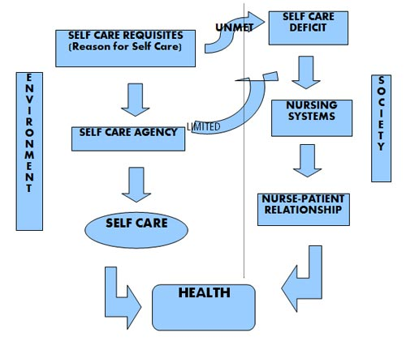
How the theory came to be
Global to Focused
“What do nurses do and what should nurses do as practitioners of nursing?” (Fawcett,2001,p.34).
“Why do nursed do what they do?” (Fawcett,2001,p.34).
“What results from what nurses do as practitioners of nursing?” (Fawcett,2001,p.34).

Slide 7
Orem’s definition of Nursing
Nursing is the provision of self-care, which is therapeutic in sustaining life and health, in recovering from disease or injury, or coping with their effects.
Nursing is a service to people, not a derivative of medicine.
Nursing promotes the goal of patient self-care.

Slide 8
General theory of nursing
Comprised of three concepts:
1. Self-care :activities that the person can accomplish without assistance.
2. self- care deficit: ability does not allow for care to be completed independently.
3. nursing systems: assistance provided by nursing entity to accomplish self-care needs.

Slide 9
General theory of nursing
Self-Care
1.self- care- activities
2.self-care agency- person’s ability
self-care agent
dependent care agent
3.self-care requisites- needs
Universal requisites
Developmental requisites
Health deviation requisites
4.therapeutic self-care demand- steps needed to ensure adequate health.

Slide 10
General theory of nursing
Self-Care Deficit = need < ability
Affecting variables
Self-care agency
Therapeutic demands
5 Nursing Assisted Methods
Acting/doing for
Guiding
Teaching
Supporting
Enabling environment

Slide 11
General theory of nursing
Nursing system enacts nurses to:
Prescribe
Design
Provide
Three types of nursing systems
Wholly compensatory
Partly compensatory
Supportive- educative (developmental)

Slide 12
Orem's theory focused on person, health environment, & Nursing
Person:
Seen as an open system that is active
Masters his/her destinies
Health:
Absent of signs and symptoms of disease
Functional health – self care deficiency

Slide 13
Orems theory focus
Environment:
Physical and psychosocial
Nurse – patient interaction
Nursing:
Provide services to its society
Focus is individual self care

Slide 14
Nursing process for self care deficit
Step 1: Determine why a patient needs care (Assessment)
Step 2: Design a nursing system & plan the delivery of care (Planning and Interventions)
Step 3: Management of nursing systems (Initiating, and Controlling nursing actions)

Slide 15
Nursing process to maintain self care
To maintain a level of optimal health and wellness
Advocate
Redirect
Support Patient and overall
provide an environment conducive to therapeutic development.

Slide 16
References
Tomey, A., & Alligood, M. R. (2006). Dorothea E. Orem.Nursing theorists and their work (6th ed., pp. 267-287). St. Louis, MO: Mosby/Elsevier.
Fawcett, J. (2005). Orem's Self-Care Framework.Contemporary nursing knowledge: analysis and evaluation of nursing models and theories (2nd ed., pp. 223-294). Philadelphia, PA: F.A. Davis Co.
Kalisch, P. A. & Kalisch, B.J. (1987). The Changing Image of the Nurse. Menlo Park, CA: Addison-Wesley Publishing Company.
Kozier, B., Erb,G.,& Blais, K. (1997). Professional nursing practice: Concepts and perspectives. Menlo Park, CA: Addison Wesley Longman
Simmons, S. (1990). The Health-Promoting Self-Care System Model: directions for nursing research and practice. Journal of Advanced Nursing, 15(10), 1162-1166. Retrieved from EBSCOhost. http://search.ebscohost.com/login.aspx?direct=true&db=rzh&AN=1991122724&site=ehost-live&scope=site
Hanucharurnkul, S. (1989). Comparative analysis of Orem's and King's theories. Journal of Advanced Nursing, 14(5), 365-372. Retrieved from http://search.ebscohost.com/login.aspx?direct=true&db=rzh&AN=1989094611&site=ehost-live&scope=site
Fawcett, J. (2001). The nurse theorists: 21st century updates-Dorothea E. Orem (Nurs Sci Q 2001 14:34) Retrieved from Nursing Science Quarterly website: http://nsq.sagepub.com/content/14/1/34

