Slide 1
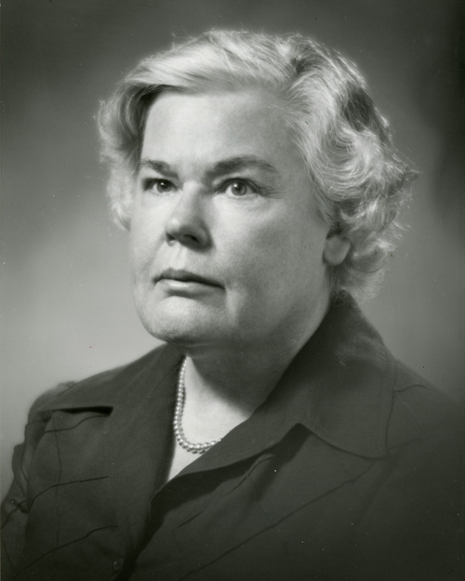
Dorothea Orem
1914-2007

Slide 2

Early in Her Life
-Born in Baltimore, MD in 1914
-Youngest of two sisters
- Father was construction worker and Mother as a house mother/wife

Slide 3
Education
Received degrees in BSN Ed. And MSN Ed. at Catholic University of America in Washington DC
Went on to finish her Doctor of Humane Letters at Illinois Wesleyan
Graduated from University of Missouri in Columbia as a Doctor Honoris Causae.

Slide 4
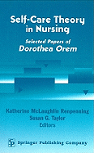
Later in Life
- In 1958, Orem started working on the self-care theory
- In 1976, Orem received the honorary Doctorate of Science from Georgetown University

Slide 5
Development of Theory
The development of this theory took many years and experience being a nurse.
1949-1957 Orem worked for the Division of Hospital and Institutional Services of the Indiana State Board of Health.
Her goal was to upgrade the quality of nursing in general hospitals throughout the state. During this time she developed her definition of nursing practice.

Slide 6
Development of Theory Continued
1959 Orem subsequently served as acting dean of the school of Nursing and as an assistant professor of nursing education at CUA.
She continued to develop her concept of nursing and self care during this time. Orem’s Nursing: Concept of Practice was first published in 1971 and subsequently in 1980, 1985, 1991, 1995, and 2001.

Slide 7
Basic Concepts of Theory
The purpose of Dorothea Orem’s theory of self care deficit is to allow individuals and their families to maintain control of their healthcare.
The most important part of Orem’s theory is that it shows when the nurse is needed to help take care of the patient. If there is a problem and the patient cant fully take care of them self nursing care is needed to ensure the person can reach their optimal health.
The three main goals of this theory are to restore, promote, and maintain the patients health.
Self- Care is an ever changing process throughout life and requires constant reassessment.

Slide 8
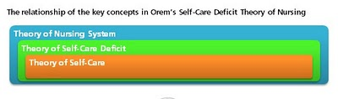
There are three key concepts to the self care deficit theory which are the theory of self-care, theory of self-care deficit , and the theory of nursing system.
The Self -care theory states that self-care is learned behaviors that individuals initiate and perform on their own behalf to maintain life, health, and well-being.
Self-care deficit theory states that people benefit from nursing because they have health-related limitations in providing self-care.
Nursing system theory suggests that nursing systems form when nurses prescribe, design, and provide nursing that relates the individual's self-care capabilities and meets therapeutic self-care requirements.

Slide 9
Basic Concepts of Theory Continued
There are three main components to the Self-care nursing model, the compensatory system, the partial compensatory system and the educative-developmental system.
The Compensatory system is when the nurse provides total care for the patient. This patient cannot do anything for them self. The nurse is necessary for survival of the patient because the patient is totally independent.
The second of Orem’s systems is the Partial Compensatory. The patient and patients family can help but the nurse still has to assist with the care. The patient can go back to providing their own care when they are better but need the support and instruction a nurse can provide at this time.
The third of Orem’s systems is the Educative-developmental system. The patient has total control over their health; the nurse just assists with education and promoting better health care practices.

Slide 10
Summary of Orem’s Theory
Orem's theory (Self-care deficient theory)is based on the idea that all patients have the right, innate ability and responsibility to care for themselves. Human development is accompanied by self reliance, and a desire to be self directing. Self Care is a behavior learned in childhood and exhibited in adult hood. It encompasses activities that incite health, sustain life and well being.
The nurses role is to help the client with self care practices and maximize their self care abilities. A nurse is needed when the patient does not have the ability to maintain a amount of self care to maintain life and health, or recover from disease and injury, or to cope with their effects.

Slide 11
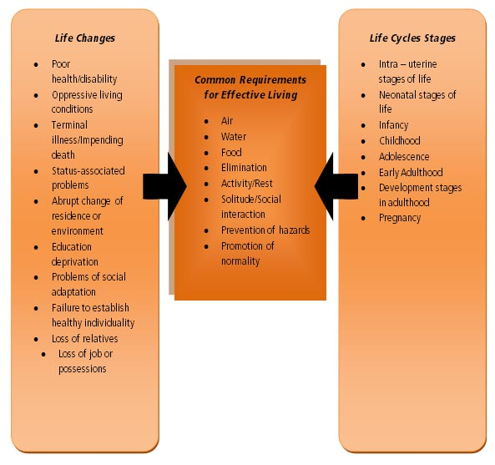
Summary Continued
Orem's 3 nursing systems.
  Wholly compensatory: The patient has no role in self care. Ex. A incapacitated patient(mentally and physically). A patient who is unable to move, but senses environment. A patient whose psychomotor skills cannot respond to the needs of life.
  Partly compensatory: Both the nurse and patient perform self care measurements. The nurse compensates for the patients inability to maintain self care.
  Supportive education: the patient is physically and psychologically capable of maintaining self care. The role of the nurse is to support, guide and teach.
The modern self care plans evolved from Orem’s theory.

Slide 12
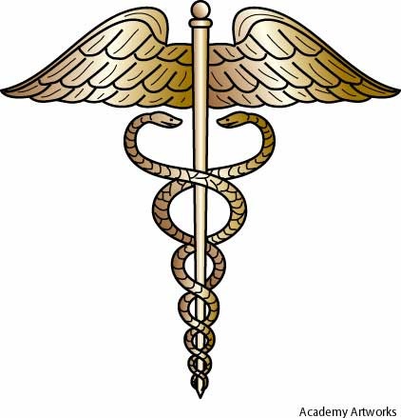
Resources
Clark, M.D.(1986). Application of Orem’s theory of self-care : A case study. Journal of Community Health Nursing, 3.3, 127-135.Retreived from http://www.jstor.org.proxy.lakeland.cc.il.us:2048/stable/3427521

