Slide 1
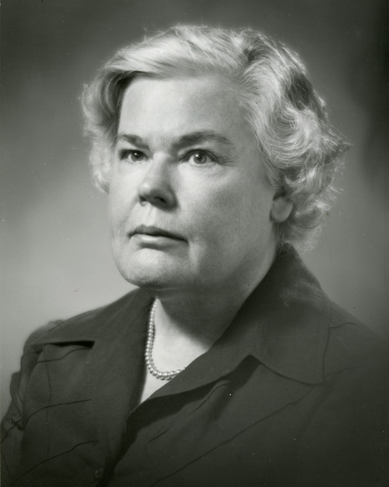
Dorothea Orem 1914-2007

Slide 2

Early in Her Life
-Born in Baltimore, MD in 1914
-Youngest of two sisters
- Father was construction worker and Mother as a house mother/wife

Slide 3
Education
Received degrees in BSN Ed. And MSN Ed. at Catholic University of America in Washington DC
Went on to finish her Doctor of Humane Letters at Illinois Wesleyan
Graduated from University of Missouri in Columbia as a Doctor Honoris Causae.

Slide 4
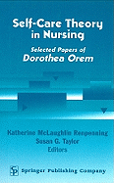
Later in Life
- In 1958, Orem started working on the self-care theory
- In 1976, Orem received the honorary Doctorate of Science from Georgetown University

Slide 5
Summary of Orem’s Theory
Orem's theory (Self-care deficient theory)is based on the idea that all patients have the right, innate ability and responsibility to care for themselves. Human development is accompanied by self reliance, and a desire to be self directing. Self Care is a behavior learned in childhood and exhibited in adult hood. It encompasses activities that incite health, sustain life and well being.
The nurses role is to help the client with self care practices and maximize their self care abilities. A nurse is needed when the patient does not have the ability to maintain a amount of self care to maintain life and health, or recover from disease and injury, or to cope with their effects.

Slide 6
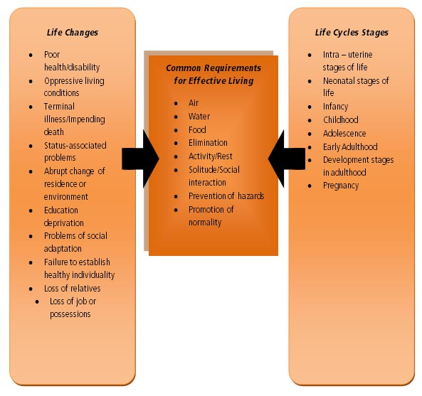
Summary Continued
Orem's 3 nursing systems.
Wholly compensatory: The patient has no role in self care. Ex. A incapacitated patient(mentally and physically). A patient who is unable to move, but senses environment. A patient whose psychomotor skills cannot respond to the needs of life.
Partly compensatory: Both the nurse and patient perform self care measurements. The nurse compensates for the patients inability to maintain self care.
Supportive education: the patient is physically and psychologically capable of maintaining self care. The role of the nurse is to support, guide and teach.
The modern self care plans evolved from Orem’s theory.

Slide 7
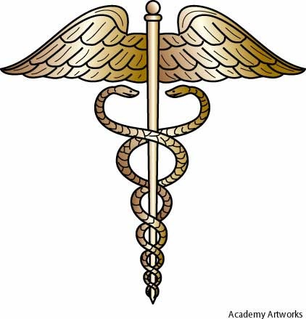
Resources
Clark, M.D.(1986). Application of Orem’s theory of self-care : A case study. Journal of Community Health Nursing, 3.3, 127-135.Retreived from http://www.jstor.org.proxy.lakeland.cc.il.us:2048/stable/3427521

