Slide 1
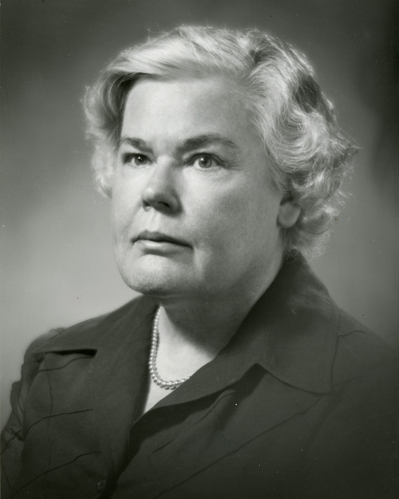
Dorothea Orem
1914-2007

Slide 2

Early in Her Life
-Born in Baltimore, MD in 1914
-Youngest of two sisters
- Father was construction worker and Mother as a house mother/wife

Slide 3
Education
Received degrees in BSN Ed. And MSN Ed. at Catholic University of America in Washington DC
Went on to finish her Doctor of Humane Letters at Illinois Wesleyan
Graduated from University of Missouri in Columbia as a Doctor Honoris Causae.

Slide 4
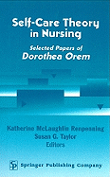
Later in Life
- In 1958, Orem started working on the self-care theory
- In 1976, Orem received the honorary Doctorate of Science from Georgetown University

