Slide 1
Dorothea Orem
By: Anna Barrera, Lisa Fresso, Peter Mbinglo, Chanelle Carley, Omololu Kafisanwo, Jamie Lowe

Slide 2
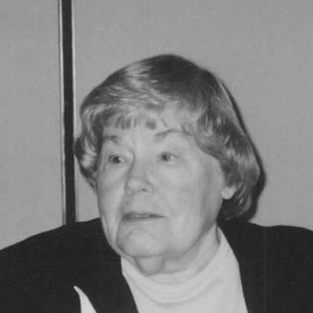
Born in Baltimore Maryland in 1914
Began nursing career at Providence Hospital Nursing in Washington D.C.
Received diploma of nursing in the early 1930s.
Received Bachelor of Science in Nursing Education and Master of Science in Nursing from The Catholic University of America (CUA) in 1939 and 1946, respectively.

Slide 3
Achievements
1971-published the first edition of her book Nursing: Concepts of Practice
Orem developed her definition of nursing practice in 1956
Held directorship of both the nursing school and department of nursing at Providence Hospital, Detroit from 1940 to 1949
Georgetown offered her honorary degree of Doctor of Science in 1976

Slide 4
Achievements

Slide 5
Orem’s definition of Nursing
Nursing is the provision of self-care, which is therapeutic in sustaining life and health, in recovering from disease or injury, or coping with their effects.
Nursing is a service to people, not a derivative of medicine.
Nursing promotes the goal of patient self-care.

Slide 6
Orem’s nursing process
Consists of 3 different steps:
Step 1: Determine why a patient needs care
Step 2: Design a nursing system & plan the delivery of care
Step 3: Management of nursing systems:
Planning
Initiating
Controlling nursing actions

Slide 7
General theory of nursing
Consists of three related theories collectively referred to as “Orem’s General Theory of Nursing”
Self-Care Theory: 3 types of self-care needs or categories.
Self-Care Deficit Theory: 5 methods of Assistance
Nursing System Theory

Slide 8
Self-care theory
Based on the concepts of:
Self-Care
Self-Care agency
Self-Care Requisites
Therapeutics Self-Care Demand

Slide 9
Orem’s self-care definition
Self-care comprises those activities performed independently by an individual to promote and maintain personal well-being throughout life

Slide 10
Self-care agency
Definition: the individuals ability to perform self-care activities
Consists of two agents:
Self-care agent-person who provides the self-care
Dependent Care Agent-person other than the individual who provides the care (such as a parent)

Slide 11
Self-care Requisites (Self-care needs)
Definition: the actions or measures used to provide self-care
Consists of three categories:
Universal- requisites/needs that are common to all individuals
Developmental-needs resulting from maturation or develop due to a condition or event
Health deviation- needs from illness, injury, disease, or its treatment

Slide 12
Self-care deficit theory
Central focus of Orem’s theory of Nursing
It explains when nursing is needed
Describes and explains how people can be helped through nursing
Results when the self-care agency (patient) cant meet his/her self-care needs or administer self-care
Nursing meets these self-care needs through five methods of help

Slide 13
5 methods of nursing help
Acting or doing for
Guiding
Teaching
Supporting
Providing an environment to promote the patients ability to meet current or future demands

Slide 14
Nursing system theories
Nursing responsibilities
Roles of the nurse and the patient
Rationales for the nurse-patient relationship
Types of actions needed to meet the patients demands

Slide 15
Nursing system theory
Refers to a series of actions a nurse takes to meet a patients self-care needs
Is determined by the patients self-care needs
Is composed of three systems:
Wholly compensatory
Partly compensatory
Supportive-educative

Slide 16
Nursing systems
Wholly Compensatory: a patient’s self-care agency is so limited that s/he depends on others for well-being
Partly Compensatory: a patient can meet some self-care requisites but needs a nurse to help meet others
Supportive-educative: a patient can meet self-care requisites but needs help in decision-making behavior control or knowledge acquisition

Slide 17
References
Tomey, A., & Alligood, M. R. (2006). Dorothea E. Orem.Nursing theorists and their work (6th ed., pp. 267-287). St. Louis, MO: Mosby/Elsevier.
Fawcett, J. (2005). Orem's Self-Care Framework.Contemporary nursing knowledge: analysis and evaluation of nursing models and theories (2nd ed., pp. 223-294). Philadelphia, PA: F.A. Davis Co..

