Slide 1
ANALYSIS OF A QUANTITATIVE STUDY

Slide 2
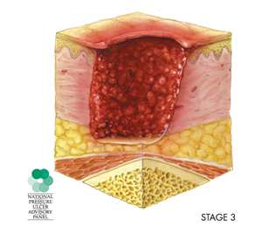
SUMMARY
Purpose was to describe how pressures can be prevented when a patient has been hospitalized also, included in the study was patient who received surgery
Cohort design was used by the researchers to collect data
The sample of patient was collected from electronic medical records of 3225
Braden score on admission can identify patients who are an increased risk
Other factors was included on the study such as low body mass index long operative procedures
Notes:
The reason for the study is because this is more than half of the hospitals in the midwest have a very hard time with pressure ulcers on patients. So medicaid has challenged the nurses to focus on patients to prevent pressure ulcers from happening. The research examined the relationship between patients’ characteristics such as age, sex, body mass index, etc. The research even took a looked at operating room time how those patients was handle after their surgery was over. The design that was used was the cohort design and the subjects 3225 was taken from electronic medical data base and look at how to see if they were at increase in pressure ulcers. A total of 12% of the patients at the hospital had at least 1 pressure ulcers develop during their hospital stay.

Slide 3
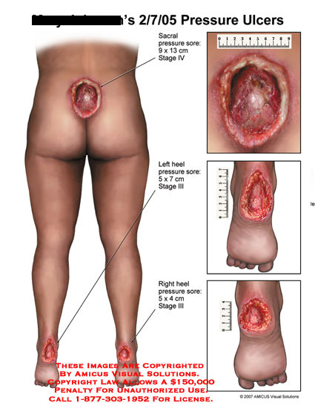
PROBLEM AND PURPOSE
Problem:
Healthcare personnel lack the care and performance when preventing patients from having pressure ulcers
Pressure ulcers have been a challenge despite all the research and it’s the number challenge for healthcare personnel
Purpose:
To examine the relationship between patient process characteristics and development of pressure ulcers in a populations of surgical patients
Notes:
The problem identified by researchers that is healthcare personnel lack the care in preventing pressure ulcers on patients’ that receive treatment at the hospital. The purpose is to see why so many patients’ have an increased risk to develop a pressure ulcers during their stay at the hospital.

Slide 4
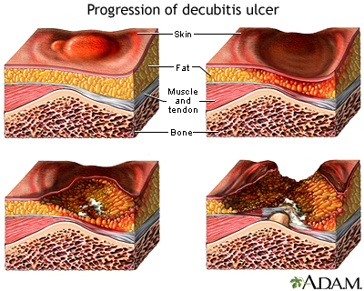
LITERATIURE
Relevant literature selected by the author
Presents clear and concise information on pressure ulcers , also discuss the useful tools in helping stopping the development of pressure ulcers
“pressure ulcers were more prevalent among patient with a lower BMI than among patient in other BMI categories” ( Gilder et al., 2007)
All references articles were from different studies done in the pass and others was within the last five years because this subject has been a problem for patient for a long time.
Notes:
The articles that accompanied the study was very old articles and even some present ones since this subject has been a problem for patients’ from the beginning trying to prevent patients’ from developing pressure ulcers while they are in the hospital. The article chosen by Gilder, et al. ( 2007) are relevant to the study. The other studies was breifly mention in the study and seem to play a big role on just background knowledge on the history of have patients’ have been developing pressure ulcers. Some of the articles are group together and breiftly explain in the article. The literature review is not separated by it’s own heading, but there is a discussion of the study and some of the studies are explained and mention in the discussion part of the study. All of the studies are not recent some came from older articles to establish the reasons for patients’ to still developing pressure ulcers. The study had 37 references and many of them came from the pasts like the late 80’s and 90’s and some of the articles are within the last five years.

