Slide 1

Domestic Violence
What is it?
Can it affect teens?
Volpe, J. (1996). Effects of domestic violence on children and adolescents: An overview. Retrieved from http://www.aaets.org/article8.htm
Smith, M., & Segal, J. (2011, December). Domestic violence and abuse. Retrieved from http://helpguide.org/mental/domestic_violence_abuse_types_signs_causes_effects.htm

Slide 2
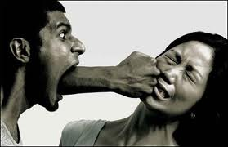
Types of Abuse
Financial abuse
Substance abuse
Sexual Abuse
Verbal
Emotional
Verbal
Physical abuse

Slide 3

Afraid Humiliate
Ignore Blame You
Property Control
Limit Threaten Jealous Possessive Hurt
…believe you deserve to be hurt or mistreated
http://helpguide.org/mental/domestic_violence_abuse_types_signs_causes_effects.htm

Slide 4
Helping your teens
Keep all your communication lines
open.
Always validate what the teen is
feeling
Support them but not the
Relationship
Aguinaldo, J. (2011, 11 23). Wikipedia. Retrieved from http://en.wikipedia.org/wiki/Domestic_violence

Slide 5
Getting Help
Local Police
Trusted Adult
Mandated Reporters (Teachers, Social Workers, Bank Managers, etc.)
http://www.youtube.com/watch?v=WL3rfk2iFww&feature=related
(2010, Sept 15). Youtube. (2010). [Web]. Retrieved from http://www.youtube.com/watch?v=WL3rfk2iFww&feature=related
National domestic violence hotline. (2011, October 25). Retrieved from http://www.thehotline.org/

