Slide 1
Diagnosed Hypertension
Kelly Sheppard, Kallie Tracy, Kristina Bailey, Kelsey Draeger, & Kathleen Mansfield
Nursing Research (N302)
July 18, 2012

Slide 2
Summary of Article
Examine the prevalence of diagnosed hypertension
Mortality rate among the diagnosed compared to undiagnosed
Examined cases of diagnosed hypertension from 1998-1999 and 2007-2008
In 07-08 6 million adults were living with diagnosed hypertension
The age standard increased 7.5%
Notes:
The researchers thought that this study would be important because hypertension is the leading risk factor for cardiovascular diseases. High blood pressure is a great risk factor for deaths and it takes off years of life in healthy individuals. The framework of this study could be inferred as prevalence and incidence of hypertension. The researchers looked at the diagnosis of hypertension in individuals and how their life progressed after. They wanted to see what was to come in these patients with a diagnosis of hypertension. The researchers started off with diagnosis in 1998-1999 and compared those numbers to diagnosis in 2007-2008. What they saw was a much larger number of diagnosis in 2007-2008. This is not surprising to me because of how much our world’s society depends on fast lifestyles and lack of exercise because of being constantly busy. The researchers teamed up with The Canadian Chronic Disease Surveillance System to get information on diagnosed hypertension. The surveillance system collects their information by use of personal health insurance numbers and add it into a database. The researchers used data of age, sex, place of residence, and date of death. The researchers chose to study people that were at least 20 years of age, had a diagnosis of hypertension by at least two physicians, and proof of hypertension for at least two years. The researchers concluded shocking results. In 2007-2008, about 6 million Canadians were diagnosed with hypertension. The numbers here were larger in women than in men. The researchers also found that there were 418,000 new cases of hypertension diagnosed in that year. These numbers seemed to be higher in men than in women. The researchers concluded that the age standard prevalence increased significantly in the 2007-2008 year study. They found that cases increased with elderly women than in elderly men because women are more aware of hypertension which was shown in other studies. The researchers concluded that the number of diagnosis is just going to keep increasing unless Canada takes action as a whole. They believe more programs need to be offered to bring aware to hypertension and help decrease it’s prevalence. They also believe that society needs to be aware that decreasing sodium consumption will help to avoid hypertension.

Slide 3
Problem/Purpose
The article states raised blood pressure as being the leading risk factor for death
A global problem, research of hypertension lacks the use of administrative data, which would provide a complete view of hypertension
This problem is clearly stated within the introduction of the article, and is researchable with the use of administrative data
Hypertension is significant to nursing in that it is a global health issue. In the healthcare field and workplace, nurses will frequently come in contact with patients who have hypertension, whether it has been previously diagnosed or not
Notes:
The article states that raised blood pressure (or hypertension) is the leading risk factor for death. Research of hypertension lacks the use of administrative data, which if used would provide more of a complete picture regarding hypertension as a global issue. The problem of hypertension is clearly stated within the article in the introduction section. This problem is in fact researchable with the use of administrative data, as the authors suggest. The topic of hypertension is significant to nursing in that it is a global health issue. In the healthcare field and the workplace, nurses frequently come in contact with patients who have hypertension, whether it has previously been diagnosed or not.

Slide 4
Conceptual Framework
Not clearly stated.
Framework is appropriate to problem.
Relationships between concepts identified.
Notes:
The framework was not clearly described, but it can be inferred from the introduction and results paragraphs. The framework was based off prevalence and incidence of hypertension in Canadian adults from the years 1998/99 to 2007/08. The framework identifies the concepts and how they are related. Hypertension must be diagnosed by two different physicians within two years , or must be claimed in a discharge chart for hypertension to be considered significant for this study. The prevalence and incidence were compared by using age and sex.

Slide 5
Review of Literature
Literature was relevant to topic.
Current research was used.
The need for the study was clearly stated in both the abstract and the introduction.
Literature was well critiqued.
All literature was obtained from the same database and then was processed by SAS macros to ensure comparability.
Notes:
The previous studies were briefly described in the introduction, which supported that more research need to be done to determine the prevalence of hypertension. The literature review was not separated out in the article by its own heading, however, it was included in the introduction and data sources as to how it was obtained and the credibility of it.
The references used for this study were current for the time when the study was conducted (1998/99 to 2007/08). However, the article was not published until 2012, so not all references used were not considered current, although the majority of the references used were published after the year 2002.

Slide 6
Research Question/Hypothesis
It is inferred from the article that the researchers believe both incidence and prevalence of hypertension to increase as years progress
This hypothesis had to be inferred, as it was not clearly stated within the article
The hypothesis is researchable, by using a series of databases and statistically analyzing the results.
It relates to the problem of the study, as well as the literature review discussed within the article. It also appropriately relates to the discussion of the results
Notes:
One must infer from the article that the researchers believe both incidence and prevalence of hypertension to increase as years pregress. This hypothesis had to be infered, since it was not clearly stated within any portion of the article. The hypothesis is researchable by first using a series of databases and then statistically analyzing the results. The hypothesis does in fact relate to the problem of the study, as well as with the literature review discussed in the article. It appropriately relates to the discussion of the results.

Slide 7
Variables
Canadian Adults 20 years and older
Independent Variables:
Prevalence of diagnosed hypertension
Incidence of diagnosed hypertension
Dependent Variables:
Mortality among people with and without diagnosed hypertension
Notes:
Demographic Variables include Canadian adults 20 years and older excluding women aged 20-54 years who were suspected to have pregnancy induced hypertension.
Prevalence and incidence of diagnosed hypertension are independent variables for this study. A diagnosis of hypertension was conceptually defined as either having two or more physician claims for hypertension within two years or one recording of hypertension in the hospital discharge abstract. Prevalence of diagnosed hypertension is operationally defined as the number of people diagnosed with hypertension divided by the insured population. Incidence of diagnosed hypertension can also be operationally defined as the total number of people with newly diagnosed hypertension divided by the total number of people at risk for hypertension. The mortality rate among people with and without diagnosed hypertension is the dependent variable in this study. Conceptually defined, the mortality rate was figured by dividing all-cause mortality among people with diagnosed hypertension by the number of people without diagnosed hypertension.
Extraneous variables identified in this study include but aren’t limited to individuals who don’t report having been diagnosed with hypertension as well as those who don’t follow their prescribed medication regimen. Intervening variables in this situation were out of researchers control.

Slide 8
Design
Retrospective Population-based Cohort Study
Appropriately addresses the research problem
Notes:
The retrospective design collects data from past events, in this study the past events are medical diagnosis’ of hypertension from 1997 until 2008. Because the study was also a population-based cohort study the entire Canadian population, whom had health insurance, were followed over ten years.
The internal validity of this study could not be compromised. All information related to diagnosis of hypertension and mortality causes was gathered from national health records.

Slide 9
Sample
Inclusion Criteria:
Adults 20 years or older
Health Insurance
Notes:
More than 26 million adults in Canada were studied to find the prevalence and incidence of diagnosed hypertension. The sample includes the majority of the country therefor can be described as representative of the population. The sampling method used, reviewing combined medical records from the national records, is the best fit for collecting such a vast amount of information. Protection of the subjects involved in this study was not addressed.

Slide 10
Data Collection Methods
The methods of data collection include using the Canadian Chronic Disease Surveillance System to retrieve data from health related databases from each providence of Canada
Another system, the Canadian Institute for Heath Information’s Discharge Abstract Database was used to gather data and demographics of patients specifically from Quebec
Notes:
The methods of the data collection for this study include using a systemknown as the Canadian Chronic Disease Surveillance System to retrieve data from health related databases from each providence of Canada. Another system known as the Canadian Institute for Health Information's Discharge Abstract Database was used. This particular system gathered data and patient demographics from Quebec.

Slide 11
Data Collection Methods Cont.
This approach of data collection is appropriate, since the databases the computer systems searched through provided accurate information
The systems used to gather the data are described in specific detail, including what information was gathered from what system
Reliability is included since the data collected is consistent from the databases it was obtained from
Validity was addressed within the description of each computer system used, as well as within the results that are discussed later in the article
Notes:
The approach to this data collection is appropriate, since the databases that were searched through provided the most accurate form of information that could be attained. The systems used to gather the data are desribed in specific detail, including what information was gathered from which specific system. Reliability is addressed within the article since the data that was collected is consistent from each database it was obtained from. Validity was addressed as well since each computer system that was used was described in detail, along with the results that were discussed at a later point in the article.

Slide 12
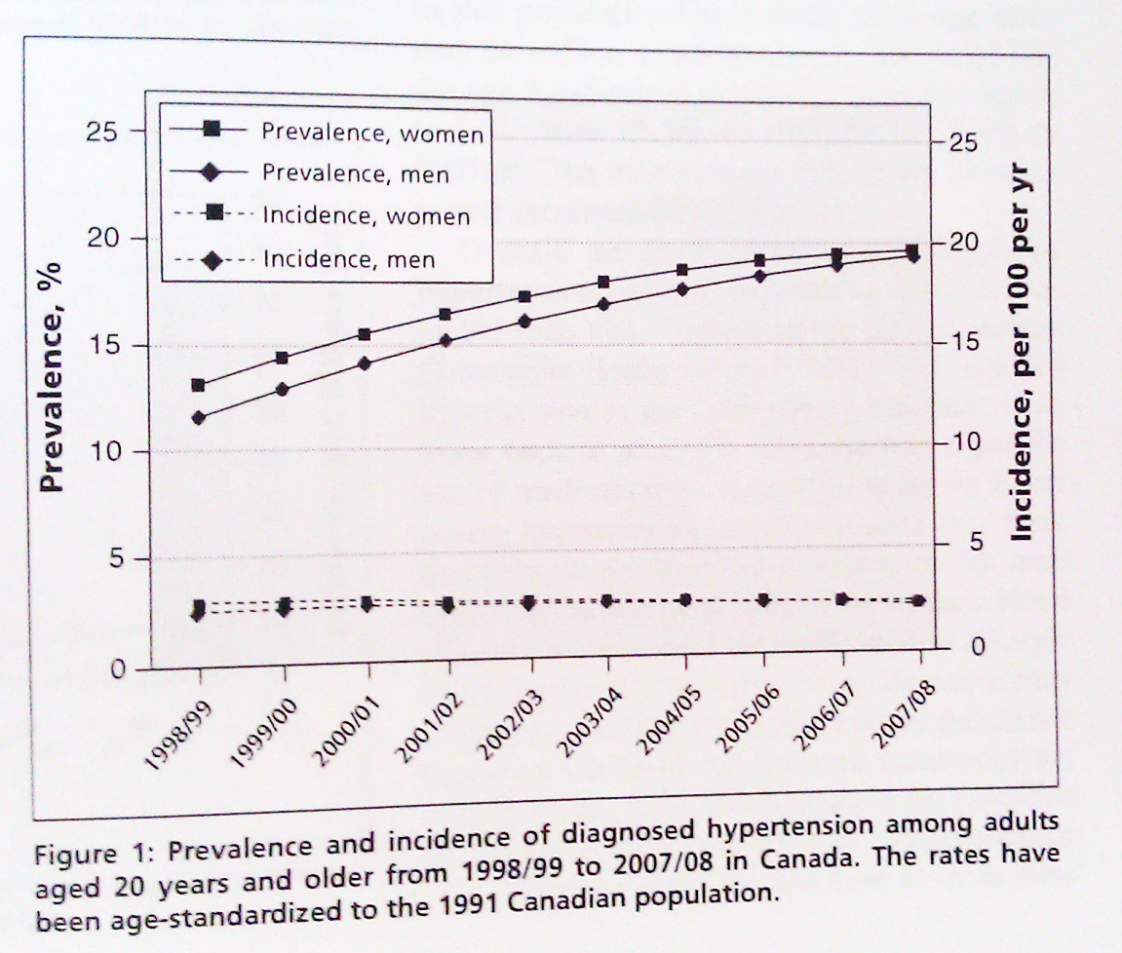
Data Analysis
Table 4: All-cause mortality and rate ratios among adults aged 20 years and older with and without diagnosed hypertension in Canada in 2007/08
All-cause mortality, per 1000 people
Age, yr | No hypertension | Hypertension | Rate ratio
20-24 | 0.5 | 2.2 | 4.2
25-29 | 0.5 | 2.0 | 4.0
30-34 | 0.5 | 1.5 | 2.7
35-39 | 0.7 | 1.8 | 2.4
40-44 | 1.1 | 2.6 | 2.4
45-49 | 1.8 | 3.5 | 1.9
50-54 | 2.7 | 4.9 | 1.8
55-59 | 4.2 | 6.7 | 1.6
60-64 | 6.4 | 9.8 | 1.5
65-69 | 10.3 | 14.9 | 1.5
70-74 | 16.5 | 22.7 | 1.4
75-79 | 28.5 | 35.5 | 1.2
80-84 | 49.2 | 57.4 | 1.2
>85 | 105.1 | 120.4 | 1.1
Notes:
Researchers analyzed prevalence and incidence of diagnosed hypertension by age, location and sex. The procedure chosen to analyze the data appropriately measures all information collected while still answering the research question. Results are presented in narrative form as well as charts and tables.

Slide 13
Results, Conclusions, Discussion of Findings
The findings and interpretations were clearly differentiated.
The research question was answered.
The limitations to the study were identified.
Implications specific to nurses was not addressed.
Recommendations for future research is recommended.
Notes:
The findings and interpretations were clearly identified in their own headings. The research question was answered, stating that mortality was at a higher risk for those who were diagnosed with hypertension. The study had three main limitations. The first stated that the study only could include people that were had come in contact with a health care system. Second the use of health administrative data to estimate diagnosed hypertension can result in misclassification of hypertension cases and non-hypertension cases. The last limitation was that geographic differences cannot be explained with certainty. The implications mentioned were not specific to nurses, but the article did recommend that that programs be started to improve the lifestyles of Canadians. Future research was recommended to continue to track hypertension to seek ways to enhance prevention and management for Canadians.

Slide 14
Conclusion

Slide 15
Reference

