Slide 2
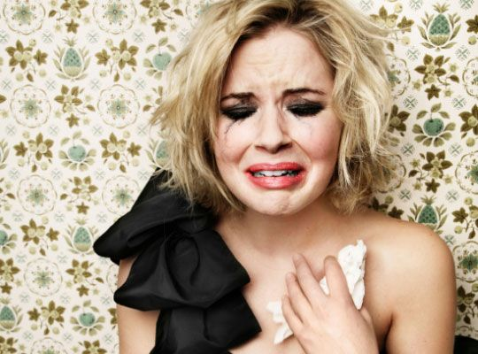
Prevention
Signs
Education
Leadership
Support

