Slide 1
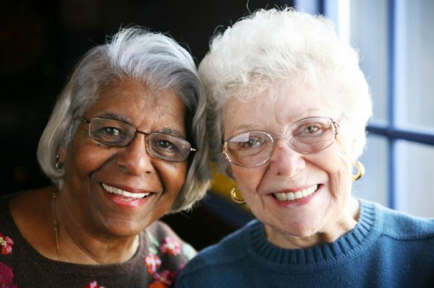
Cultural Competency Geriatric Population
(Monu, 2008)
Ilse Vega, Emily Stahl, Elizabeth Rademacher, Wendy
Oakley, Tearra McDade
Lakeview College of Nursing
Theories and Issues in Nursing
April 13, 2011

Slide 2
Purpose
Demographic representation of geriatrics
Health Preferences
Impact of nursing care
Notes:
The purpose of our presentation is to represent the geriatric population and to demonstrate how important it is to practice as culturally competence nurses. This presentation will discuss the demographic representation of the geriatric population, the cultural health preferences, and impact on nursing care

Slide 3
Demographic representation of geriatric population in the united States

Slide 4
Overview of Geriatric’s health preferences

Slide 5
Independence
Living at their homes
Maintain physical activity
Dignity
Make their own decisions

Slide 6
Impact of independence on nursing care
Encourage patients to do as much as they can for themselves
Provide care for elderly patients in their home

Slide 7
Impact of geriatrics preferences on nursing care

Slide 8
Summary

Slide 9
References

