Slide 1
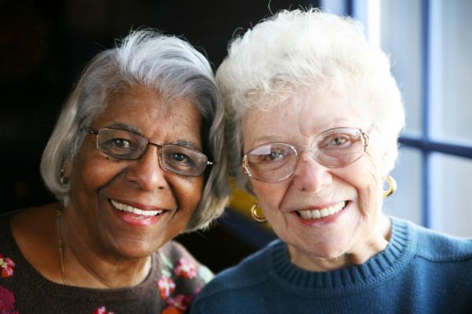
Cultural Competency
Geriatric Population
(Monu, 2008)
Ilse Vega, Emily Stahl, Elizabeth Rademacher, Wendy
Oakley, Tearra McDade
Lakeview College of Nursing
Theories and Issues in Nursing
April 13, 2011

Slide 2
Purpose
Demographic representation of geriatrics
Health Preferences
Impact of nursing care
Notes:
The purpose of our presentation is to represent the geriatric population and to demonstrate how important it is to practice as culturally competent nurses. This presentation will discuss the demographic representation of the geriatric population, the cultural health preferences, and it’s impact on nursing care

Slide 3
Demographic representation of geriatric population in the united States

Slide 4
Overview of Geriatric’s health preferences

Slide 5
Preferences on Nursing Care
-Mental Distress & the Elderly
- Importance of Primary Care Physician
Notes:
Elders tend to be very specific on who they trust with their mental health issues. The older population prefers to initiate discussions about mental health problems with their primary care provider versus other physicians they are not familiar with. Elders tend to be more embarrassed of admitting having any mental problems most likely due to the way they grew up and how mental people were viewed back then. Many older adults will accept both psychotherapy and medications but they generally prefer psychotherapy. (Avalon et al., 2010, p.136) Now a days people depend mostly on the medications versus actual therapy. Their generation didn’t depend on medications to treat their illness maybe due to lack of money for the medications or simply just ignoring the fact that they were actually sick.
The geriatric population prefers services that match their own personal preferences. Older people are very picky when it comes to their primary care provider. Geriatric patients base their opinions of their nurses and physicians on beliefs in treatment efficacy, and their expectations when administering treatments. (Avalon et al., 2010, p. 137) The younger population compared to the older population is not nearly as selective when choosing their primary care provider. The geriatric population is very dependent on their physician and do not prefer to constantly be referred to other doctors.

Slide 6
Independence
Living at their homes
Maintain physical activity
Dignity
Make their own decisions

Slide 7
Gum, A. M., Ayalon, L., Greenberg, J., Palko, B., Ruffo, E. & Areán, P. A. (2010). Preferences for Professional Assistance for Distress in a Diverse Sample of Older Adults. Clinical Gerontologist, 33(2), 136-151. doi:10.1080/07317110903551901

Slide 8
Impact of independence on nursing care
Encourage patients to do as much as they can for themselves
Provide care for elderly patients in their home

Slide 9
Impact of geriatrics preferences on nursing care

Slide 10
Summary

Slide 11
References

