Slide 1
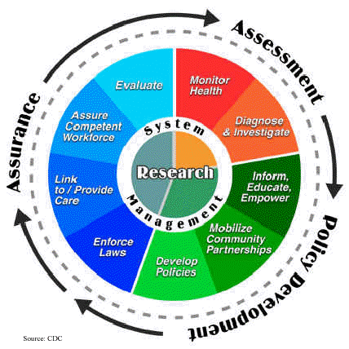
Core Functions of Public Health
Assessment
Policy formation
Assurance

