Slide 1
Oakland, Illinois
Community Assessment Project
Lakeview College of Nursing
Tenika McMillan, RN,
Alicia Northen, RN,
Sheila Roth, RN,
Lori Turner, RN

Slide 2
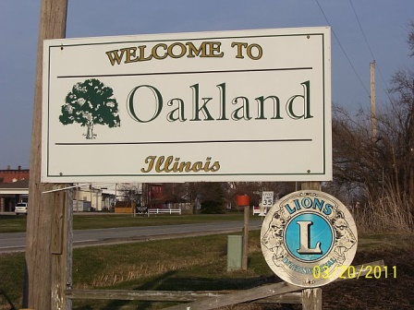

Slide 3
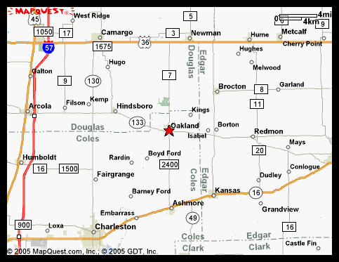
Welcome to Oakland, IL
Community located in South East Illinois
33.9 miles South East of Champaign
100.3 miles West of Indianapolis
152.1 miles South of Chicago
http:www.mapquest.com/oaklandIL

Slide 4
Welcome to Oakland (cont’d)
Surrounding communities are small towns
Difficult to find healthcare locally
Must travel significant distances for medical treatment.
Mattoon is closest area with healthcare options.

Slide 5
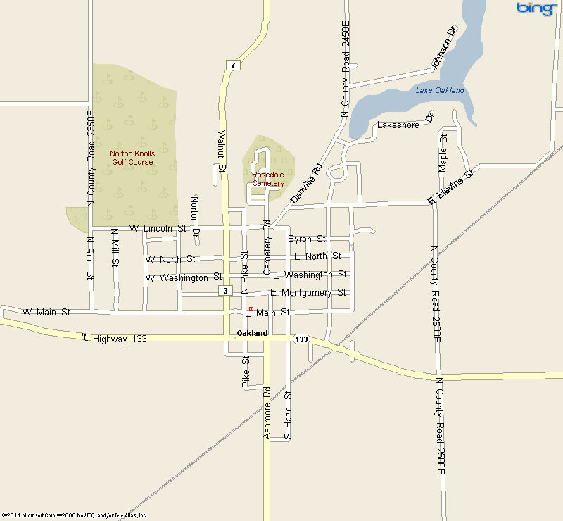
Welcome to Oakland (cont’d)
Map provides detailed look of Oakland.
Boundaries more clearly defined.
http://maps.msn.com/

Slide 6
Windshield Survey: Oakland, IL
Performed: Multiple times / different times of day.
Homes approximately same age and similar style
Styles: Ranch, Cape Cod, and Bungalow Style
Homes older but well kept.
South of Route 133 lower socioeconomic class
Moderately sized yards
No new development / few abandoned homes

Slide 7
Windshield Survey: Oakland IL, (cont’d)
Center of Town:
Open grassy area
Local businesses
People seen frequenting businesses in daytime
No one around in evening hours

Slide 8
Windshield Survey: Oakland, IL (cont’d)
North Side of Square:
Christian Church
Separated from south side of town by Route 133

Slide 9
Windshield Survey: Oakland, IL (cont’d)
East of the town square
Insurance Company
Furniture Store
Beauty and Barber Shop
Bank
Small Restaurant
Farm Implement Store
Antique Store

Slide 10
Windshield Survey: Oakland, IL (cont’d)
Food Pantry
Used Clothing Store
A few blocks further east:
Funeral Home
Lumber Yard
Crop Production Business

Slide 11
Windshield Survey: Oakland, IL (cont’d)
South of the town square:
Columbia Building
Newspaper
Noodle Company
Variety Store
Fire House
Ambulance Garage

Slide 12
Windshield Survey: Oakland, IL (cont’d)
On the West side of the square
Library
Meals on Wheels
Grocery Store
The Oaks Manor

Slide 13
Windshield Survey: Oakland, IL (cont’d)
Boundaries of Oakland:
North separated from south by Route 133
East from West / Oakland/Ashmore Road & Walnut St.
Roads found in good shape.

Slide 14
Windshield Survey: Oakland, IL (cont’d)
Observations:
No public transportation
Nearest hospital 18 miles
Predominantly white people
Very little activity observed

Slide 15
Interviews
School Nurse: Vivian Hudson
Obesity concerns / children / adults
Proactive approach / provide opportunities
Community 5K race / 1K walk
Open gym
Walk Night
Changing meals / snacks at school

Slide 16
Descriptive Data / Demographics
Obesity Calculations : Adults vs. Children
Adults: Calculating relation between height and weight
BMI between 25 & 29.9 (Overweight)
BMI >30 (Obese)
Children: BMI figured in percentiles
BMI at 85th percentile and <95th percentile (Overweight)
BMI >95th percentile same sex / age (Obese)

Slide 17
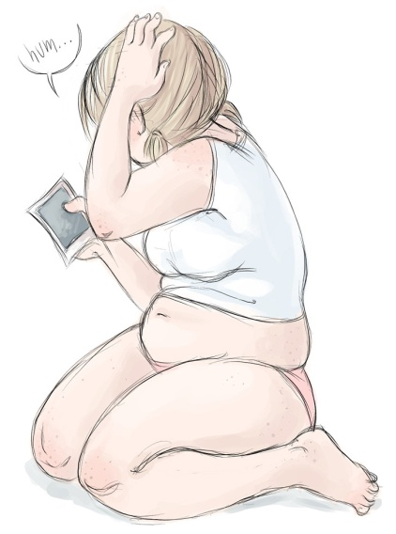
Descriptive Data / Demographics
Oakland, Illinois adult obesity rate / 2010 / 27.2%
Childhood obesity/ low-income preschool / Coles County / 13.6%
1986 Illinois obesity rate <10%
1994 increased to 15% -19%
1999 increased to 20% - 24%
2008 all time high 25% - 29%
2009 Illinois maintained same high percentage
basalt.deviantart.com/ art chubby-girl-19582902

Slide 18
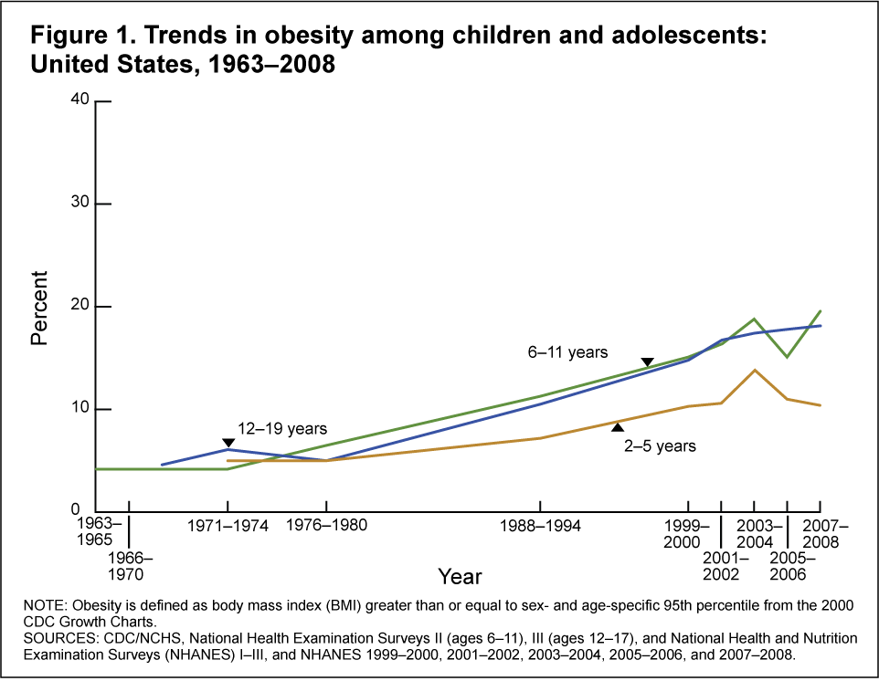
http://www.cdc.gov/nchs/data/hestat/obesity_child_07_08/obesity_child_07_08.htm#tabl0e1.

Slide 19

Descriptive Data / Demographics
Population in Oakland
In 2009 total population 933
Males: 454
Females 479
Median Age 2009: 40.5
Median Age Illinois 2009: 34.7

Slide 20

Descriptive Data / Demographics
Median household income ~ $39,498 (Oakland)
Median household income residents Illinois $53,966

Slide 21
Descriptive Data / Demographics
Most common jobs Oakland men 2009
Farmers / Farm managers 4%
Assemblers / Fabricators 5%
Metal & Plastic Workers 5%
Construction Trades 5%
Carpenters 7%
Drivers / Sales / Truck Drivers 8%
Other / Supervisors 8%

Slide 22
Descriptive Data / Demographics
Most common jobs Oakland women 2009
Secretaries / Administrative Assistants 8%
Other production occupations / Supervisors 8%
Teachers through middle school 6%
Cooks / Food Prep 6%
Other office administrative support workers 5%
Assemblers / Fabricators 5%
Retail Sales 4%

Slide 23
Descriptive Data / Demographics
Predominant Race: White 99.2%, Asian 0.8%
Education levels:
High school: 82.7%
Bachelor’s degree of higher: 15.3%
Graduate or Professional Degree: 3.8%
Unemployed: 2.7%

Slide 24

Descriptive Data / Demographics
Marital Status
Five Categories for ages 15 years or older.
Never Been Married 2009: 16.8%
Married 2009: 60.1%
Separated Individuals 2009: 0.9%
Widows / Widowers 2009: 10.0%
Divorced 2009: 12.3%

Slide 25

Descriptive Data / Demographics
Religious Congregations
Lutheran: 10%
United Methodist: 13%
Southern Baptist: 10%
Christian / Churches of Christ: 15%
Catholic: 16%

Slide 26
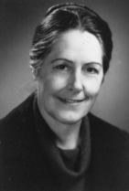
Nursing Theorist: Betty Neuman’s System Model
Betty Neuman’s System Model Believes:
Purpose of nurse: retain stability prevention levels.
Primary: Protect normal / strengthen flexible lines defense
Secondary: Strengthen resistance/ reduce reaction / increase resistance
Tertiary: Readapt / Stabilize / Protect Reconstitution / Return Wellness
www.angelfire.com/ns

Slide 27
Problem Correlates of Factors | Relationships | Supportive Data
High risk for diabetes | Patients with diagnosis | Interviews
High risk for obesity | Patients with diagnosis | Interviews
Lack of local medical care | No physician or healthcare offices in the town of Oakland | Windshield interviews
Lack of pharmacy & medical supply | No pharmacy located in town of Oakland | Windshield interviews
Lack of dental care | No dental office in town of Oakland | Windshield interviews
Lack of transportation | No agencies offering transportation to town | Interviews
Lack of health education | No agencies providing healthcare education in town | Interviews
Lack of exercise options | No gym or structured exercise programs in town | Windshield/interviews
Low socioeconomic status | No money to pay for exercise options | 49.7% poverty status in 1999
Low level of education | Limited comprehension and motivation | 14% non-graduates from H.S.

Slide 28
Strengths / Resources
School Nurse-provides school kids with education, evaluations, restatements, and organizes a 5k run annually | Churches-5-helps members, provides some local services | Food Pantry-sponsored by church | Grocery Store- in town, over the counter meds
Independent Living Facility-Oaks Manor | Senior Center-sponsors home delivered meals | Schools-k-12-large track | Swimming Pool
Golf Course | Newspaper | State Park-fishing, hiking, boating within 5 miles of town | Post office
Retail-Furniture, Noodle, Used clothing | Insurance office | Restaurants-2 | Library-could be a place for educational meetings
Funeral Home | Historical Marker-Rutherford Home | VFW Legion | Farm Implement Store
Grain Elevator | Chemical Plant | Gas Station | Police Dept
Lions Club | Masons of Illinois | Ladies VFW Auxiliary

Slide 29

Nursing Care
Nursing Diagnosis:
Knowledge deficit related to obesity in Oakland, Illinois related to lack of equipment and information provided in interviews as evidenced by CDC statistics.

Slide 30
Plan and Interventions
Completion date | Intervention | Person Responsible | Level of intervention | Evaluation-Effective, Efficient, Adequate, Appropriate
5/15/2011 | Develop parish nurse program | Public health nurse | Primary, Community | Was parish nurse hired and trained?
5/15/2011 | Contact all churches for support-schedule meeting | Public health nurse | Primary, Secondary, Individual, Family | Did all churches respond, attend a meeting?
5/31/2011 | Provide education to community on obesity-office, home visits | School Nurse, Parish Nurse, Public health nurse | Primary, Community | Is the parish nurse or lay teachers holding classes, attendance?
6/15/2011 | Schedule Lay teacher training- 3 lay teachers | School Nurse, Parish Nurse, Public health nurse | Primary, Community | Is the parish nurse training 3 teachers?
5/31/2011 | Newspaper articles-once a week for 6 weeks | Parish Nurse | Primary, Community | Did the parish nurse develop article and submit?

Slide 31
Plan and interventions (cont’d)
Completion date | Intervention | Person Responsible | Level of intervention | Evaluation-Effective, Efficient, Adequate, Appropriate
5/31/2011 | Hold classes at library regarding obesity- 2 classes per week | Parish Nurse, Lay Teachers | Primary, Community | Did the parish nurse develop article and submit?
5/31/2011 | Mail brochures to all residents | Parish Nurse, Lay Teachers | Primary, Community | Did residents receive brochures, understand, and call to schedule class?
6/30/2011 | Develop classes through churches-nutrition, exercise, healthy lifestyle | Parish Nurse | Primary, Community | Is the parish nurse fulfilling the duties-lay teachers and classes?
6/30/2011 | Provide nursing care to community | Parish Nurse | Primary, Secondary, Individual, Family | Is the nurse scheduling office and home visits-documenting?

Slide 32
Plan and Interventions (cont’d)
Completion date | Intervention | Person Responsible | Level of intervention | Evaluation-Effective, Efficient, Adequate, Appropriate
7/15/2011 | Increase exercise to 30 minutes / day | Parish Nurse, Lay Teachers | Primary, Secondary, Individual, Family | How many residents are attending exercise/walking on their own?
7/15/2011 | Develop Structured exercise programs-4 new programs | Parish Nurse, Lay Teachers | Primary, Secondary, Individual, Family | How many programs developed with teachers, participants?
7/15/2011 | Organize water aerobics at pool-once weekly | Parish Nurse, Lay Teachers | Primary, Secondary, Individual, Family | How many residents are attending aerobics/swimming on his or her own?
7/15/2011 | Walking groups at school track and state park, 5K | Parish Nurse, Lay Teachers, School Nurse | Primary, Secondary, Individual, Family | How many residents are attending groups or walking, or 5K?

Slide 33

www.daydreamer.ws/images

Slide 34
Short Term Goals
In six weeks, a part time paid registered nurse position will be approved and hired.
In eight weeks, an educational program will be implemented for healthy lifestyle changes related to obesity.
In eight weeks, the parish nurse will have office hours and home visits scheduled.
In ten weeks, a training program will be developed to train community members to lead exercise classes.
In twelve weeks, a structured physical activity program will be implemented in town.

Slide 35
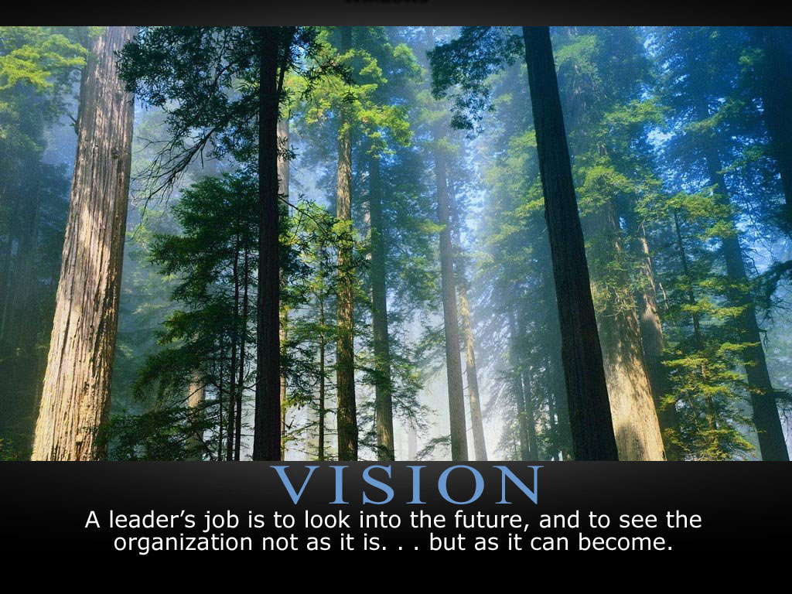
Long Term Goals
Improve knowledge deficit related to obesity involving 50% of residents of Oakland residents with obesity.
Increase awareness of risk factors of obesity within Oakland.
Increase options for physical activity in Oakland by 50%.
www.daydreamer.ws/images

Slide 36
Questions???

Slide 37
REFERENCES
Aubert, R. E., Kapuaolaokalaniakea, S., Mikami, S. (2010). Ke ano ola: Molokai's community-based healthy lifestyle modification program. American Journal of Public Health, 100(5), 779-783.
Community (defined). 2005. Webster’s Concise: English dictionary. (pp. 44). New Lanark, ML: Geddes & Grossest
CDC / National Center for Health Statistics 2010 NCHS health e-stat: Prevalence of obesity among children and adolescents United States, trends 1963-1965 through 2007-2008CDC / National Center for Health Statistics (2010). NCHS health e-stat: Prevalence of obesity among children and adolescents United States, trends 1963-1965 through 2007-2008. Retrieved March 17, 2011, from http://www.cdc.gov/nchs/data/hestat/obesity_child_07_08.htm#tabl0e1
Centers for Disease Control and Prevention 2010 Overweight and obesityCenters for Disease Control and Prevention (2010). Overweight and obesity. Retrieved March 17, 2011, from http://www.cdc.gov/obesity/defining.html

Slide 38
REFERENCES
Centers For Disease Control And Prevention 2010 U.S. obesity trends: Trends by state 1985-2009Centers For Disease Control And Prevention (2010). U.S. obesity trends: Trends by state 1985-2009. Retrieved March 17, 2011, from http://www.cdc.gov
MSN 20110315 MSN: Maps and directionsMSN (2011). MSN: Maps and directions. Retrieved March 15, 2011, from http://maps.msn.com.
Neuman Sytems Model 20101122Neuman Systems Model. (2010, November 22). In Wikipedia, the free encyclopedia. Retrieved March 17, 2011, http://en.wikipedia.org/wiki/Neuman_Sytems_Model
Oakland Illinois 20110316 City-dataOakland, Illinois (2011, March 16). City-data. Retrieved March 16, 2011, from http://www.city-data.com/city/Oakland-Illinois.html.
Stanhope, M., & Lancaster, J. (2007). Public health nursing: Population-centered health care in the community (7thed.). Philadelphia: Mosby/Elsevier.

