Slide 1
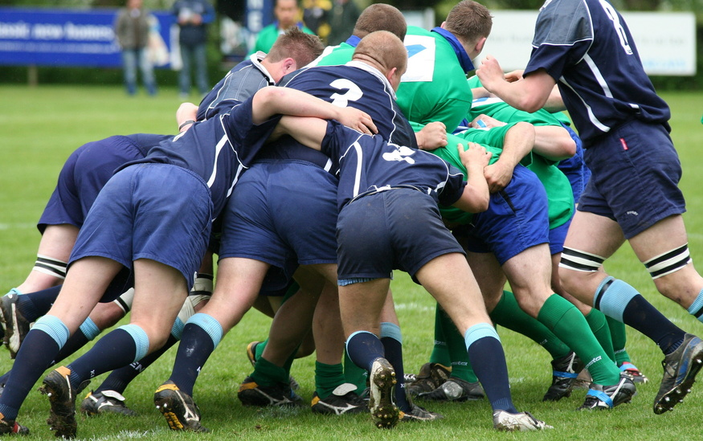
Chapter 19 Collective Action
.

Slide 2

Objectives
Evaluate key characteristics of selected collective action strategies.
Distinguish between the rights of individuals included in collective bargaining and at-will employees.
Compare the factors that contribute to decisions to be represented by collective bargaining vs. no representation.

Slide 3
Collective Action
Activities that are undertaken by a group of people who have common interests.
Notes:
[Read slide] That something may be patient care. Organizing a group of providers to ensure seamless transitions is one example of collective action. That something may focus on the workplace. Having a group sign a petition to support a manager is another example of collective action, as is committing to work together to cover a colleague’s illness. Collective action can also mean organizing for the purposes of collective bargaining. Although the purpose may differ, the desire and skill of working together are comparable across situations.

Slide 4
Collective Action (cont’d)
These strategies can coexist in any given setting. Differences about how to approach collective action exist geographically, philosophically, and certainly by type of facility.
Be informed and proactive about working together on issues of importance to nurses.

Slide 5

Collective Action
Minarik and Catramabone (1998) 4 reasons for Nursing to participate in Collective Action:
To promote professional Nursing
To establish and maintain standards of care
To ensure resources are allocated effectively and efficiently
To create satisfaction and support in the practice environment

Slide 6

Nursing Governance
The method or system by which a department of nursing controls and directs the formulation and administration of nursing policy.

Slide 7



The Focus
Shared governance
Workplace advocacy
Collective bargaining
Notes:
Although people work collectively for many reasons, we are going to focus on three common ones found in employment settings where nurses work. They are: [Read slide]

Slide 8

Shared Governance
A democratic, egalitarian concept
A dynamic process
A process of shared decision making and accountability
A

Slide 9
Shared Governance: Context
Culture
Subculture
Notes:
When the idea of shared governance is instituted in an organization, it requires that all change the way decisions are made. Although staff nurses may have to assume new roles in providing input for decisions, those nurses who previously made the decisions also have to change. They must now deliberately seek the input of staff. So, both manager and follower roles have changed.

Slide 10
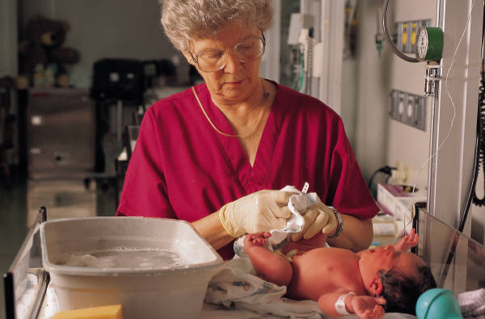
Shared Governance Can
Lead to better decisions.
Be more effective in day-to-day practices.
Generate additional ideas for implementation.
Notes:
When shared governance is first implemented, it not uncommon to find that a committee or two are charged with specific tasks. As the organization gains experience, these committee structures spread throughout the organization.
Getting to better decisions often is one of the outcomes. Because more diversity is included upfront, more ideas are tested before a decision is made.
Because “people like me” are involved in the decision, it is likely that more of us will implement the new policy or practice. After all, someone who works with a given issue on a daily basis may be able to say why other strategies wouldn’t work and why one or more strategies were more effective.
Again, because support for speaking up and offering ideas is evolving, more people risk participating and offering ideas. Those ideas may be about issues presented from management, but they eventually evolve into self-generated ideas.

Slide 11

Traits of a Good Follower
Trustworthy
Dependable
Excellent communicator and listener
Team player
Courage of convictions
Collaborator
Questioner

Slide 12

Workplace Advocacy
The objective is to equip nurses to practice in a rapidly changing environment. Advocacy occurs within a framework of mutuality, facilitation, protection, and coordination.
Notes:
Workplace advocacy describes what we do in advocating for ourselves and our peers. This advocacy process can be supportive when management and staff agree on key concepts; it can also be contentious when the basic concepts are not agreed to. For example, if both management and staff agree that a career ladder is needed, both work toward this end, and perhaps only minor disagreements may occur over specific dollar amounts or how the benefit is accessed. If, however, the groups don’t agree, then the focus of the conversation is on the core concept. Although some mutual understanding may be reached, discord may be noted within the setting because members of one “side” or the other think something was forced on them. When everyone is alert to workplace issues such as handling patients, workplaces that are free from abusive behaviors, safe transportation to and from parking facilities, and clear support for professionals speaking up for their patients, workplace advocacy can be a positive experience.

Slide 13
Workplace Advocacy (cont’d)
Manifestations of workplace advocacy:
Ensuring relevant information
Enabling the selection of information
Disclosing a personal view
Providing support for making and implementing decisions
Helping determine personal values
Notes:
A continuing issue is: [Read slide]

Slide 14

Collective Bargaining
“…the performance of mutual obligation of the employer and the representatives of the employees to meet at reasonable times and confer in good faith with respect to wages, hours, and other terms and conditions of employment or the negotiation of any agreement or any question arising thereunder...”
Labor Management Reporting Act, 1947, Section 8
Notes:
Collective bargaining is a formal process whereby employees select a bargaining agent to represent their interests. It begins with the election of a union or group to represent the employees in a class, such as registered nurses, or groups up to and including all no management employees within an organization.

Slide 15
Collective Bargaining (cont’d)
Nurses have a low rate of unionization.
Nurses are a prime target for membership growth.
Constant challenges exist to the way nurses are viewed for collective bargaining purposes.

Slide 16
Terms to Know
Nurses as knowledge workers-for them, collective bargaining seen more as associations rather than like industrial unions
Union or at will-protects Nurses from termination due to C/O about quality
Bargaining agent-for Nursing needs to be someone knowledgeable in healthcare
Whistleblower-Unionized people exempt from this

Slide 17
Whistleblower Protection
Whistleblowing “refers to a warning issued by a current or former employee of an organization to the public about a serious wrongdoing or danger created or concealed within the organization” (Hunt, 1995, p. 155). The 1989 Whistle Blower Protection Act protects federal workers. The law does not cover the private sector.

Slide 18
Suggested Criteria for Selecting a Bargaining Unit
A strong commitment to nursing practice, legislation, regulation, and education
A well-prepared practice, policy, and labor staff; a minimum of a bachelor’s degree in nursing

Slide 19
Suggested Criteria for Selecting a Bargaining Unit (cont’d)
Representative of those the bargaining unit represents in both gender and ethnic makeup
National scope and local implementation
Control by individual members over bargaining unit activities

Slide 20
Alternative Dispute Resolution
Negotiation-conferring others to bring a settlement of disagreements
Facilitation-someone externally promotes movement to desired outcome
Mediation-use 3rd party to assist with conflict resolution
Arbitration-the act of staff and management working on a mutual solution to disagreements
Notes:
Alternative dispute resolution has taken on new meanings in health care because it is a formalized process that occurs in situations where no collective bargaining agreement exists. Four common strategies are used within this construct.
Negotiation may be accomplished between two parties in dispute. Someone may help define clear ground rules and the expected outcome, but the way in which the individuals reach agreement is theirs to decide. In other situations when a dispute becomes evident, someone may say: “I expect that you will work this out. Let me know within x hours what your decision is.”
Facilitation involves the presence of a third party. This person may simply reflect what is being said and raise questions such as: “Does that fit with what you think? What could you live with in this situation? How does that strike you?” This person often starts the conversation and sets the ground rules for how the process will proceed.
Mediation is an informal process in which a neutral third party assists the opposing parties to reach a voluntary, negotiated resolution of a charge of discrimination. It gives the parties the opportunity to discuss the issues raised in the charge, clear up misunderstandings, determine the underlying interests or concerns, find areas of agreement, and ultimately, incorporate those areas of agreements into resolutions. A mediator does not resolve the charge or impose a decision on the parties. Instead, the mediator helps the parties to agree on a mutually acceptable resolution. It is a confidential process limited to the individuals involved.
Arbitration is a formal process whereby the person serving as the arbitrator makes the decision. The decision is binding on both parties. Because it is used as the last stage in the alternative dispute resolution process, it usually means that clear distinctions in positions have prevented any conclusion about how to move forward. As a result, more difficult emotions may be associated with this process.

Slide 21
Activity
Eden Valley is a community hospital, that is, it is an institution that operates solely within the community in which it is located. It is experiencing financial pressures. The options being considered include selling to a national company, joining a multihospital group in the surrounding area, and trying to preserve its identity. Employees, including nurses, are experiencing stress related to the uncertainty.

Slide 22
Classroom Activity
Breakup into 4 groups and discuss scenerio and following questions:
Employees in other job categories are unionized. Several nurses believe that it is a good time to consider organizing a staff union. They contact the constituent member association (CMA) to discuss their concerns.

Slide 23
Questions
1. What factors will influence the establishment of a union?
2. What stategies that nurses might consider before formalizing action to create a union.
4. What criteria are important in the selection of a union?
t factors will be a barrier to the establishment of a union?
3. Identify other factors.

Slide 24
Potential Answers
Cohesiveness of the nursing staff; leadership of nurses interested in unionizing and their ability to rally support; ability of management/administration to listen and collaborate with nursing about issues, union chosen to represent nurses; model of governance currently in place
2. Inability to motivate nurses to work together to form a majority for unionization; poor leadership; poor representation of the issues; employer tactics to dissuade nurses to unionize

Slide 25
Potential Answers
Open, collaborative meetings with administration; governance model that supports nursing involvement in issues that are important to nursing
Union should have a strong commitment to nursing, have a strong labor staff with nursing representation, and have national scope.

