Slide 1
Chapter 47 Nursing Care of the Child With an Immunologic Disorder

Slide 2
1. Contrast anatomic and physiologic differences of the immune system in infants and children versus adults.

Slide 3
Variations in Pediatric Anatomy and Physiology
Lymph System
Phagocytosis
Cellular Immunity
Humoral Immunity

Slide 4
Common Medical Treatments
A variety of medications as well as other medical treatments are used to treat immune deficiencies and autoimmune problems in children.
Most of these treatments will require a physician’s order when the child is in the hospital.

Slide 5
2. Determine nursing care related to common laboratory and diagnostic testing used in the medical diagnosis of pediatric immune and autoimmune disorders.

Slide 6
3. Detect immune and autoimmune disorders common in infants, children, and adolescents

Slide 7
4. Utilize appropriate nursing assessments and interventions related to medications and treatments for pediatric immune, autoimmune, and allergic disorders

Slide 8
Nursing Process Overview for the Child with an Immunologic Disorder
Assessment
Physical Examination
Inspection and observation
Auscultation, percussion, and palpation
Laboratory and Diagnostic Testing
Nursing Diagnoses and Related Interventions

Slide 9
Primary Immunodeficiencies
Hypogammaglobulinemia
Nursing Assessment
Nursing Management
Administering Intravenous Immunoglobulin (IVIG)
Providing Education and Support

Slide 10
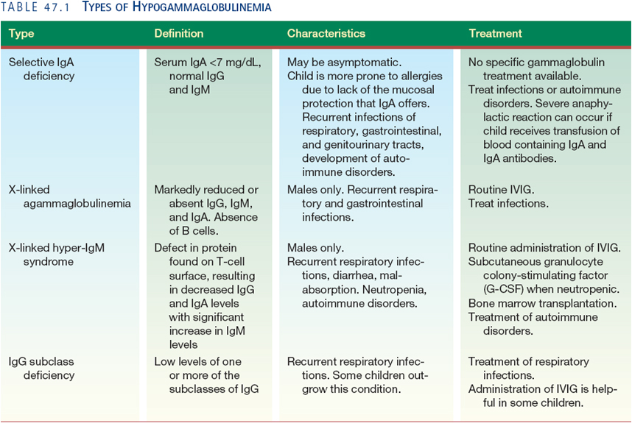

Slide 11
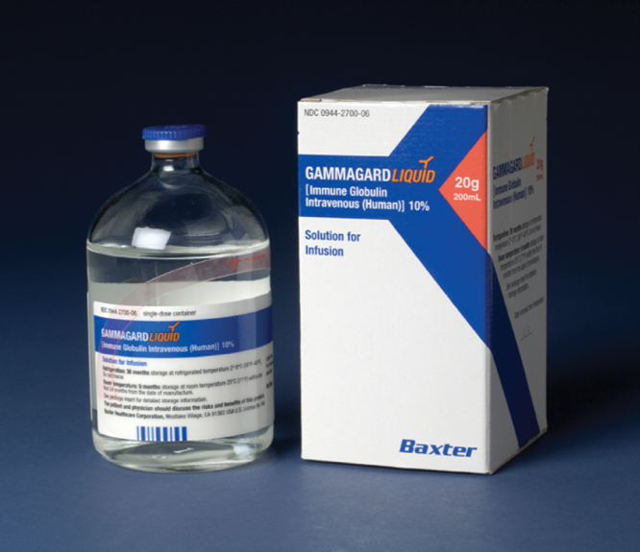

Slide 12
Primary Immunodeficiencies (Cont’d)
Wiskott-Aldrich Syndrome
Nursing Assessment
Nursing Management
Severe Combined Immune Deficiency
Nursing Assessment
Nursing Management

Slide 13
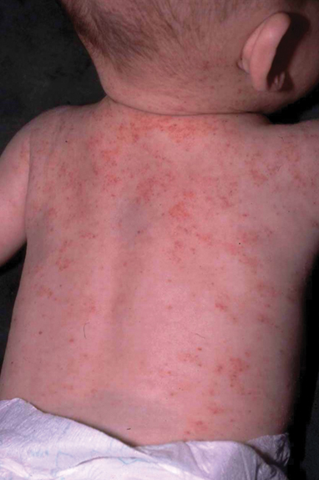

Slide 14
Secondary Immunodeficiencies
HIV Infection
Pathophysiology
Therapeutic Management
Nursing Assessment
Health History
Physical Examination
Inspection and Observation
Auscultation and Palpation
Laboratory and Diagnostic Tests

Slide 15
Secondary Immunodeficiencies (Cont’d)
HIV Infection
Nursing Management
Preventing HIV Infection in Children
Promoting Compliance with Antiretroviral Therapy
Reducing Risk for Infection
Promoting Nutrition
Promoting Comfort
Providing Family Education and Support

Slide 16
Autoimmune Disorders
Systemic Lupus Erythematosus
Pathophysiology
Therapeutic Management
Nursing Assessment
Health History
Physical Examination
Laboratory and Diagnostic Findings

Slide 17
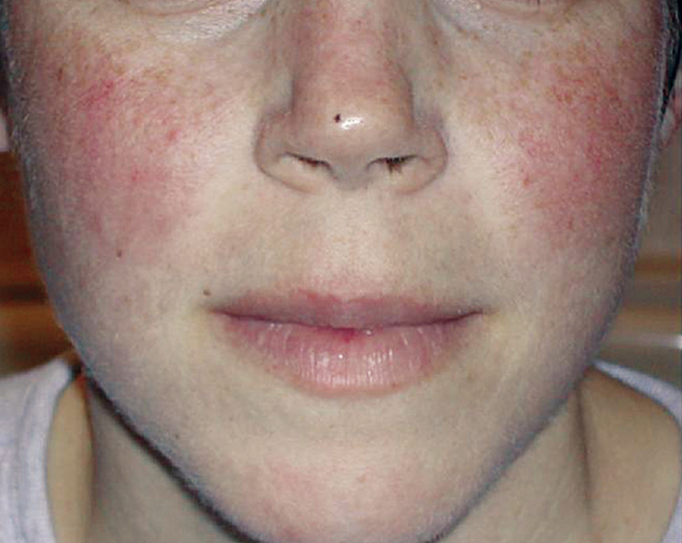

Slide 18
Autoimmune Disorders (Cont’d)
Systemic Lupus Erythematosus (cont’d)
Nursing Management
Preventing and Monitoring for Complications

Slide 19
Autoimmune Disorders (Cont’d)
Juvenile Idiopathic Arthritis
Nursing Assessment
Nursing Management
Managing Pain and Maintaining Mobility
Promoting Normal Life

Slide 20
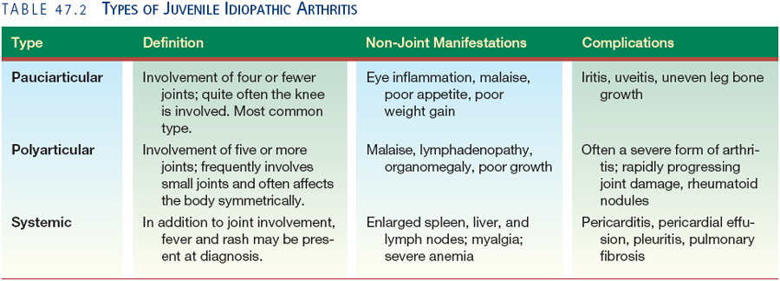

Slide 21
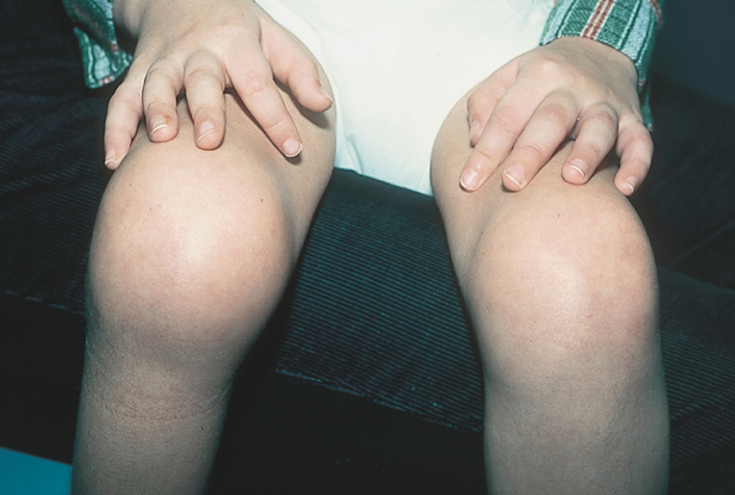

Slide 22
Allergy and Anaphylaxis
Food Allergies
Therapeutic Management
Nursing Assessment
Nursing Management
Managing the Child’s Diet

Slide 23
Allergy and Anaphylaxis (Cont’d)
Anaphylaxis
Nursing Assessment
Nursing Management
Preventing and Managing Future Episodes
Latex Allergy
Nursing Assessment
Nursing Management

Slide 24
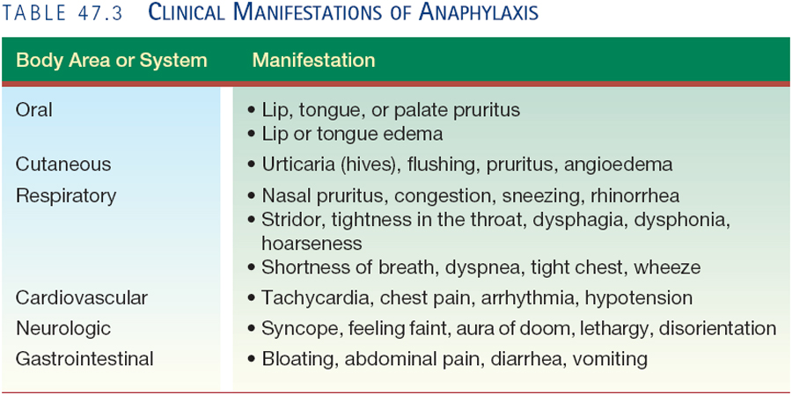

Slide 25
5. Develop an individualized nursing care plan for the child with an immune or autoimmune disorder.

Slide 26
6. Detect the psychosocial impact of chronic immune disorders on children.

Slide 27
8. Develop patient/family teaching plans for the child with an immune or autoimmune disorder.

Slide 28
7. Devise a nutrition plan for the child with immunodeficiency.

