Slide 1
Chapter 38
Nursing Care of the Child With a Disorder of the Eyes or Ears

Slide 2
Variations in Pediatric Anatomy and Physiology
1. Contrast the anatomy and physiology of the eyes and ears in children vs. adults.
Eyes
  Sclera
  Eyeball
  Lens shape
  Visual acuity
Ears
  Congenital deformities
  Placement of Eustachian tubes

Slide 3
2. Relate various factors associated with disorders of the eyes and ears in infants and children.

Slide 4
3. Determine common laboratory and other diagnostic tests used in the diagnosis of disorders of the eyes and ears.

Slide 5
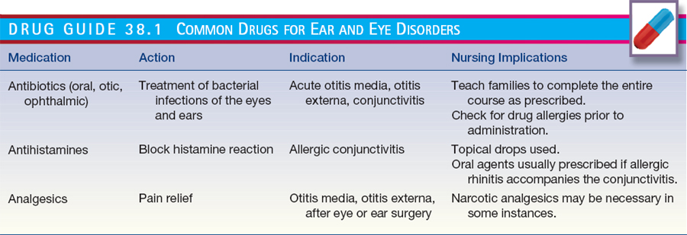

Slide 6
4. Determine common medications and other treatments used for treatment and palliation of conditions affecting the eyes and ears.

Slide 7
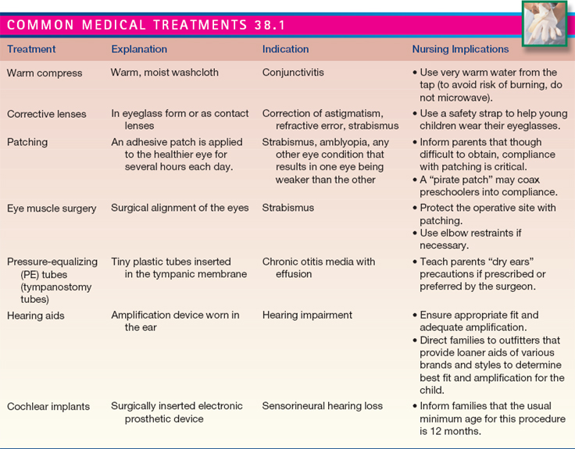

Slide 8
5. Relate risk factors associated with various disorders of the eyes and ears.

Slide 9
Nursing Process Overview
Assessment
  Health History
  Physical Examination
    Inspection and Observation
    Palpation
    Laboratory and Diagnostic Testing
Nursing Diagnoses and Related Interventions (see Nursing Care Plan 38-1)

Slide 10
6. Distinguish different disorders of the eyes and ears based on their signs and symptoms.
7. Utilize nursing interventions commonly used for disorders of the eyes and ears.
8. Devise an individualized nursing care plan for the child with a sensory impairment or other disorder of the eyes or ears.
9. Develop child/family teaching plans for the child with a disorder of the eyes or ears.
10. Detect the psychosocial impact of sensory impairments on children.

Slide 11
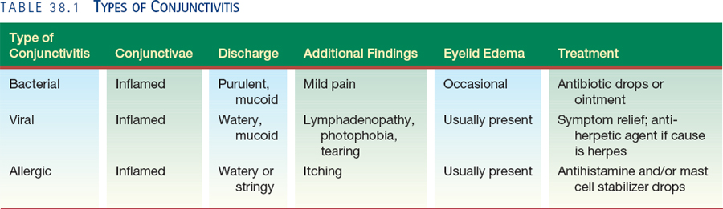
Conjunctivitis

Slide 12
Question
Is the following statement True or False?
A child with bacterial conjunctivitis typically exhibits a watery mucoid discharge.

Slide 13
Answer
False.
A child with bacterial conjunctivitis typically has a purulent mucoid discharge.

Slide 14
Conjunctivitis
Nursing Assessment: common signs and symptoms
Nursing Management
  Symptom alleviation
    Eye drops or ointment
    Compresses
    Reduction of allergens
  Prevention of spread of infection

Slide 15
Nasolacrimal Duct Obstruction
Nursing Assessment
  Tearing or discharge from one or both eyes
  Redness of lower lid of affected eye
  Possible culture of drainage
Nursing Management
  Typically spontaneous resolution by age 12 months
  Parent education
  Nasal lacrimal duct massage (see Teaching Guidelines 38-1)

Slide 16
Eyelid Disorders
Hordeolum (stye)
Chalazion
Blepharitis
Therapeutic Management
Nursing Assessment
Nursing Management

Slide 17
Periorbital Cellulitis
Bacterial infection of eyelids and tissues surrounding the eye
Therapeutic management: IV antibiotics followed by oral antibiotics
Nursing assessment: pain around eye, restricted eye movement, reddish-purple eyelid and edema (see Figure 38-7)
Nursing management: warm soaks, IV antibiotic administration, family education

Slide 18
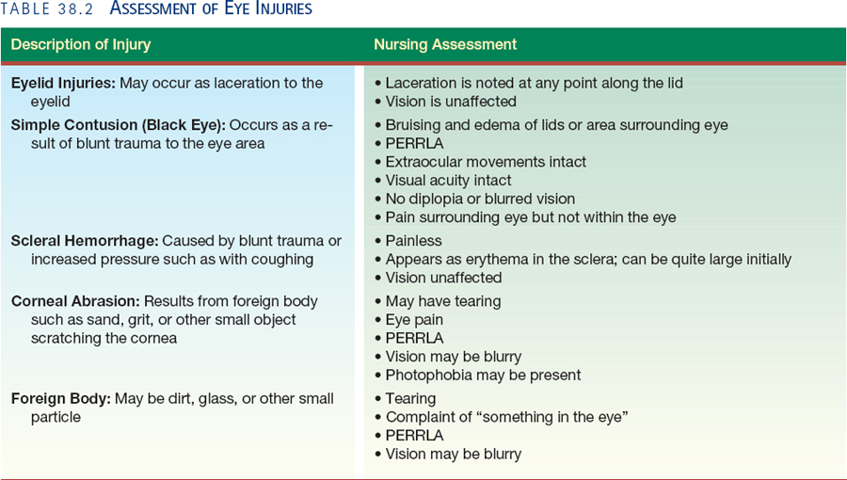
Eye Injuries

Slide 19
Question
Which of the following would the nurse be most likely to find in a child with blepharitis?
Reddened conjunctiva
Tearing from both eyes
Eyelid edema
Stringy discharge

Slide 20
Answer
C.
With blepharitis, eyelid edema is most likely present, with the conjunctiva remaining clear. Tearing from both eyes would suggest nasolacrimal duct obstruction. A stringy discharge would suggest allergic conjunctivitis.

Slide 21
Refractive Errors
Hyperopia (farsightedness) and myopia (nearsightedness)
Nursing Assessment
  History of visual complaints
  Visual acuity testing
Nursing Management
    Educating about eyeglasses use
    Educating about contact lens use
    Monitoring for fit and visual correction

Slide 22
Astigmatism
Uneven corneal curvature
Nursing Assessment
  Visual complaints
  Visual acuity testing and refractive error evaluation
Nursing Management
  Use of corrective lenses
  Client and family education

Slide 23
Strabismus
Misalignment of eyes
Most common types: exotropia and esotropia
Nursing Assessment
Nursing Management
  Education about patching
  Education about eyeglasses

Slide 24
Amblyopia
One eye stronger than the other; “lazy eye”
Nursing Assessment
  Preschool screening
  Visual acuity testing
  Asymmetrical corneal light reflex
Nursing Management
  Patching
  Eyedrops
  Eye safety

Slide 25
Infantile Glaucoma
Autosomal recessive disorder
Therapeutic Management: surgical correction
Nursing Assessment
  Family history
  Appearance of eye
Nursing Management
  Providing postoperative care
  Educating family

Slide 26
Question
Is the following statement True or False?
Amblyopia involves a misalignment of the eyes.

Slide 27
Answer
False.
Amblyopia refers to poor visual development in the otherwise structurally normal eye. The vision in one eye is reduced because the eye and brain are not working together properly.

Slide 28
Congenital Cataract
Nursing Assessment
  Lack of visual awareness
  No red reflex in affected eye
Nursing Management
  Providing post-operative care
  Family education
  Follow-up assessments

Slide 29
Retinopathy of Prematurity
Risk factors: changes in oxygen tension and duration/concentration of supplemental oxygen
Nursing Assessment: routine screening of all premature infants
Nursing Management

Slide 30
Visual Impairment
Nursing Assessment
  Health History
  Physical Examination
Nursing Management
  Supporting the Child and Family (see Box 38-1)
  Promoting Socialization, Development, and Education

Slide 31
Acute Otitis Media (AOM)
Bacterial or viral infection in middle ear
Pathophysiology
Therapeutic Management (see Table 38-3)
Nursing Assessment: Health History (see Box 38-3); Physical Examination (see Figure 38-10) and Diagnostic Testing
Nursing Management
  Pain management
  Family education
  Prevention

Slide 32
Question
Is the following statement True or False?
On otoscopic examination, the tympanic membranes of a child with AOM will appear dull and bulging.

Slide 33
Answer
True.
On otoscopic examination, the tympanic membrane will have a dull or opaque appearance and is bulging and/or red.

Slide 34
Otitis Media with Effusion (OME)
Nursing Assessment
  Health History
  Physical Examination (see Figure 38-11)
Nursing Management
  Educating the Family
  Monitoring for Hearing Loss
  Providing Postoperative Care for the Child with Pressure-Equalizing Tubes

Slide 35
Otitis Externa
Nursing Assessment
  Health History
  Physical Examination
Nursing Management
  Managing pain
  Treating the infection
  Preventing reinfection (see Teaching Guidelines 38-2)

Slide 36
Hearing Loss and Deafness
Extent of hearing loss based on softest intensity of sound perceived, in decibels
Congenital usually due to recessive gene inheritance
Delayed onset: conductive, sensorineural, or mixed
Nursing Assessment
  Health History: common signs and symptoms
  Physical Examination and Laboratory and
  Diagnostic Tests

Slide 37
Hearing Loss and Deafness (cont’d)
Nursing Management
  Augmenting Hearing
  Promoting Communication and Education (see Table 38-4)
  Encouraging Education
  Providing Support

