Slide 1
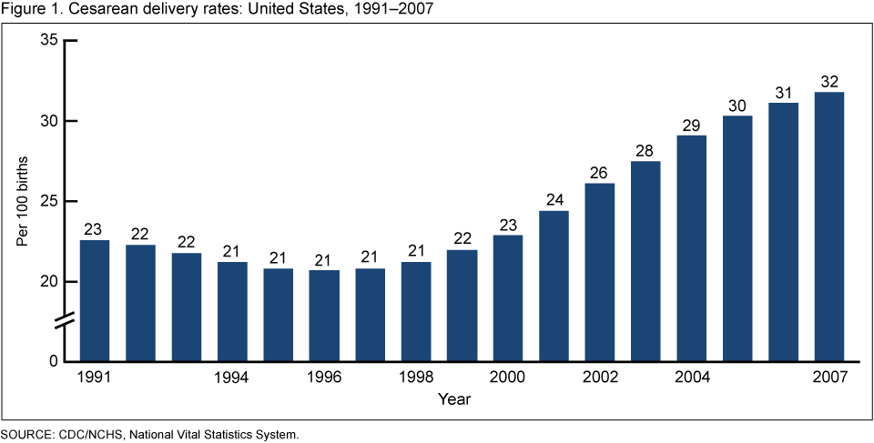
Cesarean Birth
There were 1.4 million cesarean births in 2007, representing approximately one-third of all births in the United States.
Following a decline in the early 1990s, the cesarean rate increased by 53% from 1996 to 2007, from 21% to an all-time high of 32% (Figure 1).
The number of cesarean births increased by 71% from 1996 (797,119) to 2007 (1,367,049).
Cesarean rates rose for women in all age groups from 1996 to 2007 . Rates for all age groups increased modestly from 1996 to 2000, then rose more than 33% from 2000 to 2007. Women under age 25 experienced the greatest increases in cesarean deliveries from 2000 to 2007 (57%).
Rates of cesarean delivery typically rise with increasing maternal age. As in 1996 and 2000, the rate for mothers aged 40–54 years in 2007 was more than twice the rate for mothers under age 20 (48% and 23%, respectively).

Slide 2
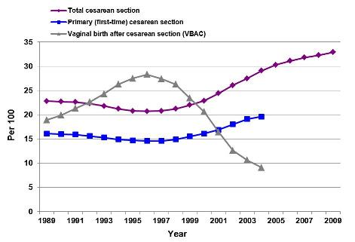
Cesarean Birth
In December 2010, the National Center for Health Statistics released the preliminary U.S. national cesarean rate for 2009: 32.9%. This rate has increased by 50% over the past decade, reaching a record level every year in this century . The most common operating room procedure in U.S. hospitals, C-section involves considerable morbidity in women and babies and considerable expense for private payers/employers and Medicaid/taxpayers.

Slide 3
Financial Implications
On average, hospitals charge many thousands of dollars more for a C-section than for vaginal birth. And among the hundreds of procedures performed in U.S. hospitals, C-section is the most common one.
In 2003, U.S. hospitals charged an average of $15,519 for a C-section with complications:
$11,524 for a C-section with no complications
$8,177 for a vaginal birth with complications
$6,239 for a vaginal birth with no complications.
The most common reason for hospitalization in the U.S. is a woman having a baby, and there are over 4 million births every year. Avoidable cesarean surgery adds billions of dollars to the burden of health care costs for governments, employers and individuals in the U.S. Access to health care coverage is jeopardized, and health care costs threaten the economic stability of governments, businesses and families. We cannot afford to tolerate costly, avoidable surgical procedures.
A cesarean costs nearly twice as much as a vaginal birth ($7,186 average vs. $4,334 average in 1989 in the US). It has been estimated that in Quebec, Canada, if the current rate of cesareans (18.8%) were reduced to that of Finland (11.9%), costs incurred by the provincial health care system could be reduced approximately $19 million per year.
*Childbirthconnection.org

Slide 4
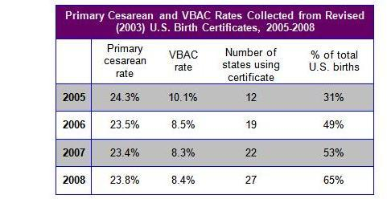
C-Section’s at a Glance
An unplanned (emergency) C-section may be needed if you or your baby’s health is at risk during pregnancy or labor. Some women might like the idea of requesting a C-section even if there aren’t medical reasons.
Among women who ended up with an unplanned C-section, failure for labor to progress was cited in nearly half the cases.
Fetal distress or non-reassuring fetal testing was listed as a reason for more than a quarter of unplanned C-sections.
Nearly half of all planned C-sections were scheduled because the woman had had a previous C-section.
*American Journal of Obstetrics & Gynecology.

Slide 5
Summary
In 2007, approximately 1.4 million women had a cesarean birth, representing 32% of all births, the highest rate ever recorded in the United States and higher than rates in most other industrialized countries.
From 1996 to 2007, cesarean rates increased for all women, regardless of age, race and Hispanic origin, or state of residence. In 2006, cesarean delivery was the most frequently performed surgical procedure in U.S. hospitals . Cesarean rates also increased for infants of all gestational ages and may be partly related to the increased rate of multiple births .
In addition to clinical reasons, nonmedical factors suggested for the widespread and continuing rise of the cesarean rate may include maternal demographic characteristics (e.g., older maternal age), physician practice patterns, maternal choice, more conservative practice guidelines, and legal pressures.
*CDC.gov

